Slide 1

What are Executives Thinking About Agile Development?
Todd Little
Sr. Development Manager

Slide 2
Challenges to Agile Adoption
Rank | Item
1 | Corporate culture
2 | Enterprise/organization challenges beyond the development team
3 | Poor technical practices
4 | Executive buy-in that Agile is effective
5 | Mid-Level buy-in Agile is effective
5 | Customer/Business buy-in that Agile is effective
7 | Team buy-in that Agile is effective
8 | Legacy code
9 | Distributed teams
10 | Lack of tools to help manage the development
11 | Contracts
12 | Dealing with a regulated environment

Slide 3

The Context of Feedback

Slide 4
Most Important Drivers
Rank | Item
1 | Top-down leadership driven
2 | Evangelist driven
3 | Grass roots from key individuals
4 | Team self initiated

Slide 5









Sue McKinney VP Engineering Pitney Bowes | Stefan Andersson VP Product Creation SAAB Group | Chandra Yeleshwarapu Director Halliburton
Hendrik Esser Head of Portfolio Mgt Ericsson | Pete Morowski Sr. VP Sabre Airline Solutions | Ravi Waran CIO Air Liquide
Allen Rutzen Sr. Manager Nokia | Jing Yang Technical Director ZTE | Mike Harkins VP Applications Transamerica

Slide 6
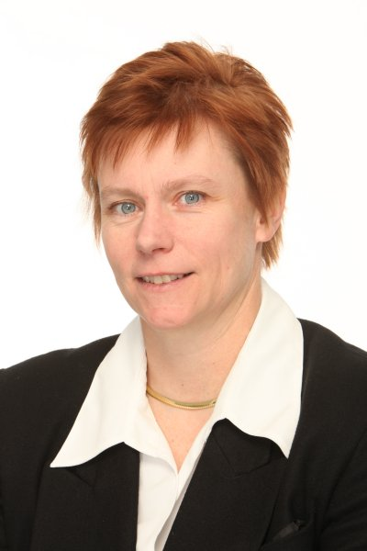

Vice President, WW Product Development
Pitney Bowes, Inc
Sue MCKINNEY
Notes:
Regardless of what company you work for, agile works.

Slide 7
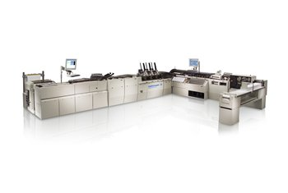
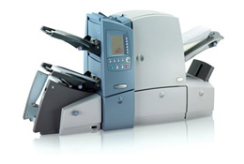
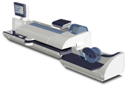
world class
mailing solutions

Slide 8
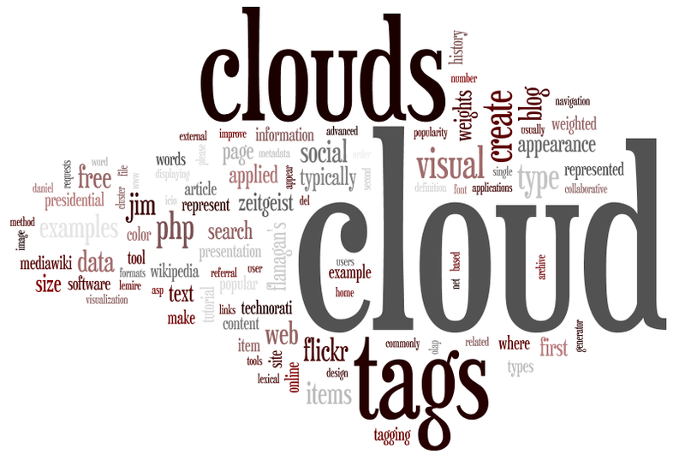
evolve portfolio to SW based solutions
Notes:
Our transformation started with creating value-added services for our clients. Creating smarter mailing devices and providing services over the web.
AMEN – this makes sense! But how do we get started???????

Slide 9

what do
executives
fear?

Slide 10

Surprises!
Notes:
Managing risks is really all about avoiding surprises. If we have put some thought into what could happen on a project, the chances of us being surprised is greatly reduced.

Slide 11

market
uncertainty
technical uncertainty
project
duration

Slide 12
How do they react?
Notes:
12
Risk is the possibility that something could happen which would have an impact, positive or negative on your project, your team, and your organization.

Slide 13

set
project
dates
Notes:
13
Creates a false sense of certainty
Creates a sense of urgency for engineering

Slide 14


Slide 15

transparency
risk
management

Slide 16

agile
to deal with
uncertainty
Notes:
market
uncertainty
technical uncertainty
project duration

Slide 17
Deep Dive on Roles
Notes:
17
Risk is the possibility that something could happen which would have an impact, positive or negative on your project, your team, and your organization.

Slide 18

Executives

Slide 19

give them “waterfall” status
Notes:
Give status at the right level. Senior executives are more interested on achieving business goals – revenue, time to market, etc

Slide 20

create
synergistic
alignment
Notes:
Too often the development community drinks the Agile koolaid – how to make everyone else buy-in or sync up with development

Slide 21

CEO and Senior Management Council
Product Management
IT
Employees
Educate and Enable ...
Notes:
Give examples how training and coaching gave organizations the willingness to try agile.

Slide 22
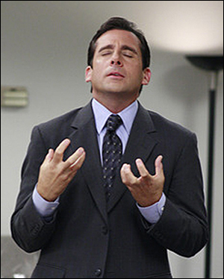
and
now the
middle
manager
Notes:
What are their fears?
Losing control and not making all decisions. Always was Big man on campus! Asking for status………

Slide 23

give up
command
and
control

Slide 24

teams figure out how
Notes:
24
Ok, here’s the data, the features we want you to build and oh, by the way, here’s how we want you do to it?!?
How often as a leader do you ask your teams to size something and when they say it will take them 4 weeks, you say – “can you do it in 3 weeks?” And what’s the normal response and outcome???????

Slide 25

give and re-enforce
ownership
Notes:
25

Slide 26

and
now the
project
manger

Slide 27

task
driven
mindset

Slide 28
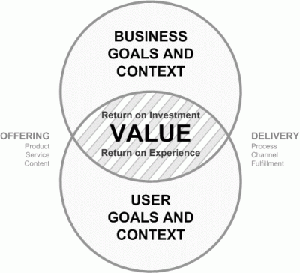
shift to
value driven
mindset
Notes:
A real good project manager can transition to PO or Scrum Master role

Slide 29
create decision filters that help teams understand business value priorities
High
Partner?
Innovate
Market
Differentiating
Who cares?
Parity
Low
Low
High
Mission Critical
Notes:
Help define and prioritize the backlog

Slide 30

and
now the
software
developer

Slide 31


shift from individual pack to team pack

Slide 32

Definitions
craftsmanship and competency

Slide 33
But wait ……
Notes:
33
Risk is the possibility that something could happen which would have an impact, positive or negative on your project, your team, and your organization.

Slide 34

now the antibodies arrive

Slide 35

hero syndrome
Notes:
Supress information – and dive in later to save the team

Slide 36

passive
aggressive
behavior

Slide 37

unleash the
talent
within
the
organization
Notes:
37

Slide 38

give
people
what they need to succeed
Notes:
38

Slide 39


SAAB AERONAUTICS
Stefan Andersson
Head of Product Creation
Saab Group Operational Excellence
Lean and Agile Ways of Working

Slide 40

COMMITTED PEOPLE
RESPECT FOR COMPETENCE
EVOLUTIONARY DEVELOPMENT
FOCUS ON USABILITY

Slide 41
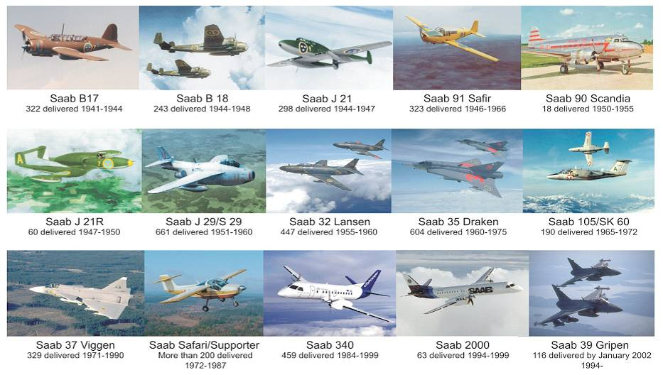
SAAB AERONAUTICS’ HISTORY
Notes:
41

Slide 42




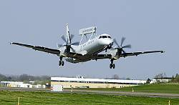

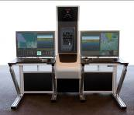

SAAB AERONAUTICS TODAY
COMMERCIAL AND MILITARY
AIRCRAFT SYSTEMS

Slide 43
OUR JOURNEY – MY VIEW
Small teams who handled design, implementation and test
Committed People
Usable documents
Close collaboration with the users
A lot of trial and error
Way of working insufficient w.r.t
Usability and performance
Lead time
Cost
That led us (back) to Lean/Agile
Org. hierarchies and stove pipes
High staff turnover
Documentation because of standards
Feedback from users = Req. creep
Focus on planning and control
1970
1980
1990
2000
2010
2020

Slide 44


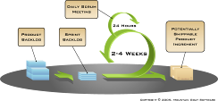
SOURCES OF INSPIRATION
SE
Saab Integrated
Product Creation System
Systematic handling of architecture and non-functional requirements
LEAN
Focus on value stream, continuous improvement and banish waste
AGILE
Focus on handling changing or unclear requirements and needs

Slide 45
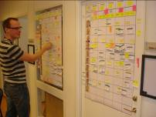

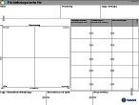


USE OF LEAN AND AGILE TOOLS
VISUAL PLANNING (100 team)
SCRUM ORGANIZATIONAL PATTERN (35 teams)
VISUAL PROJECT MANAGEMENT SYSTEM (All projects)
KAIZEN SYSTEM (70 teams)
5S in Work Shops, Labs and Offices

Slide 46
LESSONS LEARNED
Success factors for Effective R&D
Visual planning and control – Team level. Short and Long Term
Leaders are coaches that support and inspire the teams
”Pull” culture instead of sitting and waiting
Teams that understand their customer and the big picture (end-user)
Success factors for Effective Organizational Change
Trust – Embrace the fact that people want to be Lean and Agile
Encourage local initiatives – Don’t start with standardization
Leader commitment and competence – Don’t rely on consultants
Let the change process be Agile – Don’t get stuck in business cases

Slide 47

GRIPEN NG
Next generation Gripen for the Swedish Airforce and for the Export Market
  Increased Range and Performance
  Improved Situational Awareness
  Improved Survivability (EW)
  Improved robustness
  Lead Time Reduction
  Decreased Development and Production Cost
  Decreased Operate and Support Cost
  Growth potential beyond 2025

Slide 48

HOW WE INTRODUCED SCRUM
The introduction of Scrum and “Agile” methods were to a large extent initiated by the teams
Every project member had a Scrum basics training
We hired an experienced consultant for advice and follow-ups on our handling of Scrum ceremonies and roles
Adaptations where made in order to handle:
  Long term perspective (> 4 years)
  Firm deliveries
  Coordination of parallel teams contributing to one delivery
Notes:
Initially short sprints in order to practice the methodology.

Slide 49

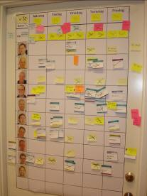

POSITIVE EXPERIENCE
Improved quality
  Customer and user involvement
  Incremental Development
More efficient development
  Improved communication
  Better “situation awareness”
  30 % increase of efficiency (self-assessment)
  Increased well-being and commitment in the teams
Continuous improvement
  Continuous lessons learned and improvement of way of working

Slide 50
CHALLENGES
The method
  Handling hierarchy of teams (Scrum of scrums)
  Definition of done vs. value added
  Potentially shippable deliverables after each sprint
The Product Owner role
  Understanding the impact of features and the
  appropriate development planning
  Indistinct customer: two pilots – three opinions
  Miscommunication with the teams => wrong
  prioritization by the teams
  Distant deliveries potentially neglected
Support from the surrounding organization
  Project management with lack of understanding of the fundamental principles of Scrum
  Fixed delivery dates, but increasing scope
Notes:
Upper (project) management ignorant regarding the methodology
Everything get obvious – Thank Scrum, don’t blame Scrum
Traditional planning and progress reports
Fixed delivery dates, increasing scope
- You’re agile, squeeze it in!

Slide 51

Building Complex Software
Vision, Trust, Interfaces and Assumptions
Chandra Yeleshwarapu
Director of Information Management and Platform Technology

Slide 52


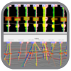



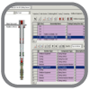

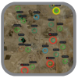

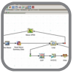
Landmark E&P Ecosystem
Collaborative Applications – Data Management – Modern Platform – Expert Services
DecisionSpace Platform
Geosciences
Reservoir
Drilling and Completions
Production
Services and Support
BASIN
GEOPHYSICS
GEOLOGY
EARTH
MODELING
FIELD
PLANNING
SIMULATION
DESIGN
REPORTING
SURVEILLANCE
REAL-TIME
OPTIMIZATION
Data Management

Slide 53
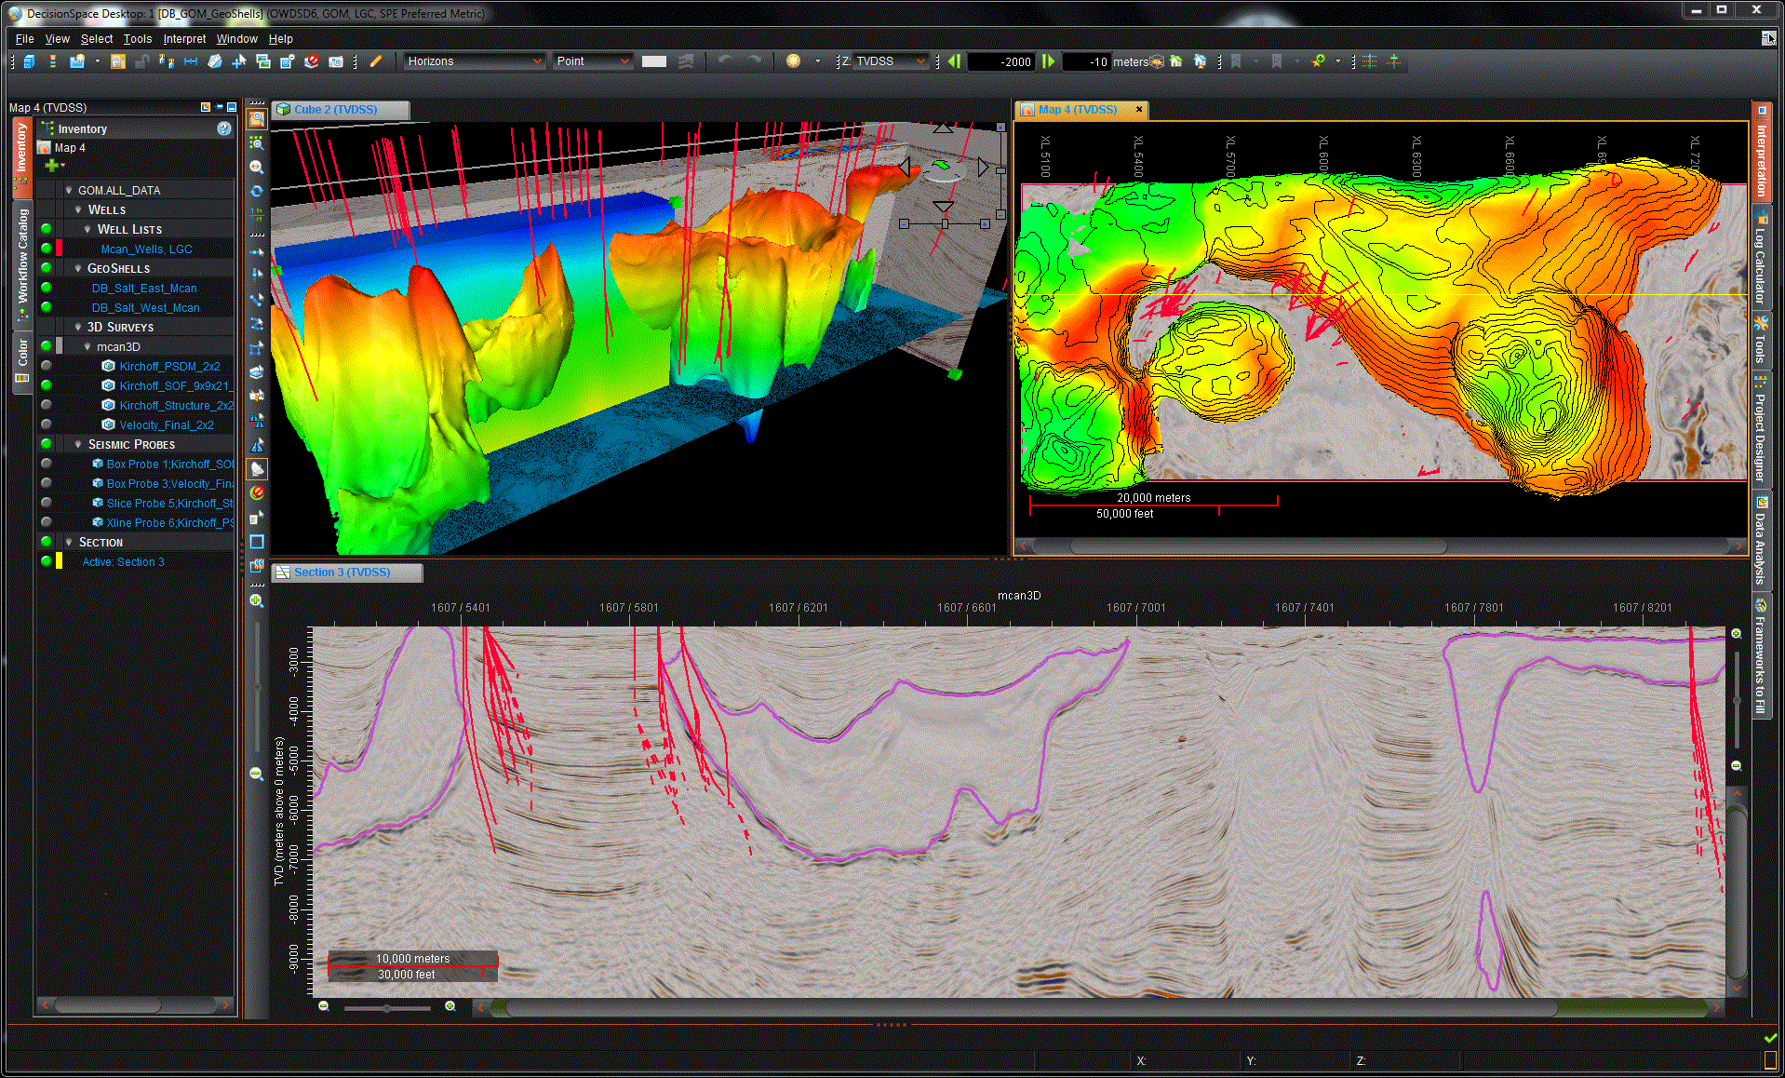
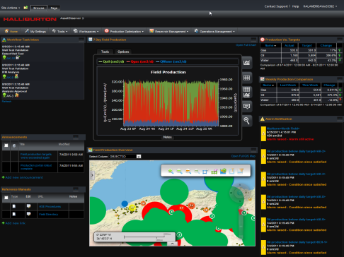
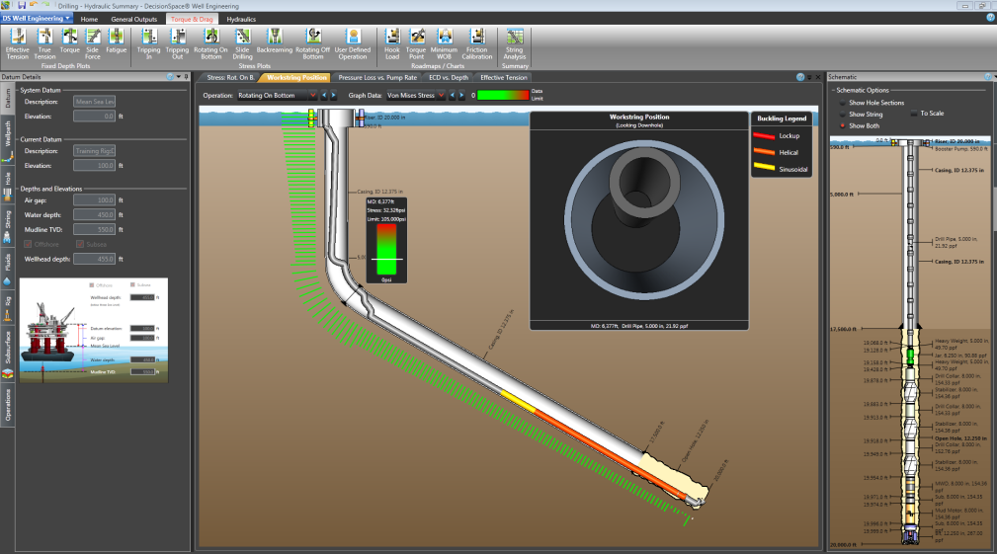
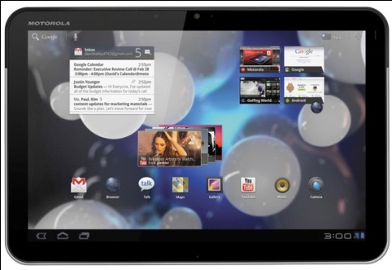
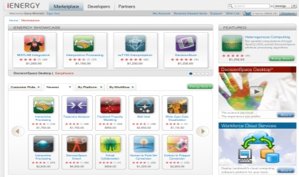
E&P Upstream Applications
GeoSciences – Basin, Geology, Earth Modeling, Engineering. Reservoir, Production, Data Management

Slide 54

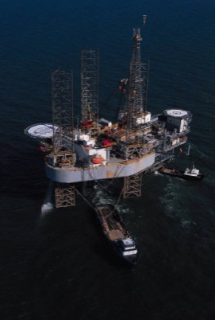



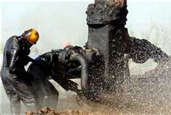
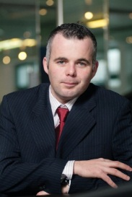
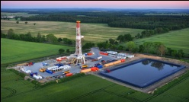




Deployment Challenges and Models
Collaboration Centers
Mobile
Access
Business/Technical
Field/Professional
Disconnected
Computing
Remote Rendering
Individual Workstation

Slide 55
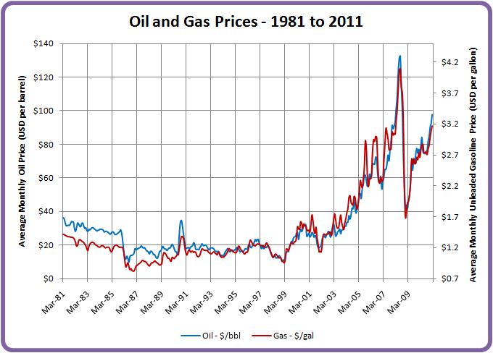
Contributing factor for the Software complexity
Market Forces
Market Changes Rapidly
Adoption Cycle is long – 3-10 years
Workflows are complex and changing

Slide 56
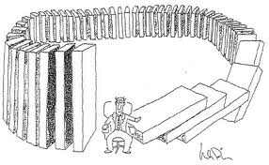
False perception of Quick Wins
Point Solutions
Do it yourself rather than use horizontal technologies
Not Leveraging internal teams and external ecosystem
Making technology and architectural compromises
Grab talent with an outsource partner

Slide 57
Agile Approach to Delivering Complex Software
It’s not just about Agile Development
Market
Customer
Sales
R&D Process
Release
Adoption
Maintenance
Supply Chain
Marketing
Training, Education
Finance
Sustaining
10%

Slide 58
Agile Approach to Delivering Complex Software
It’s not just about Agile Development
Market
Customer
Sales
R&D Process
Release
Adoption
Maintenance
Supply Chain
Marketing
Training, Education
Finance
Sustaining
Emphasis and iterate on incremental Value (End User Workflow)
Validate Vision, Strategy, and Execution

Slide 59
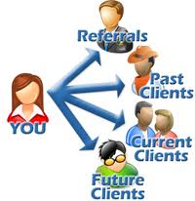
Customer Intimacy
Customer Advisory Boards –
User groups and Product groups –
1-1 Customer meetings –
Partner Drops -
Beta Programs –
Try and Buy Programs -

Slide 60

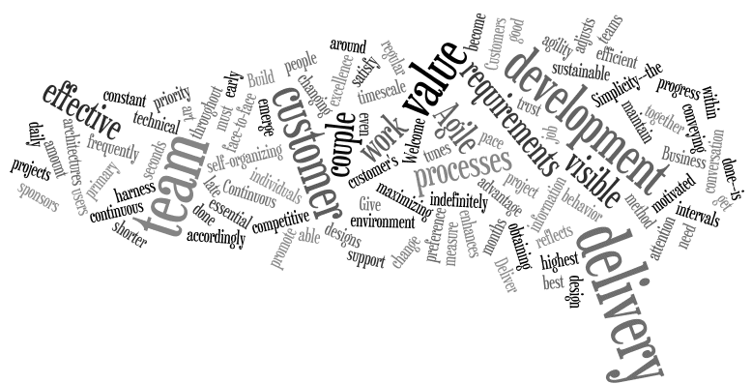
Organization Intimacy
Inclusion in the Software development cycle
Sales and Tech Support –
Services –
Training and Education –
Marketing -
Usability –

Slide 61

Partnerships
External
Use Open Source
Use Horizontal Technologies
Use Agile R&D partners

Slide 62


Architectural Alignment is the Key
The DecisionSpace® Platform and Ecosystem
Platform
services
Device
Deployment
Mobile
Browser
Desktop
Disconnected
Thin client
Smart client
Hosted/Cloud
Thick client
Security & Identity
Presentation
services
Portal
GIS/maps
Visualisation
Charts
Preferences
1D/2D/3D
Graphical edit
Schematics
Sessions
Entitlements
Business
services
Search
Reporting
Collaboration
P2P comms
Alarms
BI/Analytics
Content management
BPM
Knowledge
Monitoring
Computation
Application Domain
Developer enablement
Geosciences
Drilling
Production
IM
Integration
services
ETL
Cartographic
Real-time
Industry standards
Shared memory
Service repository
Sync
Units
Federation
Messaging
Data
services
Data Services Layer
Cloud enablement
Native SDKs
HPC
DecisionSpace IM Foundation
Search
Project
Operational
Real-time
Corporate
Warehouse
3rd party
Spatial
Unstructured

Slide 63


Innovation
Emphasize and accelerate
Grass roots Innovation
Patents, publications
Intellectual Property Days
Innovation Days
Intern Programs with stretch goals
Incremental versus Extreme

Slide 64

Key Takeaways
Alignment of Strategy and Vision
Build trusted relationships External and internal partners
Architectural and Functional Interfaces
Innovate – break the assumptions
Measure and Monitor alignment
Develop less
integrate more
Monitor and Measure
Encourage and Measure

Slide 65
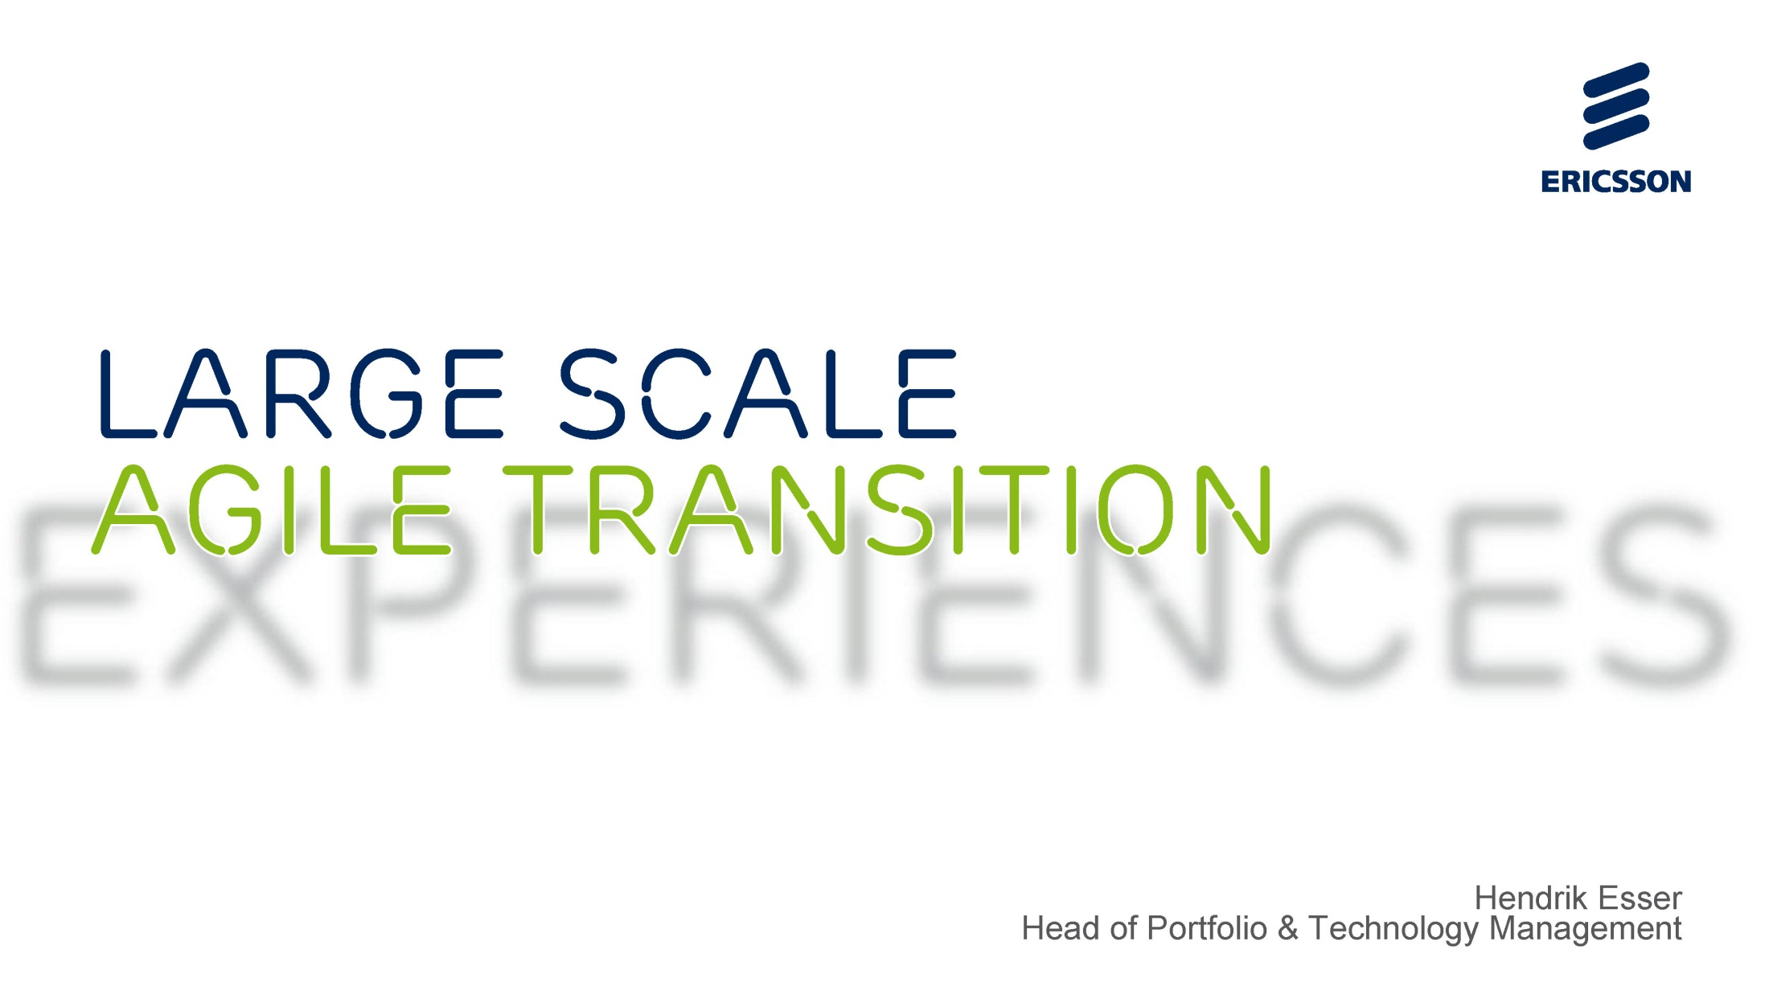
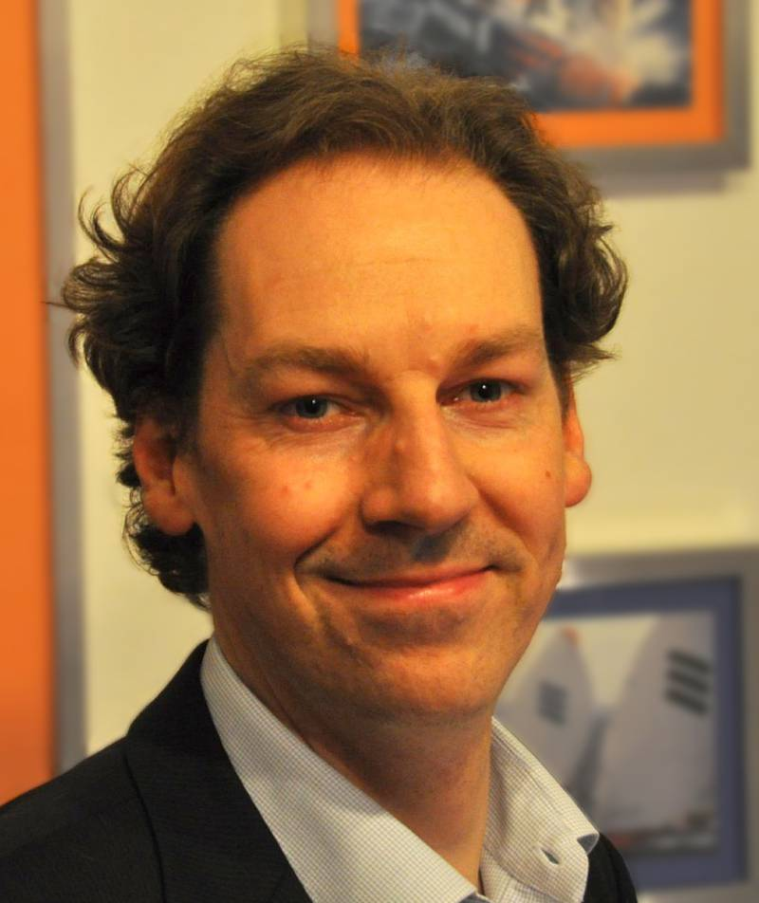

Slide 66
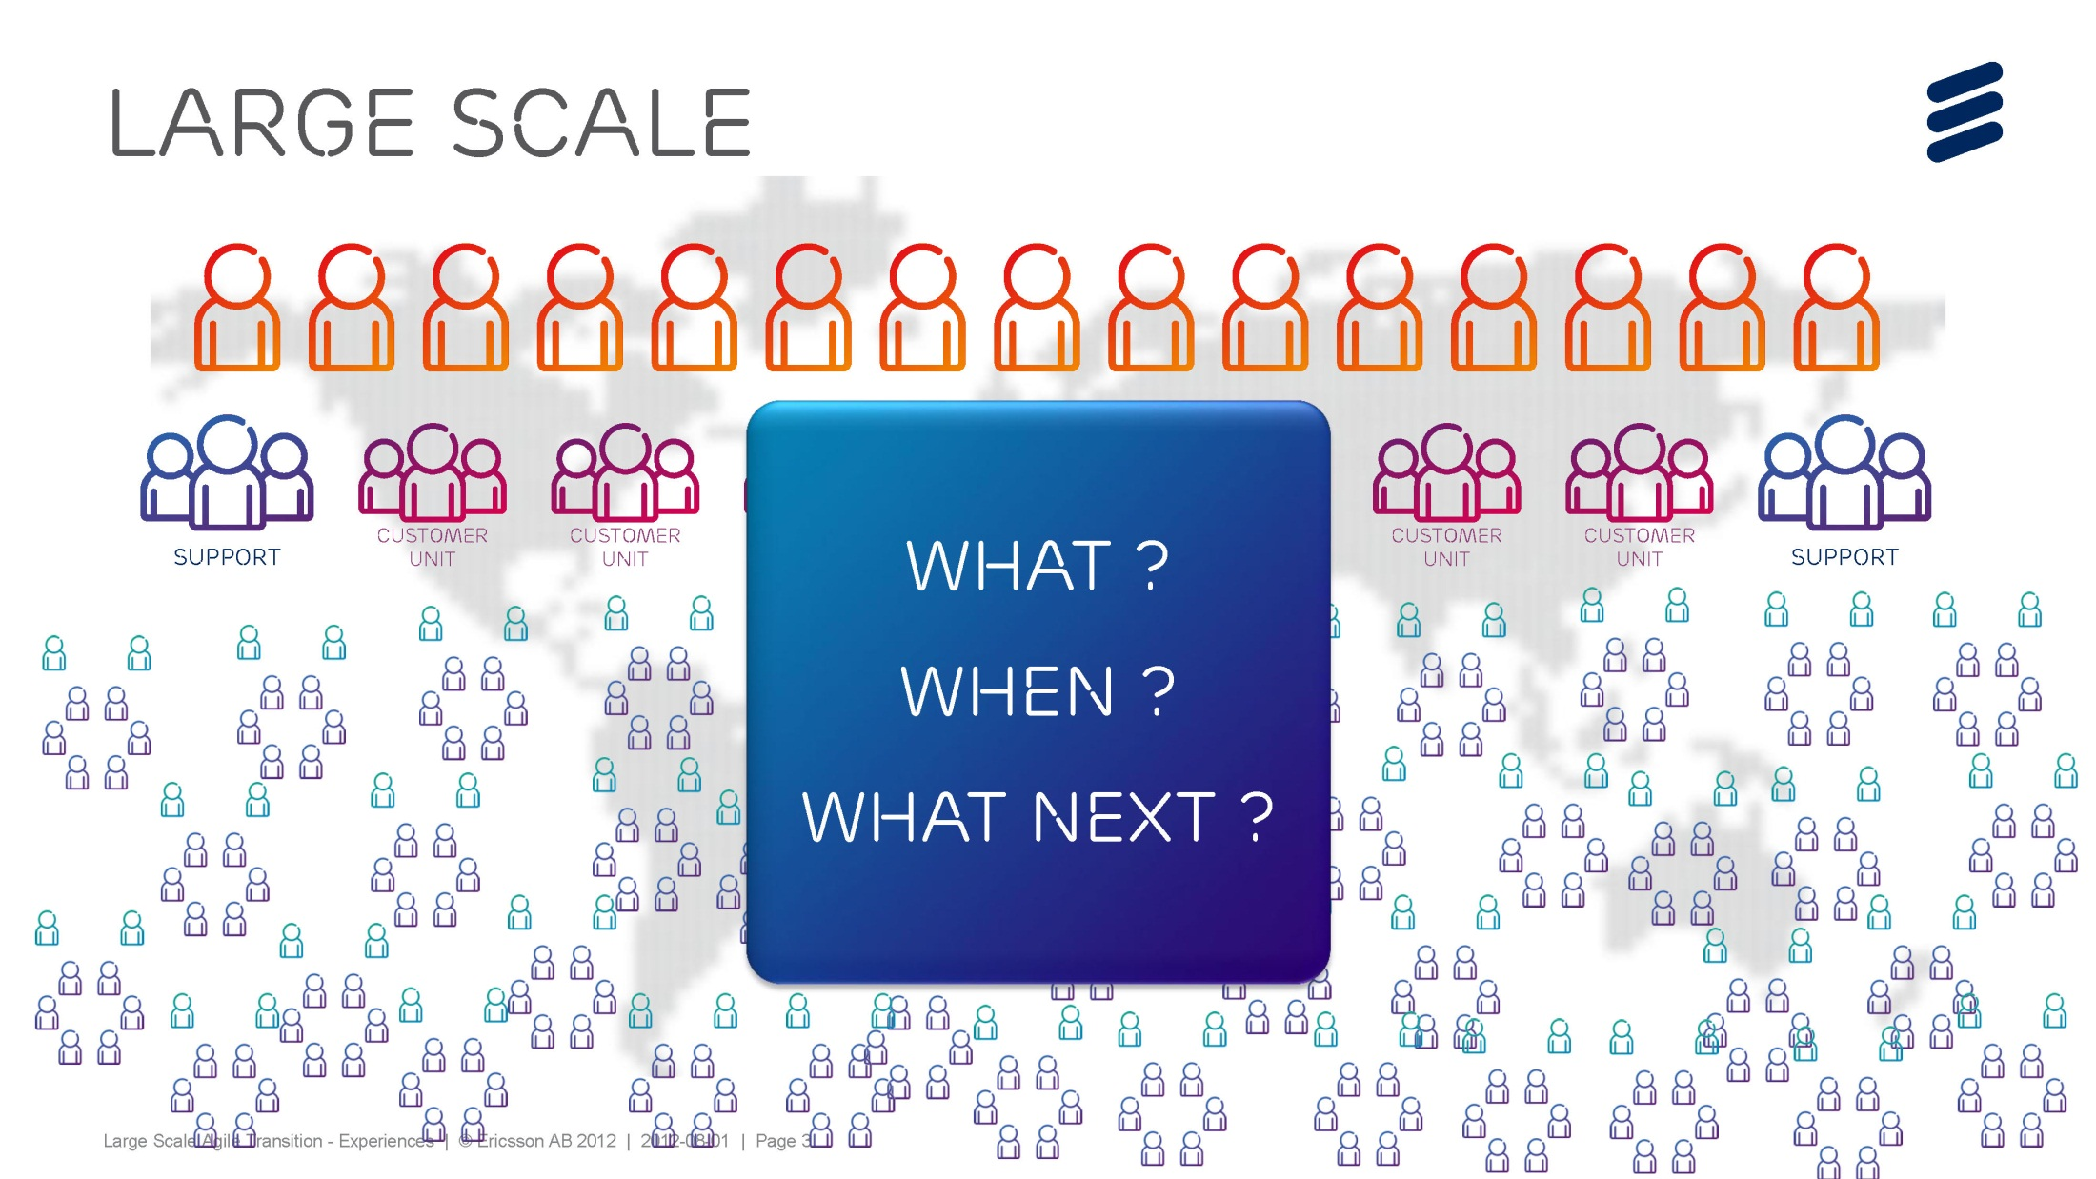

Slide 67


Slide 68
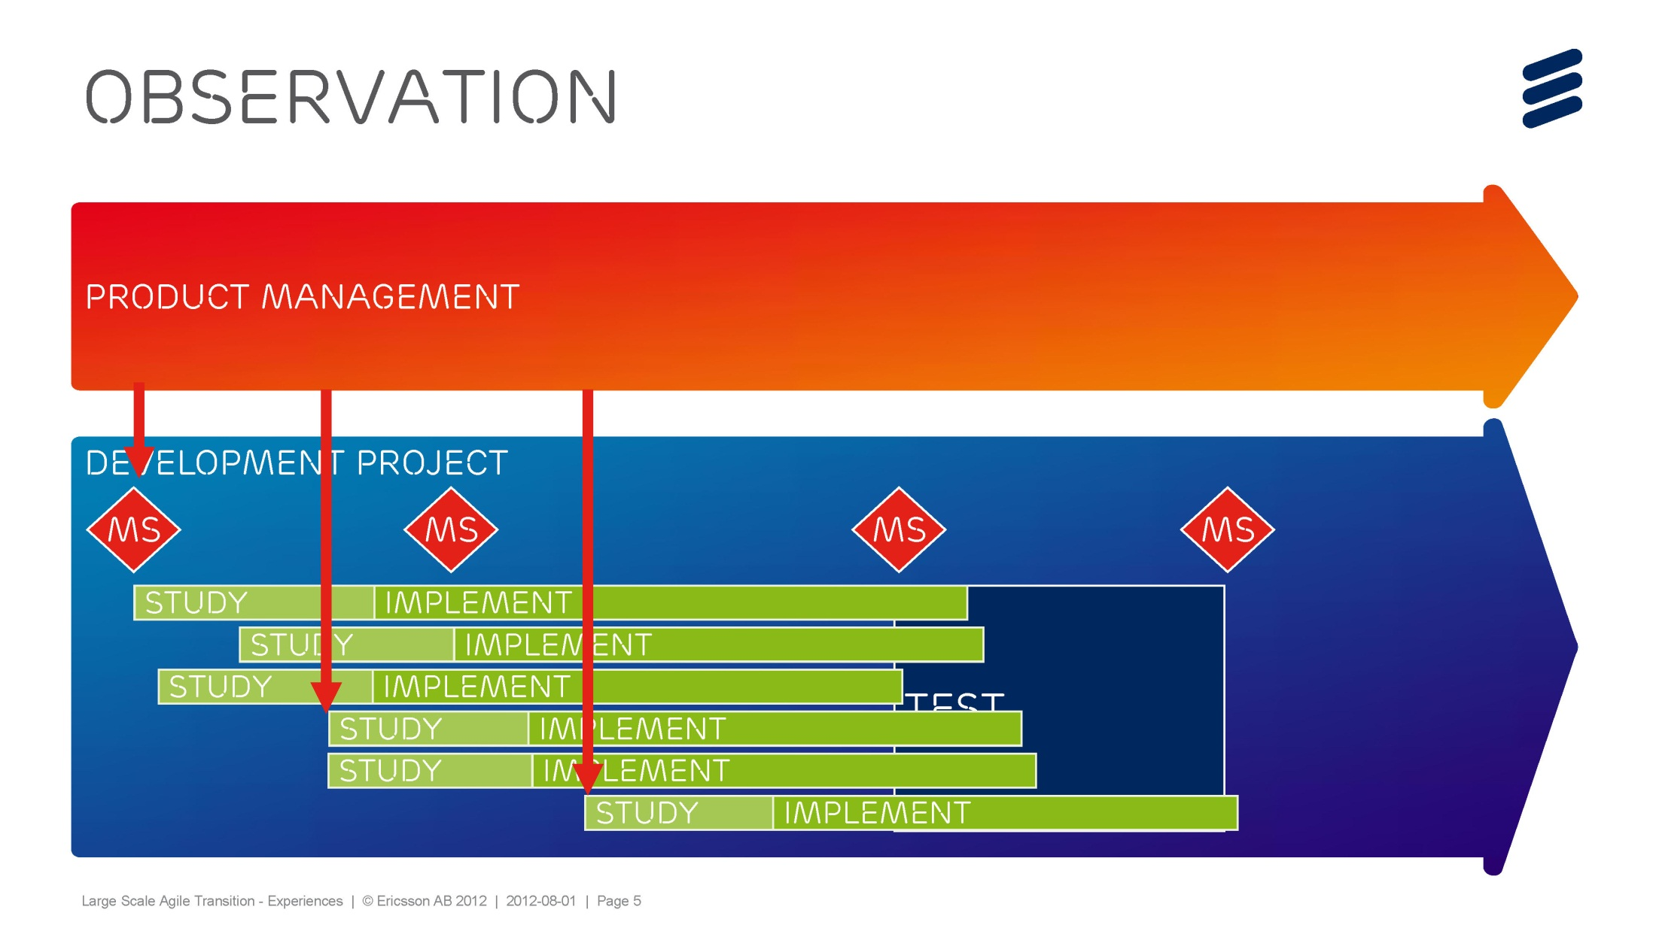

Slide 69
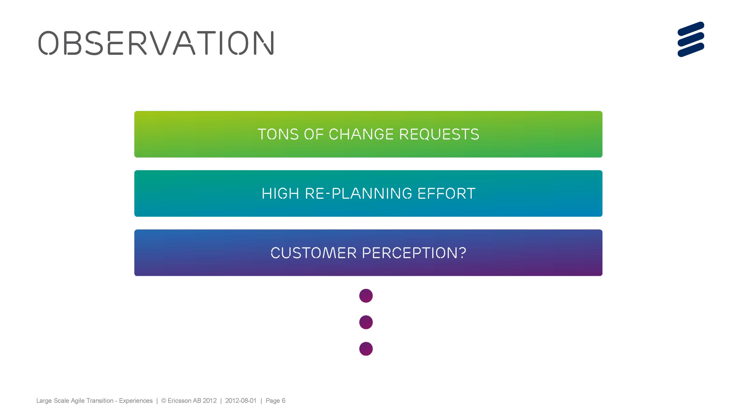

Slide 70
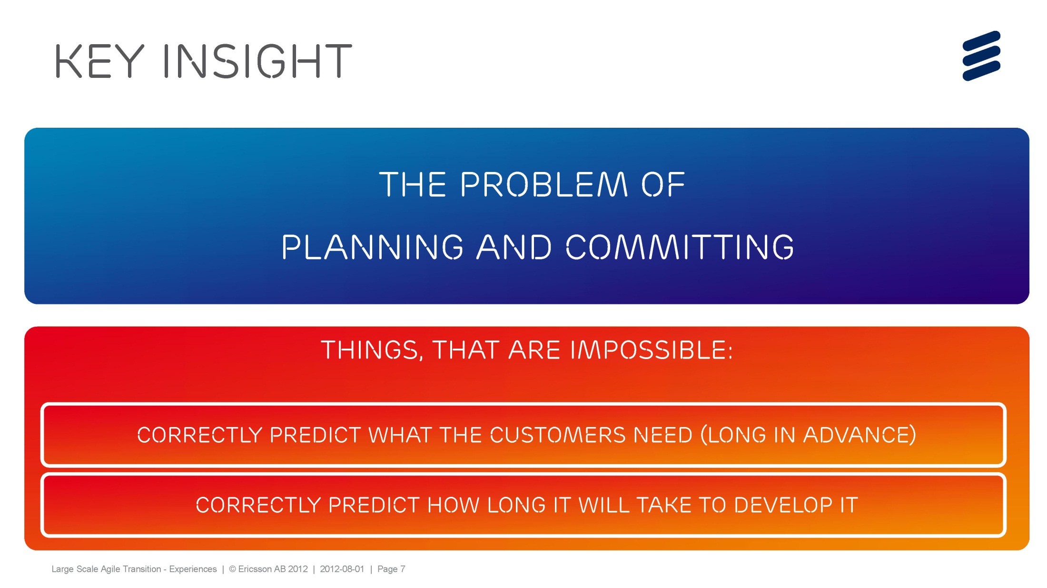

Slide 71
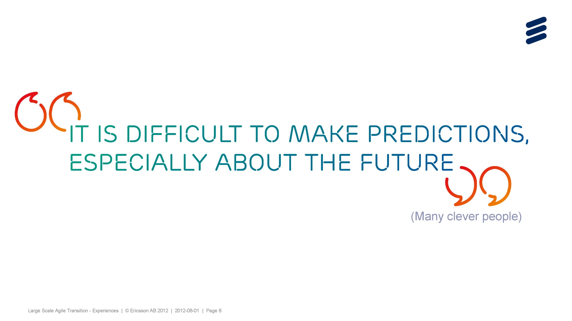

Slide 72
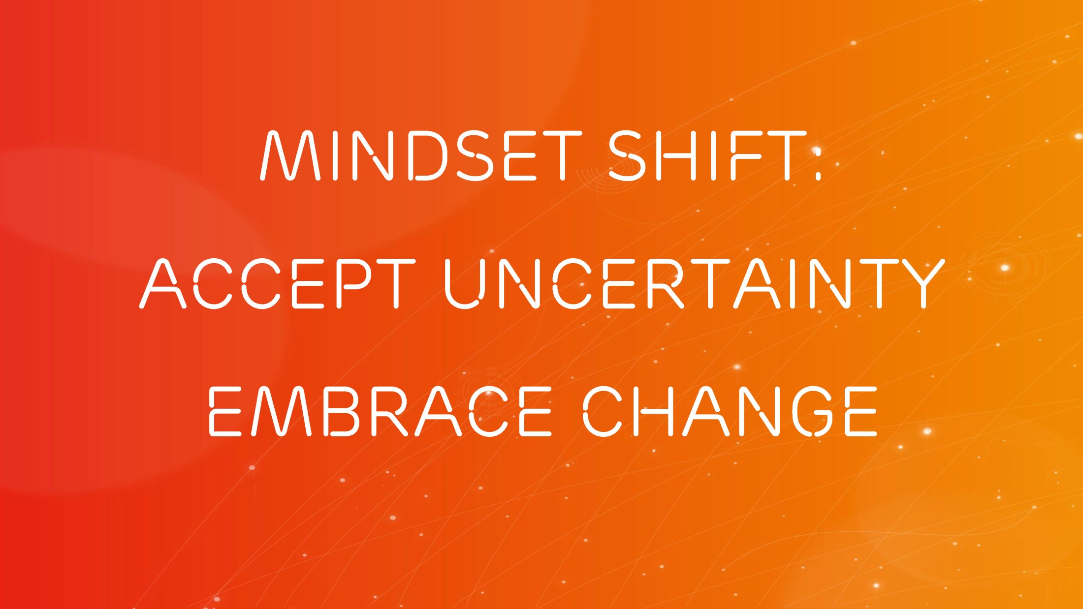

Slide 73
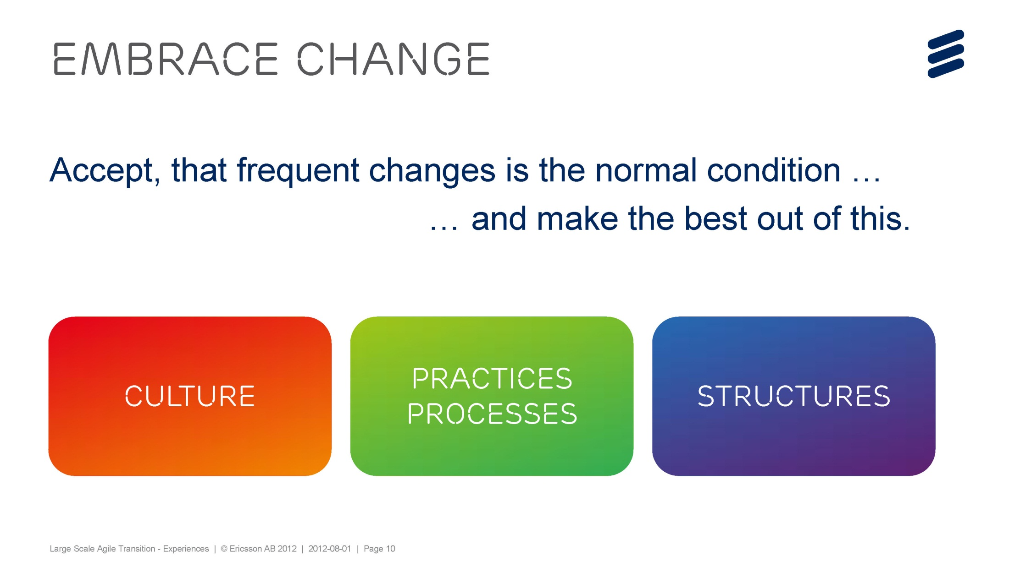

Slide 74


Slide 75
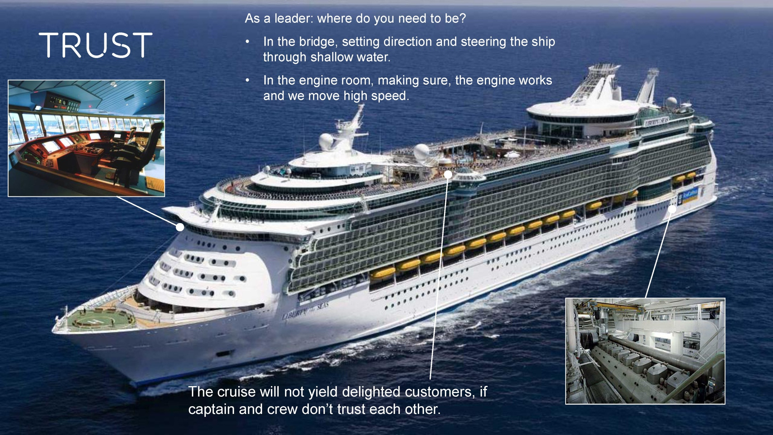

Slide 76
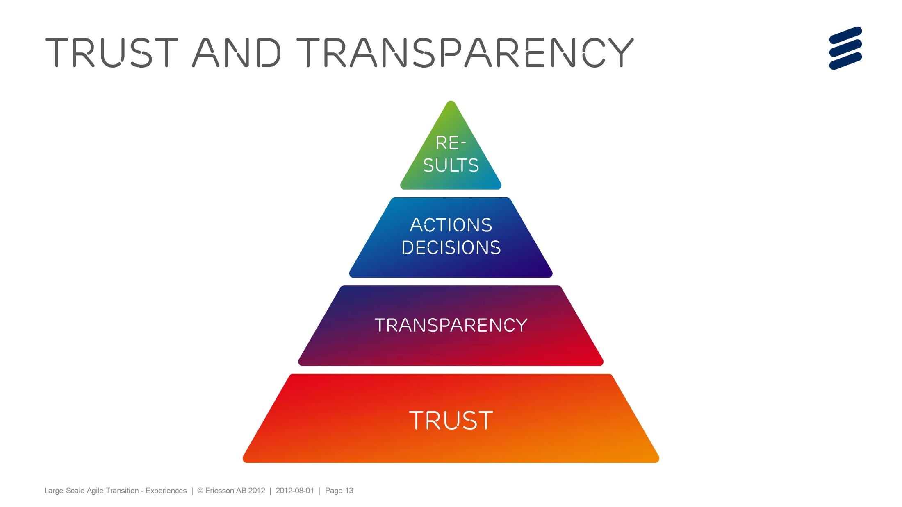

Slide 77


Slide 78
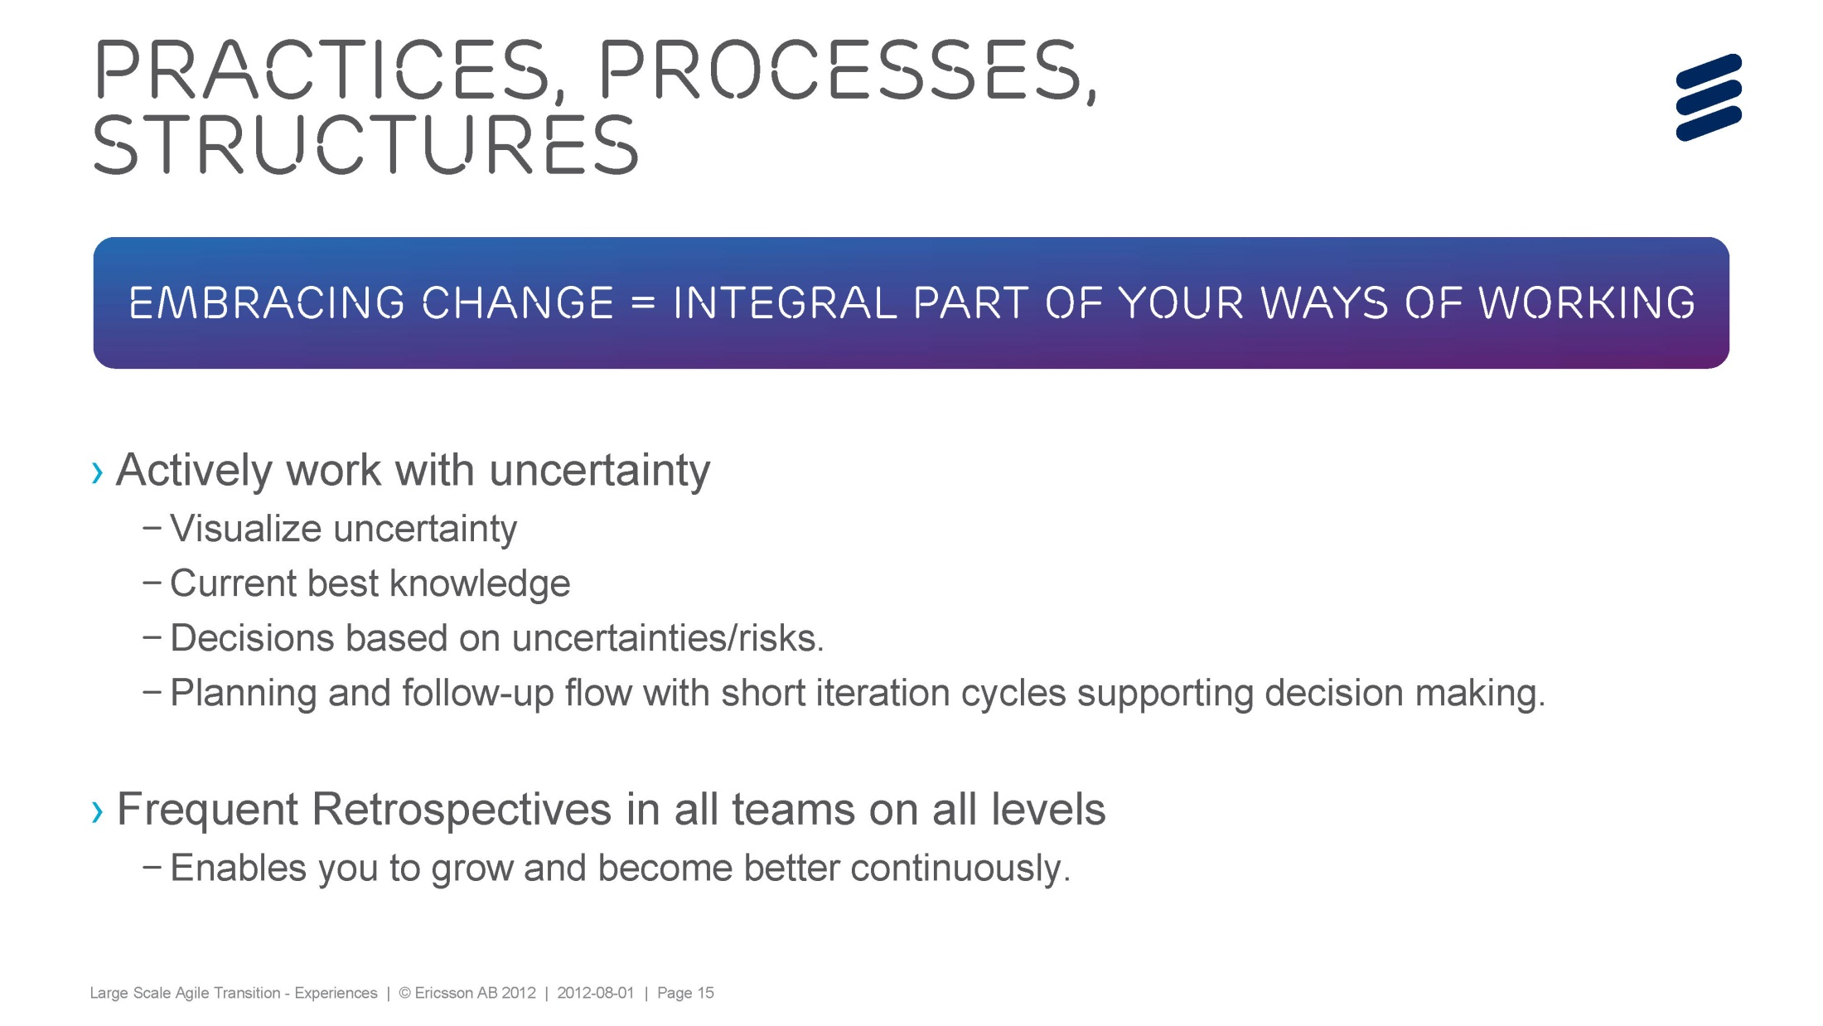

Slide 79
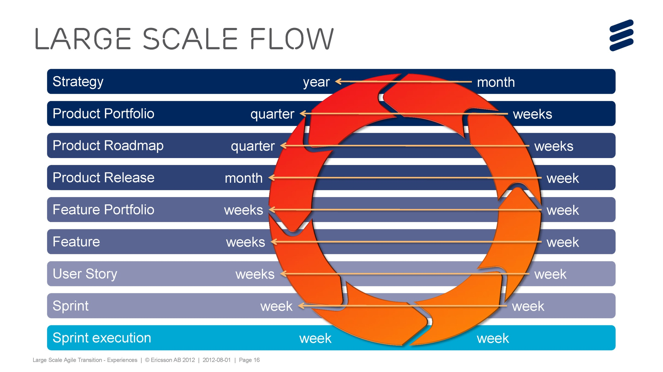

Slide 80


Slide 81
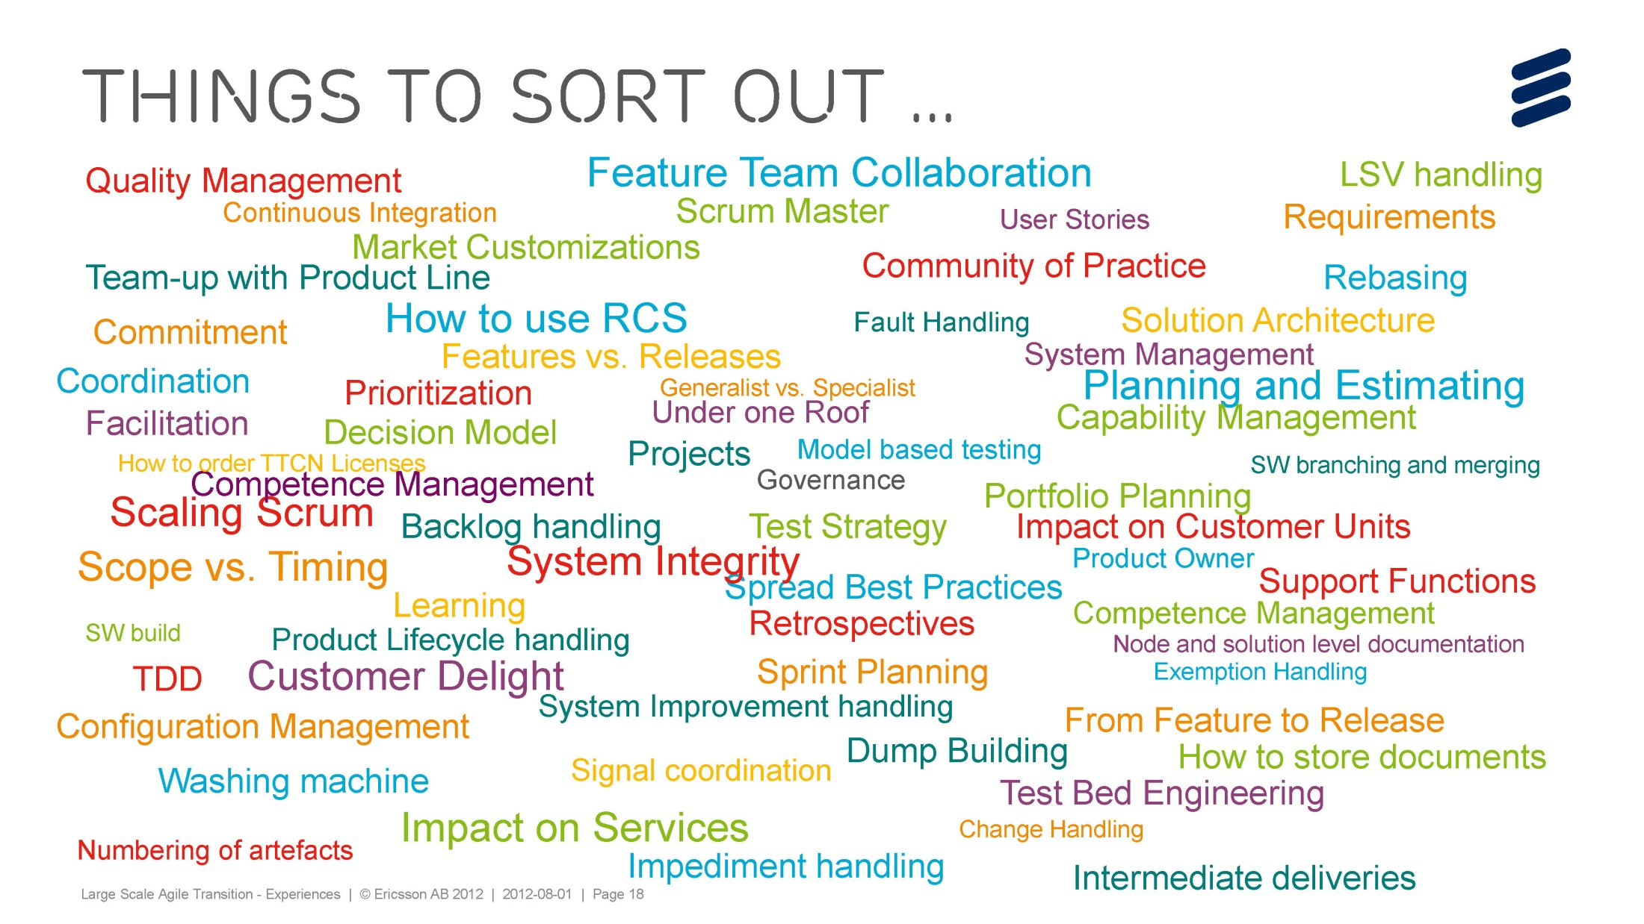

Slide 82
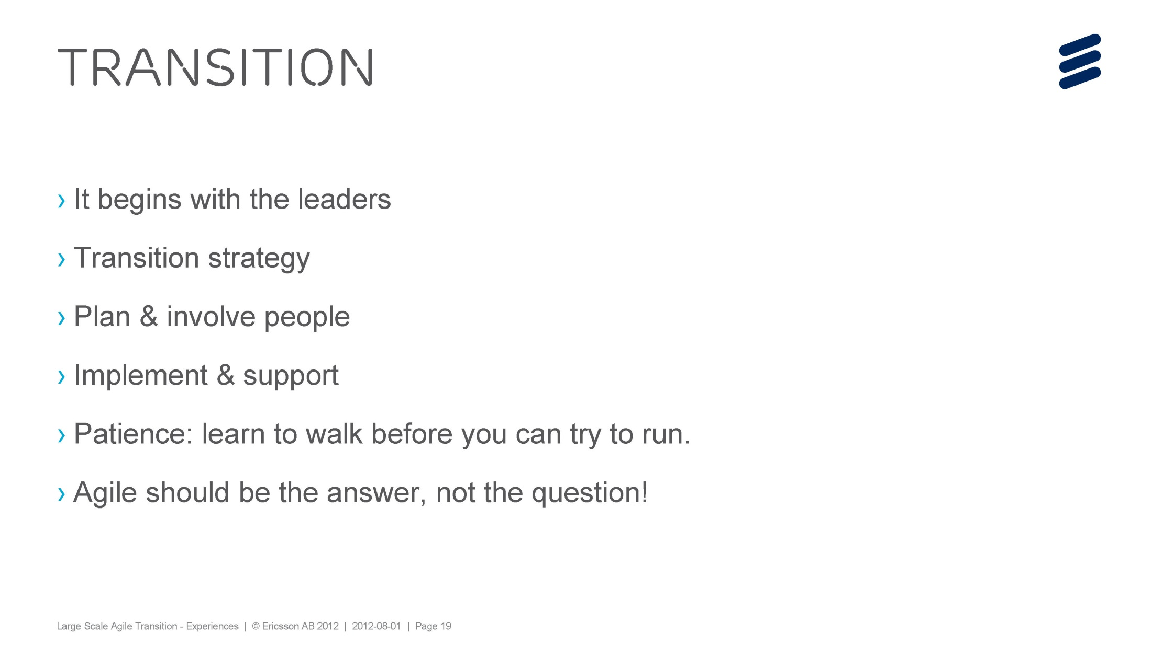

Slide 83
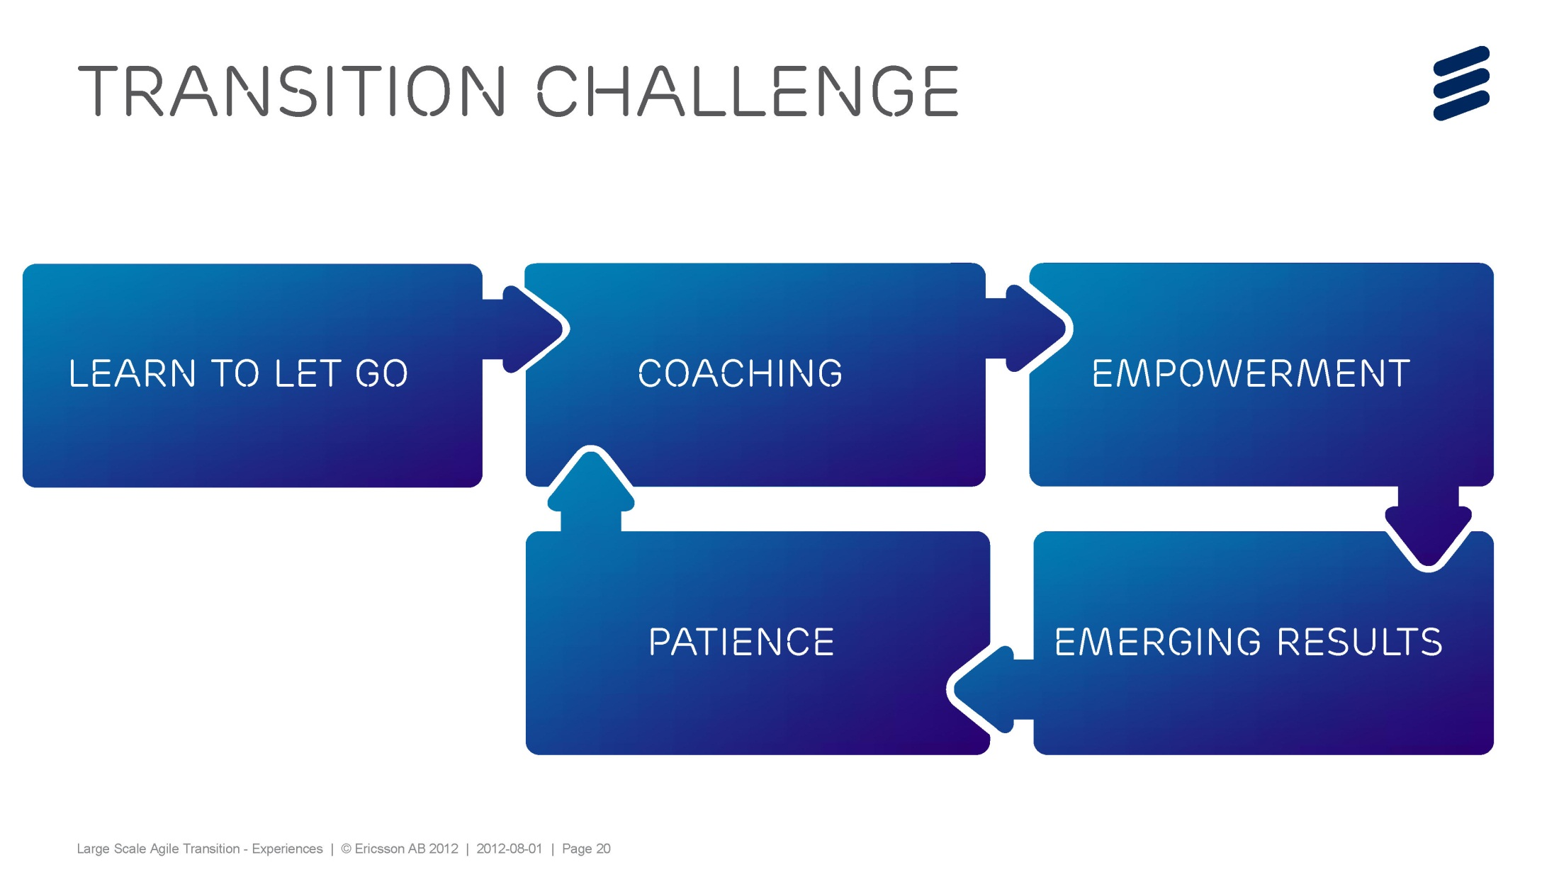

Slide 84
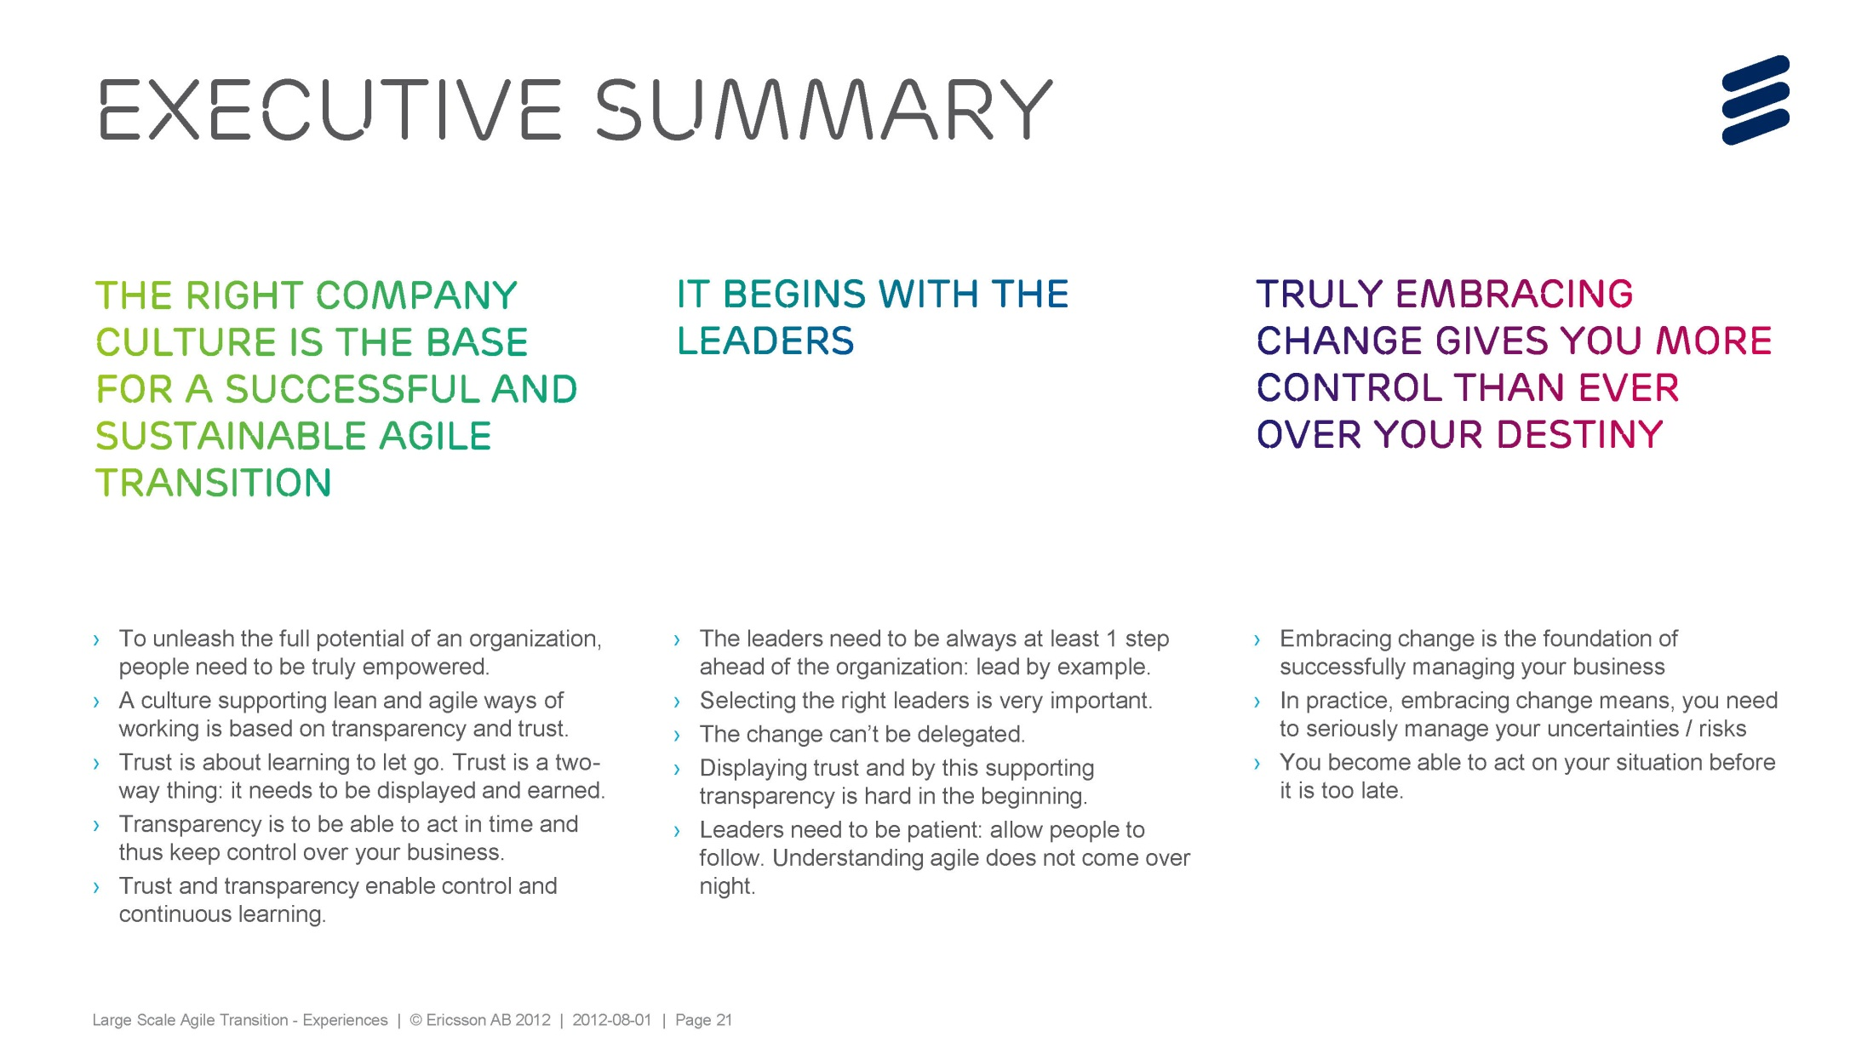

Slide 85

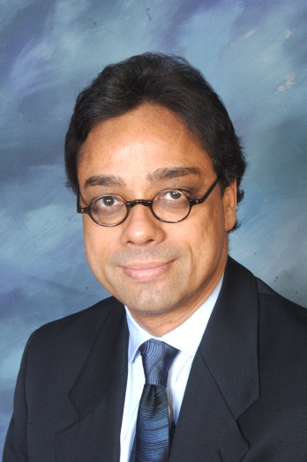

Laying a Foundation for Agility Through
Aligning IT & Business Process: A Case Study
Ravi Waran, CIO Air Liquide Agile2012 Conference, Dallas TX

Slide 86
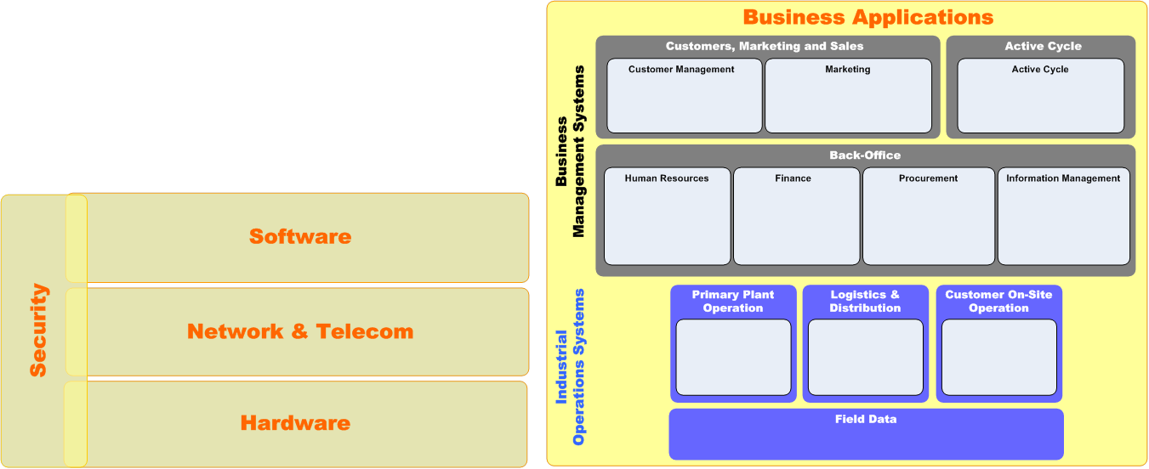
Consolidate Efficiencies, Drive Targeted Differentiation
TARGETED IT
‘Differentiate”
CORE IT
“Keep The Lights On”
Standardization and rationalization yield lower TCO, boost reliability & performance, and provide a plug and play foundation for agility
Added value comes from exploiting agility and fostering innovation

Slide 87
Infrastructure Strategy
Projects:
SOFTWARE
Approach:
rationalize &
standardize
SECURITY
Approach: standardize
& balance
Projects:
VOICE & NETWORK
Approach: boost reliability & expand capacity
Projects:
HARDWARE
Approach: rationalize & standardize
Projects:

Slide 88
Business Process Convergence Strategy
Key Areas
Converge
Focus
Keep the Lights On
Maximize efficiences
Business Process
Converge
Differentiate
Drive competitive adv
Keep the Lights On
Drive TCO down
Standardize
Lower complexity
Fewer platforms
IT Domains
Differentiate
Drive business value
Keep the Lights On
Leveraged resources
Aligned, connected
Common tools
Shared governance
Optimal outsourcing
Support model
Differentiate
Provide proximity
Targeted support
Notes:
The three separate but interconnected pillars defining roadmap strategy
1) Business Process, 2) IT Domains, 3) Support Model
Design of each drives the next, in sequence
Common transformation theme across all three pillars
Convergence & standardization, followed by
Focus & differentiation
Shadow box shows scope of validation study.

Slide 89



Establishing a Technical Debt Practice
Pete Morowski
Senior Vice President - Development
Sabre Airline Solutions
An Executive Perspective

Slide 90

What is it and why is it important ?
Technical Debt

Slide 91

Provides vocabulary to quantify the technical health of software in terms of business impact.
Software as a Business Asset
“
Notes:
Measures

Slide 92

Strategic Effect of Technical Debt
In applications with high technical debt, estimating accurately is nearly impossible
Only 3 strategies
  Do nothing, it gets worse
  Replace, high cost/risk
  Incremental refactoring, commitment to invest
©2008 InformationArchitects, Inc.

Slide 93

Simplifying the conversation
Quality Debt
Config. Mgmt Debt
Code Debt
“Technical Debt”

Slide 94

Our Approach
Practice Evolution

Slide 95

Establishing our Practice
educate
measure
communicate
adopt
institutionalize

Slide 96

Measuring debt
Measurement Pilot
  Senior technical team
  Tools usage
  Challenges
Portfolio Analysis and Product Summaries
Measurement Practice
  Baseline
  Usage and frequency

Slide 97
Communicate
educate
measure
communicate
adopt
institutionalize
Executive Communication
  Focus on funding
  Establishing a consistent language and presentation
  Communicate business impact and don’t assume tech knowledge
Technical Teams
  Focus on fixing
  Not one time effort
  Highlight wins

Slide 98
Adopt
educate
measure
communicate
adopt
institutionalize
Data Visibility and Usage
Remediation
  Investment Prioritization
  Business Collaboration
  Refactor vs Rewrite
Prevention
  Measurement and Monitoring
  Training and tooling
  Code Stewardship

Slide 99
Institutionalize
educate
measure
communicate
adopt
institutionalize
Not there yet
Not a “tech” thing
  Annual Budget planning
  Technology transitions
  Consideration in Acquisition process
Once remediated teams actively apply tech debt practices
  Debt can be measured and managed on an iteration basis

Slide 100
Learnings: My Top 5
Leadership and buy-in from senior technical team was critical
  Tooling/Measure Challenges
  Time Investment
Importance of standard format product summaries
Impact in changing the discussion with the business
  Surprised in adoption of terminology across company
  Need ability to communicate dynamics of software development
Impact to development teams in approach to coding
  Visibility quantifies impact of “short cuts”
Most effective tool I have had in justifying technical investment

Slide 101


Cost to Service is the key
Type of Debt | Cost to Service
Home Mortgage | 3%
Student Loan | 3.4%
Credit Card Debt | 18%
Louie the Loan Shark | 100%

Slide 102

Don’t Mess With the Scrum Master
Allen Rutzen
Sr. Manager, Agile Working Group
Nokia, Location & Commerce
Agile Executive Forum 2012
August 13, 2012

Slide 103
Dedicated Scrum Master
Scrum Master responsibilities done by dedicated Scrum Masters that typically handle 2 teams.
Pros | Cons
Dedicated role Scrum Master | Scrum Master is not dedicated to the team.
This is the most common and presumed default.

Slide 104
Team Member as Scrum Master (Dedicated)
Scrum Master responsibilities get priority and should be allocated at 50% of that person.
Pros | Cons
Dedicated role | Team tasks can infringe on Scrum Master tasks. Team velocity is reduced
This is a workable solution, but requires a person who will resist the temptation to deemphasize Scrum Master responsibilities

Slide 105
Team Member as Scrum Master
(Rolling Responsibility)
Scrum Master responsibilities get priority and the assigned Scrum Master can only be allocated at 50% for other tasks.
Pros | Cons
Each team member gets exposure to the role | Team tasks can infringe on Scrum Master tasks. Team velocity is reduced
It should only be considered for teams with high levels of Agile maturity

Slide 106
Product Owner as Scrum Master
Product Owner must be available to allocate 50% of time to Scrum Master tasks.
Pros | Cons
?? | Product Owner responsibilities can infringe on Scrum Master tasks Checks and balances with respect to sizing stories and velocity-based planning is compromised
It should only ever be considered for teams with high levels of Agile maturity and a Product Owner that is a strong proponent of Agile

Slide 107
Functional Manager as Scrum Master
The Functional Manager must be able to clearly delineate the duties of manager and Scrum Master.
Pros | Cons
?? | Too tempting to move from servant-leader to directive-leader mindset. The collaborative team culture is in jeopardy as open dialogue is always in danger of being suppressed
It should only be considered as a temporary solution

Slide 108
No Scrum Master
(responsibility shared among team members)
Tasks are “picked up” by multiple team members.
Pros | Cons
Each team member gets exposure to Scrum Master tasks | Team tasks can infringe on Scrum Master tasks. Team velocity is reduced
It should only be considered for teams with high levels of Agile maturity

Slide 109
Summary of Scrum Master Models Used At Nokia/NAVTEQ
Model | Number | Percentage
Traditional SM Model | 45 | 70%
Team Member as Scrum Master (dedicated) | 9 | 14%
Team Member as Scrum Master (rolling ) | 2 | 3%
Product Owner as Scrum Master | 1 | 2%
Functional Manager as Scrum Master | 6 | 9%
No Scrum Master (shared responsibility) | 1 | 2%

Slide 110
Summary of Scrum Master Models
Model | Stipulations | Recommendation
Traditional SM Model | SM is dedicated to SM duties Not to exceed two teams | Yes
Team Member as Scrum Master (dedicated) | Scrum Master responsibilities get priority Can only be Scrum Master for one team. Experienced Scrum Master | Yes, but SM responsibilities get priority and should be allocated at 50%
Team Member as Scrum Master (rolling ) | Scrum Master responsibilities get priority | No
Product Owner as Scrum Master | Product Owner must allocate 50% of time to SM tasks | No
Functional Manager as Scrum Master | The FM must be able to clearly delineate the duties of manager and Scrum Master | No
No Scrum Master (shared responsibility) | Tasks are “picked up” by multiple team members | No

Slide 111



Slide 112


Slide 113


Slide 114


Slide 115


Slide 116


Slide 117


Slide 118


Slide 119


Slide 120


Slide 121


Slide 122


Slide 123


Agile – It’s All About The People
Mike Harkins
August 2012
Notes:
Introduce myself
Started in 2008 in a division
Now part of L&P
Implementing on a bigger scale

Slide 124

IT Tries But The Business Is Not Happy
Are they delivering quality software?
Business & IT frequently do not have a healthy partnership
Notes:
Before we started our agile implementation:
The business departments lacked confidence in IT’s ability to deliver;
And the business relationship with IT was not good.

Slide 125

Wasted Time & Effort
The requirements process delays starting development and approvals are too often used as a weapon
No focus on getting value quickly
Copyright 2002 Standish Group
Notes:
We relied on people to be able to tell us everything they needed and since they had not seen anything yet, this led to an incomplete understanding due to a combination of the people not thinking of some things and misinterpretation on the part of the hearer.
Study by the Standish Group said that 45% of features and functions were never used, 19% were rarely used, 16% were sometimes used, 13% were often used, and 7% were always used. We can debate the specific percentages but the concept seems valid.
Our situation was similar.

Slide 126
Challenges
Scope was broad, implementation delayed due to work on less valuable functionality
Do they really need this?
Implementation
delays when users
finally saw what
was developed and
wanted changes
Notes:
Instead of doing first and getting into production the things that would bring the most value, projects usually tried to do everything which made them longer and increased the likelihood they would go on and on and on..

Slide 127

Self Examination
As a leader, you must believe in it
You must overcome problems, challenges, and doubts
Get convinced before you start
Stay the course
Notes:
As a leader, it is your job to improve things by making people uncomfortable at a pace they can handle.
U.S. Grant’s realization in his first battle that the enemy was just as scared as he was so he just decided to not be afraid from then on

Slide 128

Executive Sponsorship
Utilize success stories at other companies to get executive support
Notes:
There are enough successes to provide strong evidence about the success of agile methods

Slide 129

Volunteers Versus Experts
Notes:
Volunteers are always better with new ventures
Not at Transamerica but at other companies I know about, experts have delayed and sabotaged agile implementations
Experts may feel threatened or resent losing their position of importance

Slide 130

Training & Coaching
Training before starting is critical
Coaching is helpful in the beginning and for checkups
Scrum Master & Product Owner training after they get experience
Join local agile groups
We are doing internal mentoring
Notes:
Light bulbs went on at the training session.
Business and IT people got excited, but of course, we had skeptics.
We quickly reached the tipping point when people kept asking when they could start doing it instead of waiting for the pilot to finish.

Slide 131

Dilemma
The key is to get a second team going
The tipping point for us was when we had a second team start without permission during our pilot

Slide 132

Management Control
Managers must allow the teams to make decisions
Managers should make teams solve their own problems
Managers should focus on developing people and improving things that are beyond the team’s control

Slide 133

Agile Exposes Weaknesses
It is difficult to hide in an agile environment
This is true for people and processes
Notes:
Agile exposes weaknesses in people and processes

Slide 134

Lessons Learned
Agile has specific techniques, when we follow the discipline, the results are better
Teams over committed initially
Keep teams together if possible
Less is more, by limiting the concurrent projects that teams were assigned, the teams did more and did it faster

Slide 135


Strengths
We utilized the Gallup Group’s assessment to identify people’s individual strengths
We utilized CoreClarity’s tools to understand our team’s collective strengths
Employees are more engaged and productive when they utilize their strengths

Slide 136

Balance the reality of uncertainty with the wish for certainty
give them “waterfall” status
agile
to deal with uncertainty

Slide 137
Standardize to reduce costs, Differentiate to generate value
TARGETED IT
‘Differentiate”
CORE IT
“Keep The Lights On”

Slide 138
Standardize to reduce costs, Differentiate to generate value
High
Partner?
Innovate
Market
Differentiating
Who cares?
Parity
Low
Low
High
Mission Critical

Slide 139

Optimize the whole
Market
Customer
Sales
R&D Process
Release
Adoption
Maintenance
Supply Chain
Marketing
Training, Education
Finance
Sustaining

Slide 140


Culture is important. Adjust your culture to be more agile, adjust your agility to match your culture(s).

Slide 141

Understand your technical debt and the cost of servicing it. Remember “craftsmanship over crap”

Slide 142


The Scrum Master / Coach

Slide 143
Discover and leverage the strengths of individuals

Slide 144


