Slide 1

Leveraging Global Talent for Effective Agility
Todd Little, VP Product Development at IHS
Notes:
Over the past 3 years Landmark has been incorporating Agile methodologies in our development processes.

Slide 2


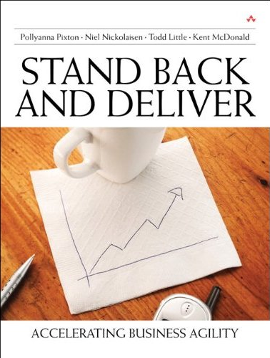





About Todd
j. s. nolen
& associates

Slide 3
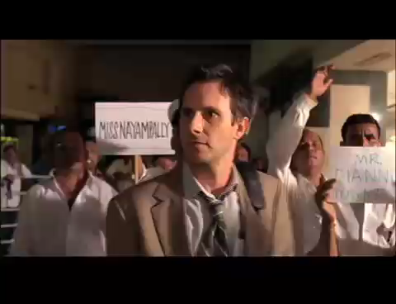

Slide 4
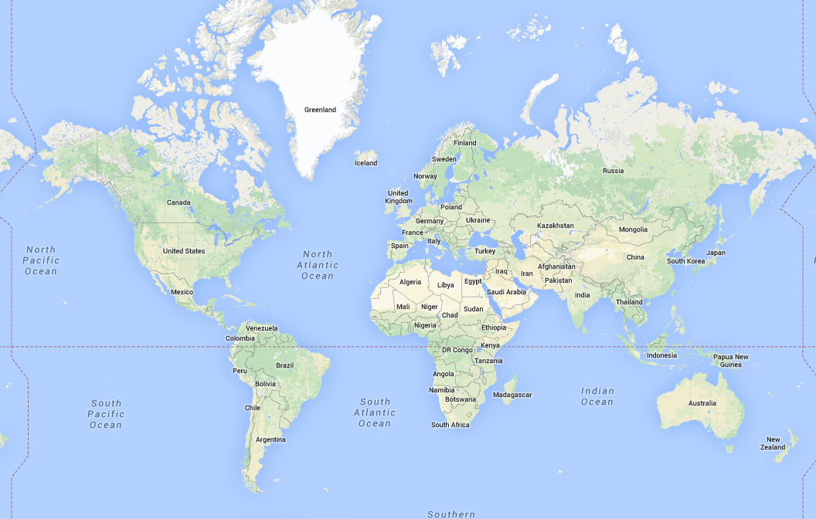
Globally Distributed Teams

Slide 5
Globally Distributed Teams

Slide 6
Locations
Houston
Austin
Denver
Calgary
London
Stavanger
Islamabad
New Delhi
Chennai
Pune
Mysore
Bucharest
Ho Chi Men
Dnipropetrovsk
Houston
Dallas
Denver
Calgary
Tetbury
Geneva
Bangalore
Chennai
Hyderabad

Slide 7
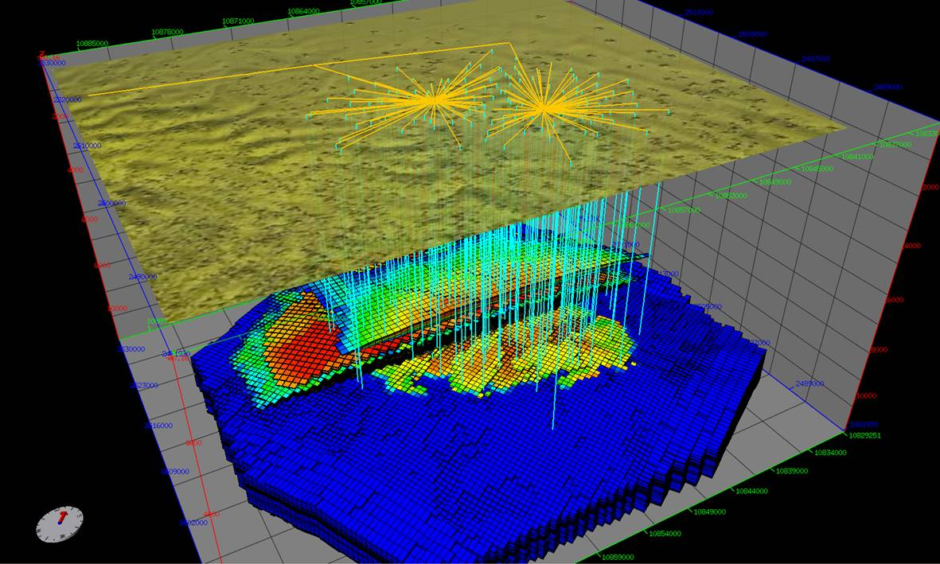
Nexus Reservoir Simulation
Next Generation Reservoir Simulation

Slide 8
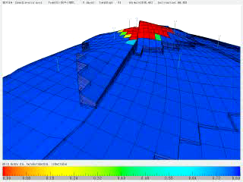
Petroleum Reservoir Simulation

Slide 9
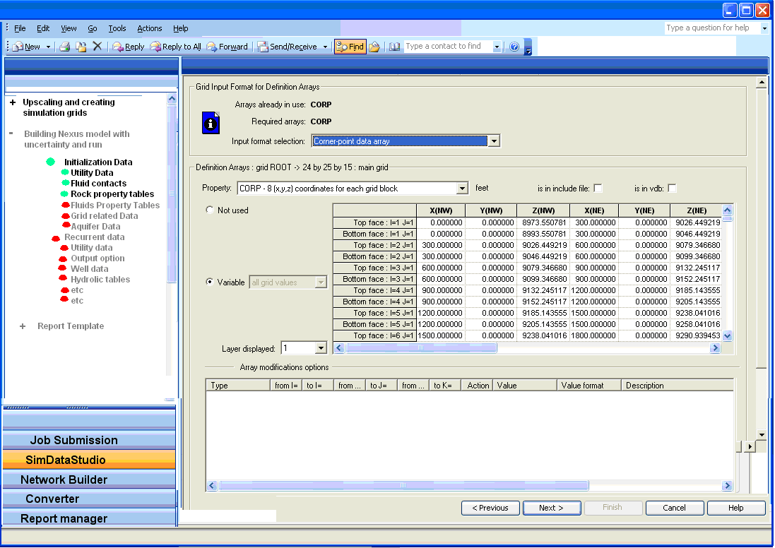
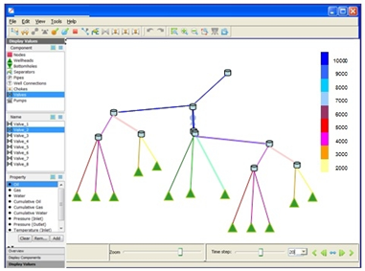
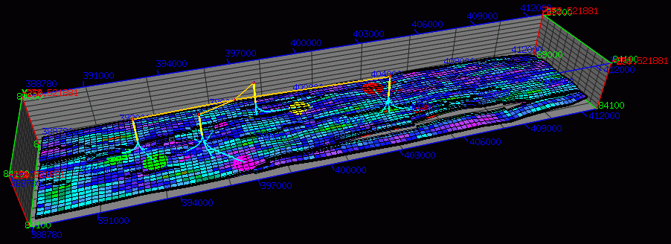
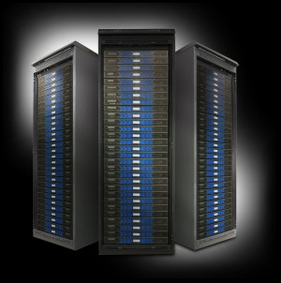
System Workflow
User Interface
Graphical Pre-Processing
Graphical Post-Processing
High Performance Cluster

Slide 10
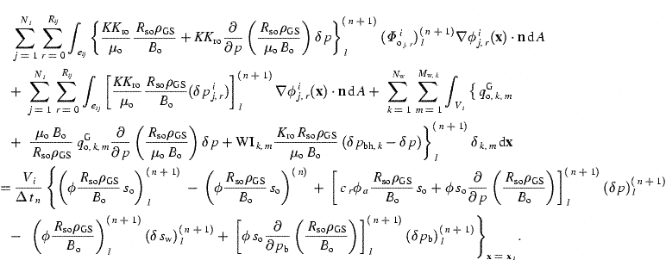
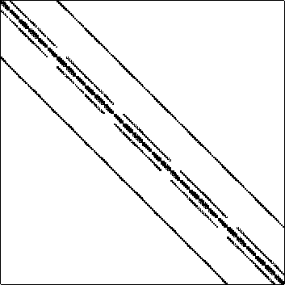
Computing
Challenges
Some Simulations take hours or even days, or even …
Our Testers are Petroleum Engineers, not Test Automation Specialists
Numerical Simulation is an approximation and as such is subject to round-off and/or perturbation differences

Slide 11
Our Problem(s)
Too many defects found in beta
Too much back end testing
Not getting sufficient coverage early
Tests take a long time
Global shortage of Petroleum Engineers
Our testers do not have automation skills
Limited unit tests
Approximation breaks abstraction

Slide 12




Managing the Coming Storm
Inside the Tornado
Project Kickoff
When will we get the requirements?
All in good time, my little pretty, all in good time
But I guess it doesn't matter anyway
Just give me your estimates by this afternoon
Team Unity
Not so fast! Not so fast! ... I'll have to give the matter a little thought. Go away and come back tomorrow
No, we need something today!
Ok then, it will take 2 years.
No, we need it sooner.
Doesn't anybody believe me?
I already promised the customer it will be out in 6 months
You're a very bad man!
Notes:
We look at a typical software project…..

Slide 13


We’re not in Kansas Anymore
Developer Hero
I may not come out alive, but I'm goin' in there!
Reorg
The Great and Powerful Oz has got matters well in hand.
My! People come and go so quickly here!
Testing
"Hee hee hee ha ha! Going so soon? I wouldn't hear of it! Why, my little party's just beginning!

Slide 14
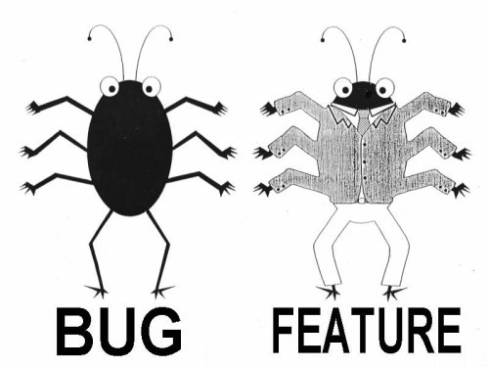
Lan Cao - Estimating Agile Software Project Effort: An Empirical Study
2X
Uncertainty
Notes:
Lessons learned: If uncertainty is high, work on it earlier. Reduce Technical Debt—Get to potentially shippable at each iteration. Finding and fixing the last bugs has high uncertainty – plan on there being uncertainty.

Slide 15
Our Strength(s)
Experienced and committed team
Passionate about the domain
Good collection of lightweight integration tests
Developer discipline
Excellent collaborative relationship with customers
Access to challenging customer data
Willingness to invest

Slide 16
Our Proposed Solution
Understand our current testing strategy and look to fill in gaps and automate where possible.
Augment current team with global teams
Find partners to augment missing skills
  Romania (Petroleum Engineers/Software Developers)
  Vietnam (Test Automation specialists)

Slide 17
System Workflow
User Interface
Graphical Pre-Processing
Graphical Post-Processing
High Performance Cluster

Slide 18
Test Automation Workflow
Input
Simulate
Output
Difference Engine
Report
Baseline

Slide 19
Testing and Automation Strategy
Customer Models
Weekly
Complexity of Tests
Smoke Tests (manual)
Nightly
Every Checkin
Developer Tests
Breadth of Coverage

Slide 20
Testing and Automation Strategy
Customer Models
Weekly
Gap
Complexity of Tests
Smoke Tests (manual)
Nightly
Every Checkin
Developer Tests
Breadth of Coverage

Slide 21
Testing and Automation Strategy
Customer Models
Weekly
Nightly
Complexity of Tests
Mid-Tier Tests
GUI Tests (automated)
Smoke Tests (manual)
Nightly
Developer Tests
Every Checkin
Breadth of Coverage

Slide 22
Simulator Regression Tests over time
Customer X
Customer Other

Slide 23
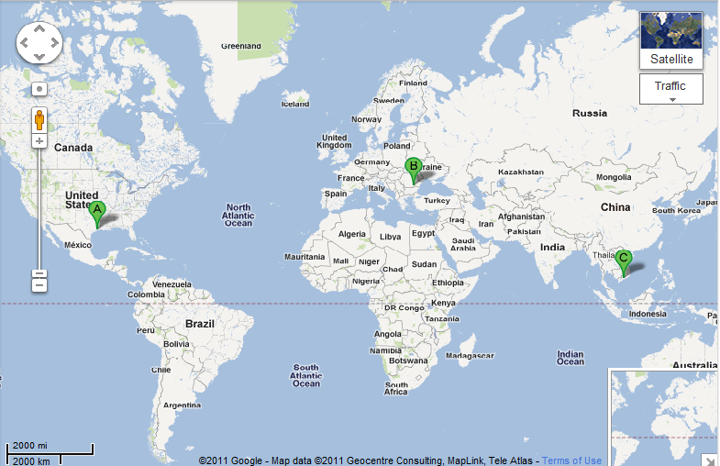


Global Expertise
(Houston, Bucharest, Ho Chi Minh City)
3 Dev
3 PE Test
15 Dev
6 PE Test
2 Pgm Mgr
2 Prod Mgr
4 Auto Test

Slide 24
Working with Partners
Romania
  3 Software Developers
  3 Reservoir Simulation Experts
  Owner was Professor of Reservoir Simulation (and a benevolent dictator)
  Communicated in the language of reservoir simulation
Vietnam
  4 automation test experts
  Specialized in Action Based Testing
  Communication from domain experts (US and Romania) via Camtasia videos.
3 Dev
3 PE Test

Slide 25
The Bottom Line
97% Reduction

Slide 26

Distributed and Offshore Teams

Slide 27
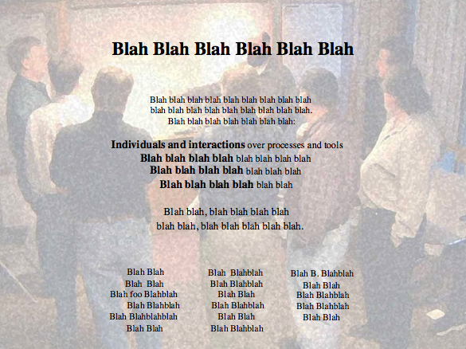
Alexey Krivitsky

Slide 28
Long Ago and Far, Far Away…

Slide 29
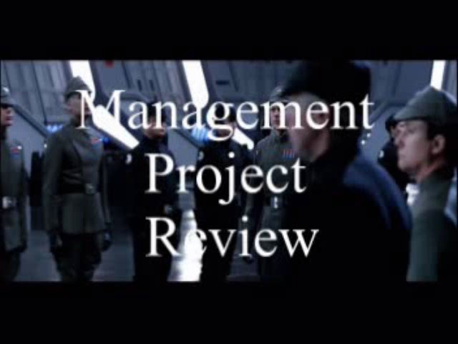

Slide 30
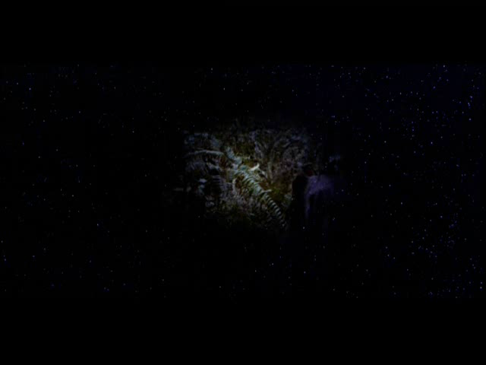
Agile Leadership

Slide 31
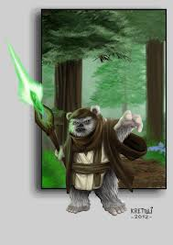

From Coding Monkey to Empowered Ewok

Slide 32
Trust/Ownership Model
Trust
Abdication
Energy & Innovation
How do we
get here?
Command & Control
Conflict
Control
Low
Team Ownership
High

Slide 33
Get the Right People
Passion
Ability
Organizational Fit
Values

Slide 34
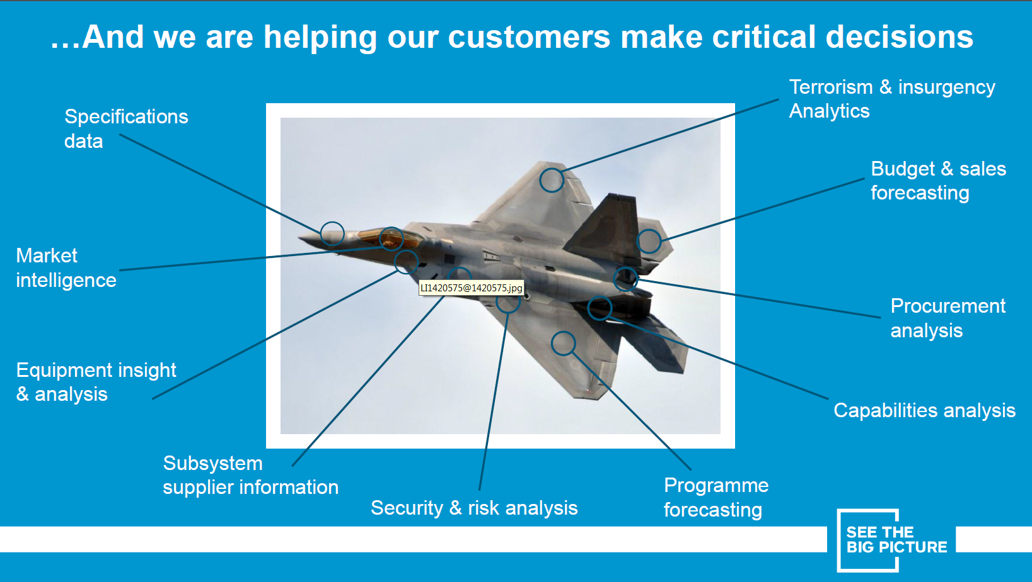
About IHS

Slide 35
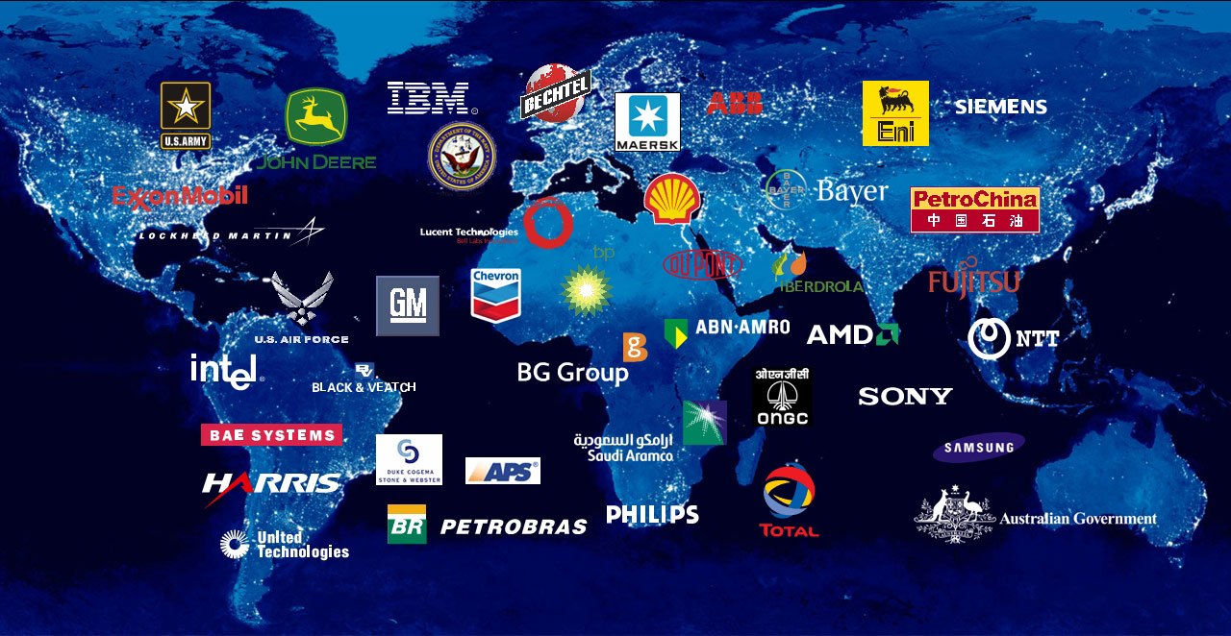
We have a diversified customer base
35
Notes:
2/26/2014 7:47 PM
35
Our acquisitions have added many more customers to this list.
Over the years, we have been able to develop an outstanding client list
We have a powerful global reach:
We serve more than 55,000 customers in over 100 countries
IHS helps customers solve mission critical problems with critical information and insight
We see things from a customers point of view…

Slide 36
In Multiple Industry Sectors

Slide 37
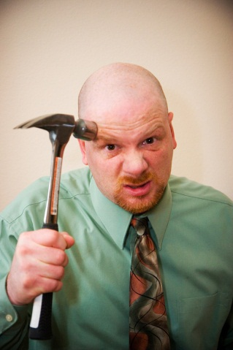
Get Alignment on the Purpose
Powerful Questions are:
What are we building?
What Business are we in?
What Building are we in?

Slide 38
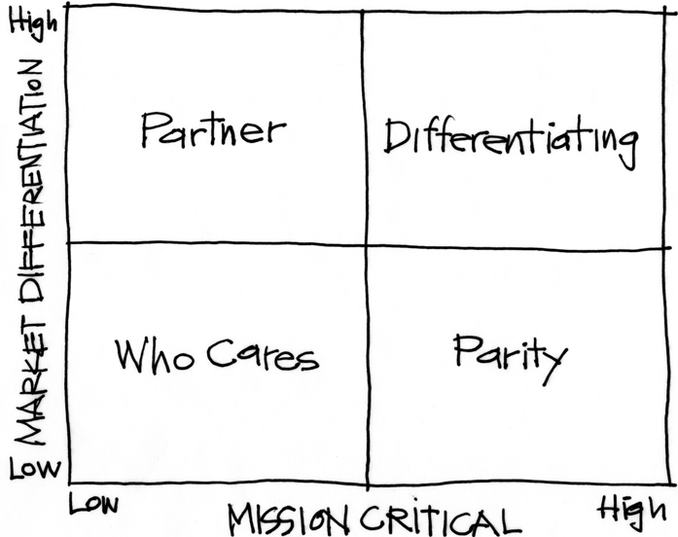
The Purpose Alignment Model
Notes:
[Purpose of slide] [#]
[Information]

Slide 39
In Practice
CAN WE
CREATE A
DIFFERENTIATED
PARTNERSHIP?
INNOVATE,
CREATE
ACHIEVE AND
MAINTAIN PARITY, MIMIC, SIMPLIFY
MINIMIZE /
ELIMINATE
Notes:
[Purpose of slide] [#]
[Information]

Slide 40

Applicable at all Levels
Corporate Strategy
Product Strategy
Feature

Slide 41
A View of Strategy - Apple
41
NEW PRODUCT DESIGN
USER EXPERIENCE
CONTENT DISTRIBUTION
ATT
MS OFFICE
INTEL HARDWARE
OTHER SOFTWARE
PERIPHERALS
Notes:
41
[Purpose of slide] [#]
[Information]
© International Institute of Business Analysis®

Slide 42
Trust/Ownership Model
Trust
Abdication
Energy & Innovation
How do we
get here?
Command & Control
Conflict
Control
Low
Team Ownership
High

Slide 43

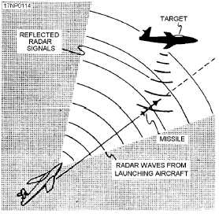
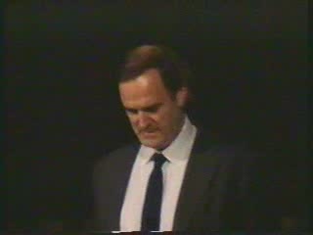
Gordon the Guided Missile

Slide 44
Control Systems
Processes
Inputs
Inputs
Inputs
Command & Control
Processes
Inputs
Inputs
Inputs
Agile Leadership
Outputs

Slide 45
Trust/Ownership Model
Trust
Abdication
Energy & Innovation
How do we
get here?
Zone of
Stable Control
Command & Control
Conflict
Control
Low
Team Ownership
High

Slide 46
Empowered Distributed Teams
Autonomy
Leadership
Domain
Dev
Test
Ownership
Trust

Slide 47

Outsourcing/Distributed Challenges

Slide 48
















Outsourcing Challenge: Proprietary Data

Slide 49
Distributed Challenge: Time Shift
8 hours
12 hours

Slide 50
Distributed Challenge: Time Shift
8 hours
12 hours

Slide 51
Distributed Challenge: Time Shift
8 hours
12 hours

Slide 52

Distributed Challenge: Xenophobia

Slide 53

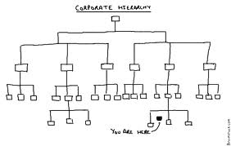
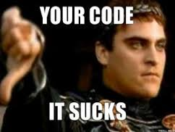
Outsourcing Challenge: Transparency and Honesty

Slide 54
Key Take Aways
  Software Quality
  Build Quality in
  Find and Correct Defects Early to Reduce Uncertainty
  A Testing Strategy Helps to Maximize Efficiency
  Test Automation Helps to Maintain Velocity
  Test Automation Does not Replace Exploratory Testing
  Action Based Testing Reduces Test Brittleness
  Distributed Teams
  Distributed Teams Can be Effective
  Autonomy and Feedback Builds Trust and Ownership
  Treat Outsourcer as a Partner
  Distributed Teams are Reality -- Leverage Global Talent

Slide 55

Leverage Global Talent

Slide 56
Think Globally and Optimize the Whole

Slide 57

Contact
Todd Little
  todd.little@ihs.com
  toddelittle@gmail.com
  www.toddlittleweb.com
  www.accelinnova.com
May the Force Be With You

Slide 58




Integrating Offshore Teams
A - Offshore
  Offshore Team Lead
  Domain Specialist
B - Onshore
  Technical Leader/ Coordinator of Offshore team
B - Offshore
  2-3 Developers
  Testers
C – Offshore
  Junior Developers and Testers

