Slide 1
Exploring Little’s Law
Throughput
(Arrival/Departure Rate)
Work In Progress
(Number of Customers)
Lead Time
(Time in System)
Todd Little
Chairman Kanban University

Slide 2
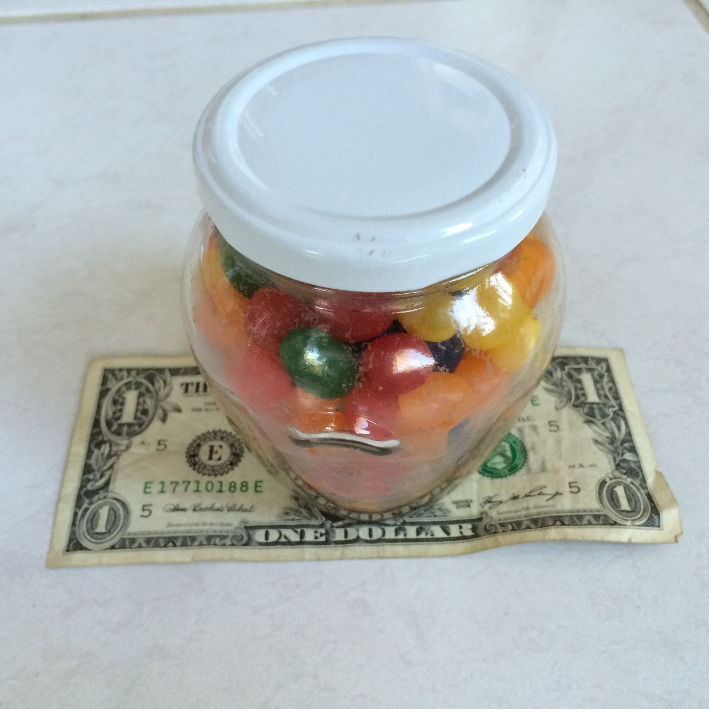
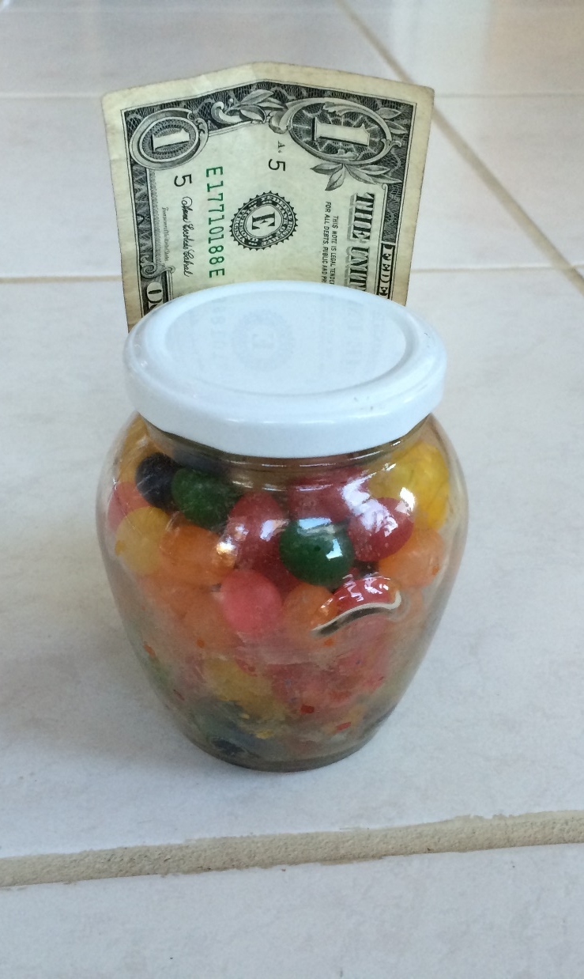
Estimate the # of Jelly Beans
Rules
Quiet
No collaboration
Just a Number
Name
Number

Slide 3
Exploring Little’s Law
Throughput
(Arrival/Departure Rate)
Work In Progress
(Number of Customers)
Lead Time
(Time in System)
Todd Little
Chairman Kanban University

Slide 4
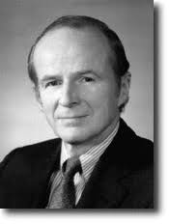
Little’s LλW (John D. C. Little version)
“The average number of customers in a system (over some interval) is equal to their average arrival rate, multiplied by their average time in the system."
L = λW
Average Arrival Rate
Average Length of Queue
Average Wait Time
$$\overline{Delivery Rate}=\frac{\overline{WIP}}{\overline{Lead Time}}$$

Slide 5
Little’s Law in Knowledge Work
Little’s Law Assumptions – The System is Stable and running at capacity
The average Arrival Rate is equal to the average Departure Rate
Throughput
(Arrival/Departure Rate)
Work In Progress
(Number of Customers)
Cumulative Flow Diagrams
Lead Time
(Time in System)
Stable system
WIP increasing
WIP decreasing

Slide 6
Little’s Law in Action

Slide 7
Flow Efficiency, Utilization, and Capacity
Few delays
Traveling time largely determined by delays.
Notes:
Focus the discussion on the time you’ll need through the system.
The cars in the left picture experience no to little delay in their travel, the cars on the right have a lot of delays on their way. Their “lead time” (time to pass the system = the part of the road) is determined largely by the waiting time, not by the time they actually drive.
Therefore, travelling on the left side is preferable, as less time is spent to cover the same mileage.
How does your Kanban Board / your project portfolio look like, and why?
Traditional management paradigms often focus on utilization (using the space available on the highway) rather than flow (getting cars quickly and smoothly through the system).

Slide 8
Summary of Video Results
WIP | Lead Time | Throughput | Flow Efficiency | Utilization
1 | 90 | 0.11 | 1.00 | 0.44
2 | 90 | 0.22 | 1.00 | 0.89
3 | 120 | 0.25 | 0.75 | 1.00
4 | 160 | 0.25 | 0.56 | 1.00
5 | 200 | 0.25 | 0.45 | 1.00

Slide 9
Flow Efficiency, Efficiency, Lead Time and Throughput

Slide 10
What does Little’s Law say about Overburdening?

Slide 11
Design for Flow

Slide 12
Be Like Water - Continuity Equation
Q = A * v
Q = 10 m³/sec A = 5 m² v = 2 m/sec
5x1
5x2
Q = 10 m³/sec A = 10 m²
v = 1 m/sec
10x1
Q = 10 m³/sec A = 10 m² v = 1 m/sec

Slide 13
Be Like Water – College Chem E Version Input – Output = Accumulation
Input
Process
Accumulation
Ouput

Slide 14
Smooth Flow Throughout Optimize the Bottleneck

Slide 15
Kanban System Design for XIT
PTC
Expedite
Development
Testing
User Acceptance
Test
Change
Requests
PM
WIP = ?
WIP = ?
WIP = ?
WIP = ?
WIP = ?
Commitment Point
Product
Managers
Backlog of
Options
Lead time of ? days or less
Notes:
Here is the complete kanban system design for XIT. Note that there is a lead time expectation expressed as 30 days or less. (This slide appears multiple times as a reminder.)

Slide 16
Kanban System Design for XIT
PTC
Expedite
Development
Testing
User Acceptance
Test
Change
Requests
PM
WIP = ?
WIP = ?
Dev Time
Cycle Time
System Lead Time
WIP = ?
WIP = ?
WIP = ?
Commitment Point
Product
Managers
Backlog of
Options
Lead time of ? days or less
Notes:
Here is the complete kanban system design for XIT. Note that there is a lead time expectation expressed as 30 days or less. (This slide appears multiple times as a reminder.)

Slide 17
Design Rules
Start with what data you have. It need not be perfect
Design for the bottleneck
For XIT - Engineering and Test
Throughput is constant through the flow
Queues – large enough to prevent starvation, small enough to keep lead time small
Difference between WIP Limit and Average WIP

Slide 18
Let’s get started

Slide 19
Little’s LλW (John D. C. Little version)
$$\overline{Delivery Rate}=\frac{\overline{WIP}}{\overline{Lead Time}}$$
Not Little’s Law, but sometimes useful
$$\overline{Delivery Rate}=\frac{Max WIP}{Max Lead Time}$$
$$Min Delivery Rate=\frac{\overline{WIP}}{Max Lead Time}$$

Slide 20
Little’s Law @XIT
 | System |  | Ready | Dev | Dev Done | Test | UAT
Ave Throughput
WIP Average
Ave Lead Time
WIP Limit
Max Lead Time

Slide 21
Determining an Expectation of Service Delivery
Engineering effort (touch time)
Average engineering time was 11 days with outliers > 24 days
Demand rate is 10-12 CR per month – can we meet it?
Throughput
Work In Progress
Lead Time
Notes:
The XIT group determined their current engineering delivery rate and the expectation (hypothesis) of the engineering delivery rate if they removed estimation.

Slide 22
Little’s Law @XIT
 | System |  | Ready | Dev | Dev Done | Test | UAT
Ave Throughput
WIP Average |  |  |  | 3 |  | 3
Ave Lead Time |  |  |  | 5.5 |  | 5.5
WIP Limit |  |  |  | 3 |  | 3
Max Lead Time |  |  |  | 12 |  | 12

Slide 23
Determining an Expectation of Service Delivery
Engineering effort (touch time)
Average engineering time was 11 days with outliers > 24 days
Demand rate is 10-12 CR per month – can we meet it?
Delivery rate estimate
Without estimation interruptions or multitasking, we have:
WIP = 6 (3 dev + 3 test)
Average Lead Time = 11 days
$Average Throughput= \frac{Average WIP}{Average LT}$ $= \frac{6}{11}=$ 0.55 items/day $=$ 11 items/mo
Queuing & buffering time estimates
Queues: large enough to prevent starvation, small enough to keep Lead Time small.
Throughput
Work In Progress
Lead Time
Notes:
The XIT group determined their current engineering delivery rate and the expectation (hypothesis) of the engineering delivery rate if they removed estimation.

Slide 24
Little’s Law @XIT
 | System |  | Ready | Dev | Dev Done | Test | UAT
Ave Throughput |  |  |  | 0.55 |  | 0.55
WIP Average |  |  |  | 3 |  | 3
Ave Lead Time |  |  |  | 5.5 |  | 5.5
WIP Limit |  |  |  | 3 |  | 3
Max Lead Time |  |  |  | 12 |  | 12

Slide 25
Be Like Water – College Chem E Version Input – Output = Accumulation
Input
Process
Accumulation
Ouput

Slide 26
Little’s Law @XIT - Smooth flow throughout
 | System |  | Ready | Dev | Dev Done | Test | UAT
Ave Throughput | 0.55 |  | 0.55 | 0.55 | 0.55 | 0.55 | 0.55
WIP Average |  |  |  | 3 |  | 3
Ave Lead Time |  |  |  | 5.5 |  | 5.5
WIP Limit |  |  |  | 3 |  | 3
Max Lead Time |  |  |  | 12 |  | 12

Slide 27
Queues and WIP limits
Ready Queue
Replenishment will be weekly.
Allow 2X buffer to prevent starvation
What is Starting WIP, Ending WIP, Average WIP?
Average Throughput of 2.7 items/week ( 5 x 0.55 )
Start with WIP limit of 5 to allow 2x buffer
Beginning WIP of 5, Ending Average WIP of 5-2.7=2.3
Average WIP of 5-(5-2.7)/2 = 3.65

Slide 28
Little’s Law @XIT - Replenishment
 | System |  | Ready | Dev | Dev Done | Test | UAT
Ave Throughput | 0.55 |  | 0.55 | 0.55 | 0.55 | 0.55 | 0.55
WIP Average |  |  | 3.65 | 3 |  | 3
Ave Lead Time |  |  | 6.6 | 5.5 |  | 5.5
WIP Limit |  |  | 5 | 3 |  | 3
Max Lead Time |  |  | 10 | 12 |  | 12

Slide 29
Queues and WIP limits
Dev Done Queue
3 items will be in Test with average Lead Time of 6 days.
How frequent does a Test slot free up?
On average, Test will free one slot every 2 days
Assume average Lead Time of 2 in Dev Done Queue

Slide 30
Little’s Law @XIT - Dev Done Buffer
 | System |  | Ready | Dev | Dev Done | Test | UAT
Ave Throughput | 0.55 |  | 0.55 | 0.55 | 0.55 | 0.55 | 0.55
WIP Average |  |  | 3.65 | 3 | 1.1 | 3
Ave Lead Time |  |  | 6.6 | 5.5 | 2 | 5.5
WIP Limit |  |  | 5 | 3 | 2 | 3
Max Lead Time |  |  | 10 | 12 | 3.6 | 12

Slide 31
Queues and WIP limits
UAT
Max Lead Time of 10 days.
WIP Limit of 10 * 0.55 = 5.5 – round up to 6
Assume Average WIP of ½ limit = 3

Slide 32
Little’s Law @XIT - UAT Buffer
 | System |  | Ready | Dev | Dev Done | Test | UAT
Ave Throughput | 0.55 |  | 0.55 | 0.55 | 0.55 | 0.55 | 0.55
WIP Average |  |  | 3.65 | 3 | 1.1 | 3 | 3
Ave Lead Time |  |  | 6.6 | 5.5 | 2 | 5.5 | 5.5
WIP Limit |  |  | 5 | 3 | 2 | 3 | 6
Max Lead Time |  |  | 10 | 12 | 3.6 | 12 | 10

Slide 33
Little’s Law @XIT - System
 | System |  | Ready | Dev | Dev Done | Test | UAT
Ave Throughput | 0.55 |  | 0.55 | 0.55 | 0.55 | 0.55 | 0.55
WIP Average | 13.7 |  | 3.65 | 3 | 1.1 | 3 | 3
Ave Lead Time | 25.1 |  | 6.6 | 5.5 | 2 | 5.5 | 5.5
WIP Limit | 19 |  | 5 | 3 | 2 | 3 | 6
Max Lead Time | 47.6 |  | 10 | 12 | 3.6 | 12 | 10

Slide 34
Can we meet a target Lead Time of 30 days with a high (98%) Service Expectation?
What knobs might you tweak to help meet the SLE?
 | System |  | Ready | Dev | Dev Done | Test | UAT
Ave Throughput | 0.55 |  | 0.55 | 0.55 | 0.55 | 0.55 | 0.55
WIP Average | 13.7 |  | 3.65 | 3 | 1.1 | 3 | 3
Ave Lead Time | 25.1 |  | 6.6 | 5.5 | 2 | 5.5 | 5.5
WIP Limit | 19 |  | 5 | 3 | 2 | 3 | 6
Max Lead Time | 47.6 |  | 10 | 12 | 3.6 | 12 | 10

Slide 35
Kanban System Design for XIT
PTC
Expedite
Development
Testing
User Acceptance
Test
Change
Requests
PM
WIP = 5
WIP = 5
WIP = 3
WIP = 3
WIP = 6
Commitment Point
System will stall in approximately
2 weeks if not serviced
Product
Managers
Backlog of
Options
Lead time of 30 days or less
Notes:
Here is the complete kanban system design for XIT. Note that there is a lead time expectation expressed as 30 days or less. (This slide appears multiple times as a reminder.)

Slide 36
Forecasting with Little’s Law

Slide 37
Let’s play a game

Slide 38
Google Spreadsheet
Old School
bit.ly/3PGymF9
Little's Law Tally Sheet
Y(cards) |  |  |  | X | Y(points) | =Cum Actual (E)*132 / Cum Size (F) | =Cum Actual (E) *20 / # Cards (A)
Card | Size | Die roll | Actual Time | Cummulative Actual | Cummulative Size | Size Forecast | Count Forecast
1
2
3
4
5
6
7
8
9
10
11
12
13
14
15
16
17
18
19
20

Slide 39
Serious Old School
Little's Law Tally Sheet
Y(cards) |  |  |  | X | Y(points) | =Cum Actual (E)*132 / Cum Size (F) | =Cum Actual (E) *20 / # Cards (A)
Card | Size | Die roll | Actual Time | Cummulative Actual | Cummulative Size | Size Forecast | Count Forecast
1
2
3
4
5
6
7
8
9
10
11
12
13
14
15
16
17
18
19
20

Slide 40
Per Table
Deck of Cards
Adjustment Table
 | Card Value
Die | 2 | 3 | 5 | 8 | 13 | 20
1 | 1 | 2 | 3 | 4 | 8 | 13
2 | 1 | 2 | 4 | 6 | 10 | 16
3 | 2 | 3 | 5 | 8 | 13 | 20
4 | 2 | 3 | 5 | 8 | 13 | 20
5 | 4 | 6 | 7 | 11 | 16 | 25
6 | 6 | 8 | 10 | 16 | 22 | 30

Slide 41
Per person
Little's Law Tally Sheet
Y(cards) |  |  |  | X | Y(points) | =Cum Actual (E)*132 / Cum Size (F) | =Cum Actual (E) *20 / # Cards (A)
Card | Size | Die roll | Actual Time | Cummulative Actual | Cummulative Size | Size Forecast | Count Forecast
1
2
3
4
5
6
7
8
9
10
11
12
13
14
15
16
17
18
19
20

Slide 42
Background
Each card represents a story in the backlog.
They have been estimated through rigorous Planning Poker
We will process cards sequentially,
but each table will have a different order
Please shuffle the deck of cards (but not after each draw)
Cards will then be pulled sequentially
Each person will implement the story by rolling their die
The die will tell us how accurate the estimate was and how long it really takes

Slide 43
Example: Draw a card to be used by everyone at the table
13
Now each person rolls their die

Slide 44
Adjustment Table
 | Card Value
Die | 2 | 3 | 5 | 8 | 13 | 20
1 | 1 | 2 | 3 | 4 | 8 | 13
2 | 1 | 2 | 4 | 6 | 10 | 16
3 | 2 | 3 | 5 | 8 | 13 | 20
4 | 2 | 3 | 5 | 8 | 13 | 20
5 | 4 | 6 | 7 | 11 | 16 | 25
6 | 6 | 8 | 10 | 16 | 22 | 30

Slide 45
Little's Law Tally Sheet
Y(cards) |  |  |  | X | Y(points) | =Cum Actual (E)*132 / Cum Size (F) | =Cum Actual (E) *20 / # Cards (A)
Card | Size | Die roll | Actual Time | Cummulative Actual | Cummulative Size | Size Forecast | Count Forecast
1 | 13 | 5 | 16 | 16 | 13
2
3
4
5
6
7
8
9
10
Card
Lookup
Sum Size
Die
Sum Actual

Slide 48
Google Spreadsheet
Old School
bit.ly/3PGymF9
Little's Law Tally Sheet
Y(cards) |  |  |  | X | Y(points) | =Cum Actual (E)*132 / Cum Size (F) | =Cum Actual (E) *20 / # Cards (A)
Card | Size | Die roll | Actual Time | Cummulative Actual | Cummulative Size | Size Forecast | Count Forecast
1
2
3
4
5
6
7
8
9
10
11
12
13
14
15
16
17
18
19
20

Slide 49
Let’s do 1 card Draw a card to be used by everyone at the table
?
Now each person rolls their die

Slide 50
Task switching – Sometimes batches are better
Run through 5 cards recording on the Tally Sheet
Calculate the Forecast based on the trends of the first 5 cards
Size Forecast = Cum Actual (E)*132 / Cum Size (F)
Count Forecast = Cum Actual (E) *20 / # Cards (A)
Continue with the remaining 15 cards in batches of 5
Old School – plot away

Slide 51
Forecasting
132 total points in 20 total cards
132
Cumulative Size
Forecast (size) = Cumulative Actual * 132/ Cumulative Size
20
Cumulative Actual
# Cards
Forecast (card) = Cumulative Actual * 20/ # Cards
Cumulative Actual

Slide 52
Little's Law Tally Sheet
Y(cards) |  |  |  | X | Y(points) | =Cum Actual (E)*132 / Cum Size (F) | =Cum Actual (E) *20 / # Cards (A)
Card | Size | Die roll | Actual Time | Cumulative Actual | Cumulative Size | Size Forecast | Count Forecast
1 | 13 | 5 | 16 | 16 | 13
2 | 5 | 3 | 5 | 21 | 18
3 | 8 | 2 | 6 | 27 | 26
4 | 2 | 6 | 6 | 33 | 28
5 | 5 | 1 | 3 | 36 | 33 | 144 | 144
6
7
8
9
10

Slide 53
Final Summary
Card | Size | Die roll | Actual Time | Cumulative Actual | Cumulative Size | Size Forecast | Count Forecast
5
10
15
20

Slide 54
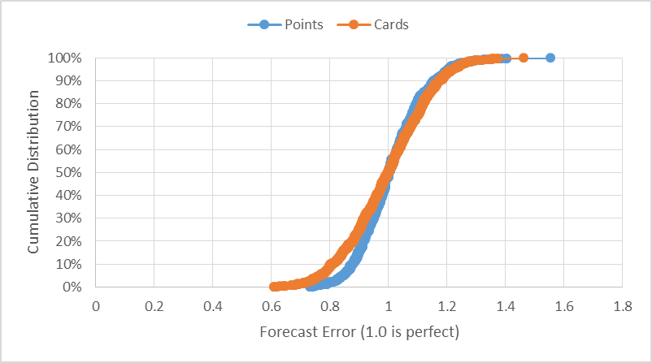
Monte Carlo Simulation Results

Slide 55
Data needs to be Thin-tailed for Little’s Law
P90/P10 <20

Slide 56
Estimate the # of Jelly Beans

