Slide 1
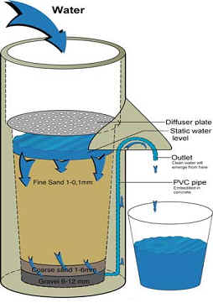
Is your Strategy a Bucket or a Filter?
Todd Little

Slide 2
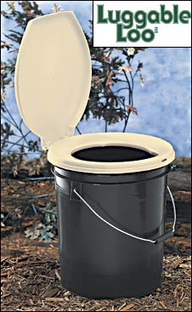
Bad Strategies (Rumelt)
Fluff
Failure to face the problem
Mistaking goals for strategy
Fuzzy or overly complex strategic objectives
“increase market share”
"our fundamental strategy is one of customer-centric intermediation."
“reaching for the impossible to do the impossible"
47 strategies and 178 action items.
Action item number 122 was 'create a strategic plan.’

Slide 3
More Crap
We will be the graphics arts services firm of choice.
We will delight our customers with unique and creative solutions to their problems.
We will grow revenue by at least 20% each year.
We will maintain a profit margin of at least 20%.
We will have a culture of commitment. Corporate goals are commitments we all work to keep.
We will foster an honest and open work environment.
We will work to support the broader community in which we operate.

Slide 4
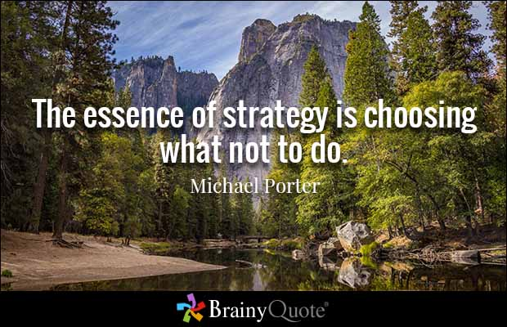

Slide 5
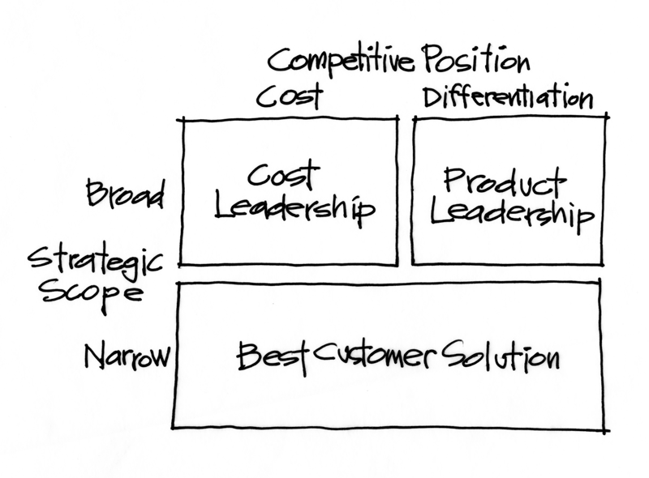
Start with Market Positioning (Tracey & Wiersma)

Slide 6
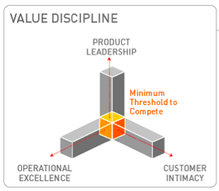
Start with Market Positioning (Tracey & Wiersma)

Slide 7
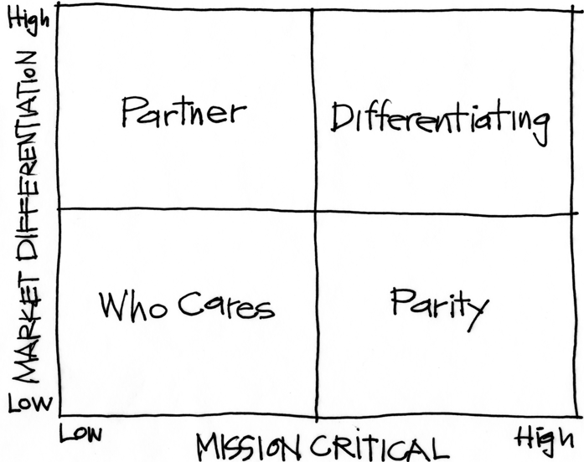
Purpose Alignment Model (Nickoliasen)
Notes:
[Purpose of slide] [#]
[Information]

Slide 8
Purpose Alignment Model (Nickoliasen)
CAN WE
CREATE A
DIFFERENTIATED
PARTNERSHIP?
INNOVATE,
CREATE
ACHIEVE AND
MAINTAIN PARITY, MIMIC, SIMPLIFY
MINIMIZE /
ELIMINATE
Notes:
[Purpose of slide] [#]
[Information]

Slide 9
Applicable at all Levels
Corporate Strategy
Product Strategy
Feature

Slide 10
A View of Strategy - Apple
10
NEW PRODUCT DESIGN
USER EXPERIENCE
CONTENT DISTRIBUTION
ATT
MS OFFICE
INTEL HARDWARE
OTHER SOFTWARE
PERIPHERALS
Notes:
10
[Purpose of slide] [#]
[Information]
© International Institute of Business Analysis®

Slide 11
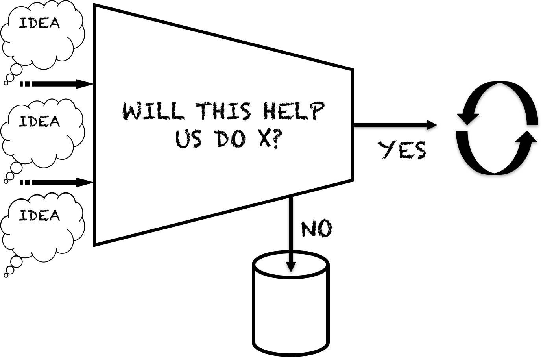
Decision Filters

Slide 12
Purpose Filter
Idea
Idea
Partner | Invest
Who Cares | Parity
Critical
Items
Roughly
Estimate
Values and
Costs
Prioritize
By
Value/Cost
Idea
Prioritize
Idea
Strategic
Fit
Other
Release
Backlog
Idea
Idea
Non-
Economic
Non-
Strategic

Slide 13
Is your Strategy a Bucket or a Filter?

Slide 14
Contact
Todd Little
toddelittle@gmail.com
www.toddlittleweb.com
www.accelinnova.com
www.linkedin.com/in/toddelittle/en

