Slide 1

Agile Leadership: Accelerating Business Agility
Context
Kent J. McDonald
kent@kbp.media
Todd Little
toddelittle@gmail.com
Niel Nickolaisen
nnick@octanner.com
Materials:
www.kbp.media/agile-leadership
Notes:
Presentation description

Slide 2
Once you categorize your projects according to their complexity and uncertainty, you can adapt your process by adding practices according to each project's profile.
-Todd Little

Slide 3




All projects are not created equal
Notes:
Photo Credits:
https://unsplash.com/@robertalvesj
https://unsplash.com/@lokeland
https://unsplash.com/@mike

Slide 4

Complexity
Size
Team
Dependencies
Notes:
Complexity is a measure of the size of the project, the dependencies of the project, and the nature of the project team.
Project Size
Project Dependencies
Project Team

Slide 5

Uncertainty
Known and unknown
Shifts in customer needs
Shifts in technological implementation
Notes:
Uncertainty is an indicator of what is known and what is not known about the project; it can include shifts in either the customer needs or the technological implementation
Known and unknown
Shifts in customer needs
Shifts in technological implementation

Slide 6
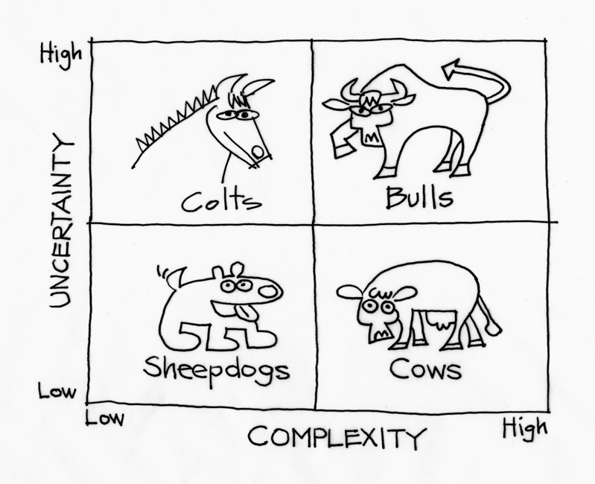
Context Leadership Model

Slide 7

CLEARLY DEFINED SCOPE
PROCESS CEREMONY UNNECESSARY
LET TEAM DO THEIR JOB AND PRODUCE RESULT
MINIMAL CORE SET OF PRACTICES
Notes:
Clearly defined scope
Let team do their job and produce result
Process ceremony unnecessary
Minimal core set of practices

Slide 8

BUSINESS/ TECHNICAL UNCERTAINTY
MINIMIZE PROCESS
CONTINUAL AND RAPID FEEDBACK
SMALL TEAM CLOSE TOGETHER
Notes:
Simple Projects with High Uncertainty
Business/technical uncertainty
Small team close together
Minimize process
Continual and rapid feedback
Keep process ceremony and documentation to minimum needed by team
Continual and rapid feedback
Leader needs strong connection
to source of uncertainty

Slide 9

MATURE SYSTEMS
RIGROUS REQUIREMENTS
LARGE PROJECT TEAMS
PUBLISHED INTERFACES
DISCIPLINED CHANGE CONTROL
INTEGRATION OF SEVERAL SHEEPDOGS
Notes:
Complex Projects with Low Uncertainty
Mature systems
Large project teams
Disciplined change control
Rigorous requirements
Published interfaces
Integration of several sheepdogs
Mature systems that are important to the business
Large project teams
Disciplined change control and rigorous requirements
Defined and published
interfaces
Often integration projects
involving a number of sheepdogs.

Slide 10
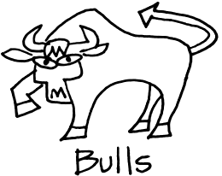
EMBRACE CHANGE THROUGH ITERATIVE FEEDBACK
REQUIRE BEST, MOST SEASONED LEADERS
UNDERSTAND BUSINESS TECHNOLOGY PEOPLE AND PROCESS
EFFICIENT COMMUNICATION CHANNELS
NEXT GENERATION PRODUCTS
Notes:
Complex Projects with High Uncertainty
Embrace change through iterative feedback
Efficient communication channels
Next-generation products
Require best, most
seasoned leaders
Understand business,
technology, people, and
process
Embrace change through iterative feedback
Efficient communication channels
Often next-generation products or solutions
Require best, most
seasoned leaders
Understand business,
technology, people, and
process

Slide 11
Complexity Drivers
Attribute | Low Complexity (1) | Medium Complexity (3) | High Complexity (9)
Core Team Size | 2 | 15 | 100
Mission Critical | Speculative | Established market | Safety critical significant monetary exposure
Team location | Same room | Within same building | Multisite, worldwide
Team maturity | Established teams of experts | Mixed team of experts and novices | New team of mostly novices
Domain knowledge gaps | Developers know the domain as well as expert users | Developers require some domain assistance | Developers have no idea about the domain
Dependencies | No dependencies | Some dependencies | Tight integration with several projects

Slide 12
Uncertainty Drivers
Attribute | Low Uncertainty (1) | Medium Uncertainty (3) | High Uncertainty (9)
Market uncertainty | Known deliverable, possible defined contractual agreement | Initial guess of market target is likely to require steering | New market that is unknown and untested
Technical uncertainty | Enhancements to existing architecture | We’re not quite sure if we know how to build it | New technology, new architecture; some research may be required
Number of customers | Internal customer or one well-defined customer | Multiple internal or small number of defined customers | Shrink-wrapped software
Project duration | 0 – 3 months | 3 – 12 months | >12 Months
Approach to change | Significant control over change | Moderate control over change | Embrace or create change

Slide 13
Exercise – Name the Species
PROJECT
PROJECT
PROJECT
PROJECT
PROJECT
PROJECT
PROJECT
Project
PROJECT
PROJECT
PROJECT
Notes:
Pick one of your current or previous projects. Determine how the project should be classified:
Sheepdog
Colt
Cow
Bull
Place a sticky note with the project name on the 2x2 Matrix.
Be prepared to share with the group why you classified the projects as you did.

Slide 14
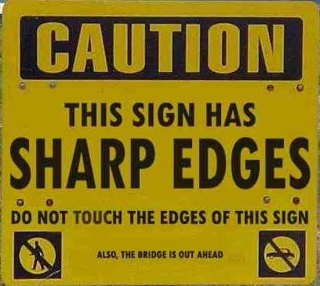
Addressing Risk

Slide 15
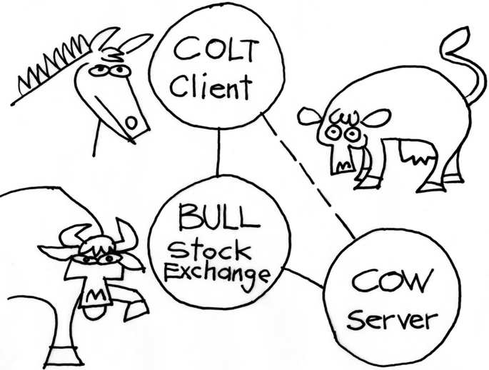
Deal with complexity through partitioning

Slide 16

Team Size
Split teams into smaller cohesive groups
Shared understanding
Bring teams together
Notes:
Attribute
Ways to lower the attribute and reduce risk
Process steps to mitigate
Team size
Split teams into smaller cohesive groups
Make sure teams have shared understanding of their purpose and the overall project success criteria. Bring teams together at regular intervals. Define, communicate, test, and manage project interfaces.

Slide 17

Mission Critical
Make decisions and status visible to all stakeholders
Ensure stakeholders understand consequences of decisions
Notes:
Mission critical
Not easy to reduce
Make critical decisions and overall project status visible to all stakeholders. Ensure that stakeholders understand the consequences of key decisions

Slide 18
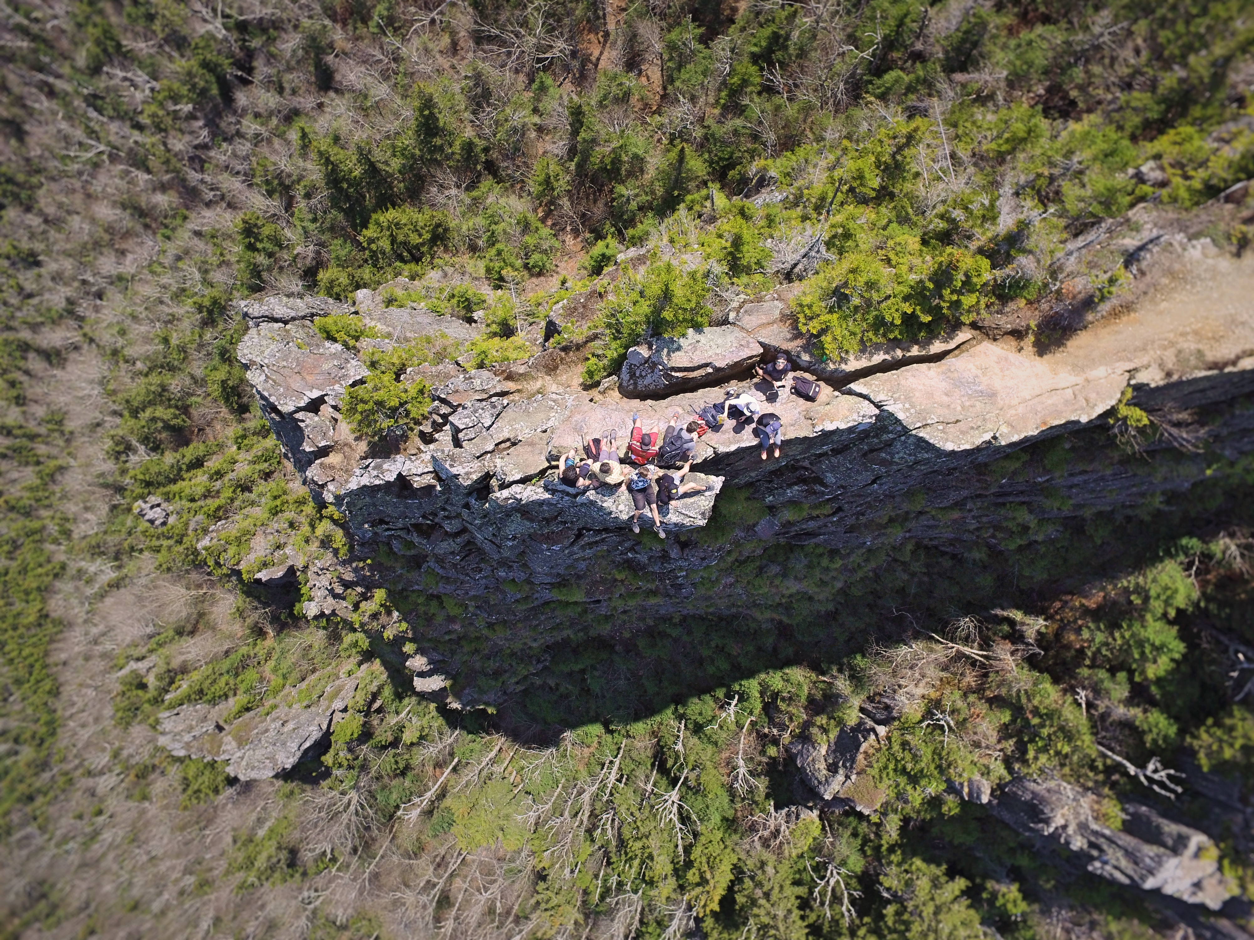
Team Location
Collocate
Frequent Face-to-face contact
High bandwidth collaboration tools
Notes:
Team location
Collocate the team if possible
Bring team members into face-to-face contact often. Invest in high bandwidth communication and collaboration tools.

Slide 19

Team Maturity
Mentor new team members
Keep experienced teams whole
Train and improve entire team
Notes:
Photo Credit: https://unsplash.com/@flenjoore
Keep experienced teams whole
Mentor new team members
Train and improve entire team

Slide 20

Domain Gaps
Staff team with domain experts
Educate team on domain
Allow team to experience domain
Notes:
Photo Credit: https://unsplash.com/@jadlimcaco
Staff team with domain experts
Educate team on domain
Allow team to experience domain

Slide 21

Dependencies
Build static versions of dependencies
Communicate with teams that depend on you
Be clear about progress
Notes:
Photo Credit: https://unsplash.com/@heytowner
Build static versions of dependencies
Communicate with teams that depend on you
Be clear about progress

Slide 22
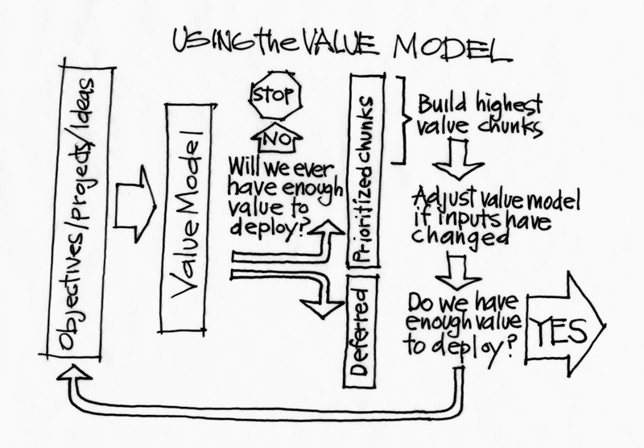
Deal with uncertainty via incremental delivery
Notes:
See Working versions
Reflect on development process
Make adjustments

Slide 23

Market Uncertainty
Deliver iteratively
Target a known market segment
Elicit stakeholder feedback regularly
Notes:
Photo Credit:
Target a known market segment
Deliver iteratively
Elicit stakeholder feedback regularly

Slide 24

Technical Uncertainty
Use familiar & proven technologies
Design flexibility in
Conduct experiments to gain information
Delay decisions
Notes:
Photo Credit: https://unsplash.com/@punttim
Use familiar & proven technologies.
Design flexibility in
Delay decisions
Conduct experiments to gain information

Slide 25

Number of customers
Target a specific group of customers.
Use a product champion
Use the Purpose Alignment Model as a filter.
Notes:
Photo Credit: https://unsplash.com/@igorovsyannykov
Target a specific group of customers.
Use a product champion
Use the Purpose Alignment Model as a filter.

Slide 26

Project Duration
Deliver incrementally
Shorten the duration
Notes:
Photo Credit: https://unsplash.com/@mili_vigerova
Shorten the duration
Deliver incrementally

Slide 27

Change
Delay decisions
Exert control over high impact changes
Utilize incremental delivery and feedback
Avoid committing to too much detail early.
Notes:
Photo Credit: https://unsplash.com/@aaronburden
Exert control over high impact changes
Delay decisions
Utilize incremental delivery and feedback
Avoid committing to too much detail early.

Slide 28
Tailoring project method
PROCESS FOR COMPLEXITY, ITERATIVE DELIVERY FOR UNCERTAINTY
ITERATIVE DELIVERY,
MINIMAL PROCESS
MINIMAL PROCESS
PROCESS TO MANAGE INTERFACES

Slide 29
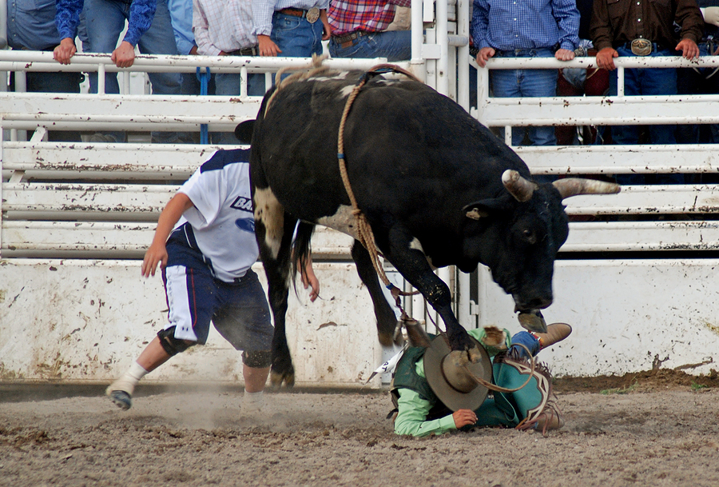
Exercise – How do you train a bull?
Notes:
Each group has been assigned a species of project.
At your table, discuss how you would approach a project of this type.
If it helps, think of the projects you classified earlier.
Be prepared to explain your answer.

Slide 30

How to tailor your project
Understand the characteristics of your project
Define the expected deliverables based on risks
Determine best approach
Identify opportunities for help/mentoring
Notes:
Photo Credit: https://unsplash.com/@patrykgradyscom
Understand the characteristics of your project
Determine best approach
Define the expected deliverables based on risks
Identify opportunities for help/mentoring

Slide 31
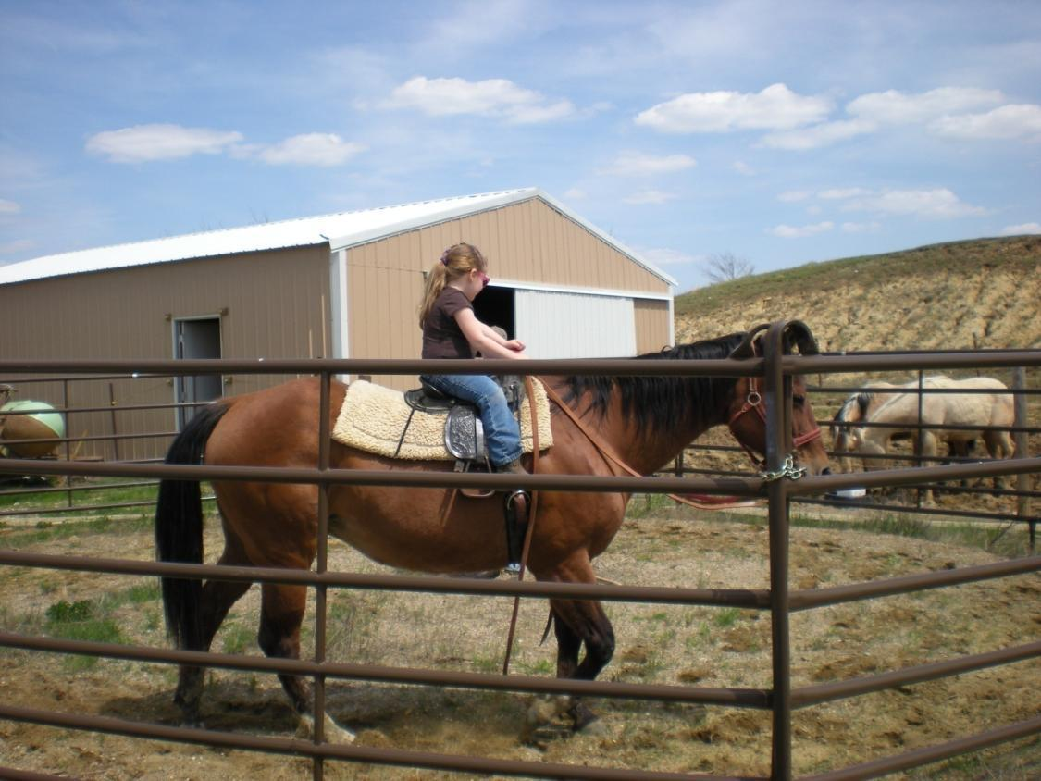
Best leader for this “project”?

Slide 32
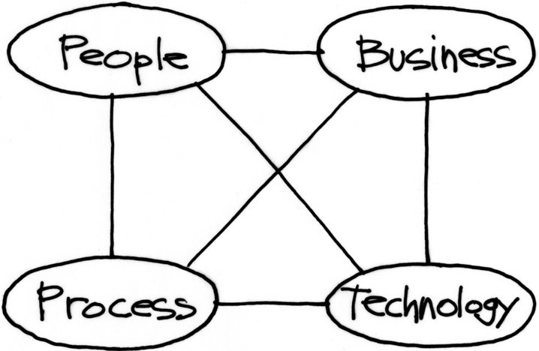
Skill areas exhibited by project leaders
THE ABILITY TO COORDINATE AND LEAD PEOPLE
CONNECTING TO AND COMPREHENDING THE BUSINESS DRIVERS
UNDERSTANDING THE APPROPRIATE PROCESSES TO GET THE JOB DONE
UNDERSTANDING THE TECHNOLOGY USED TO DEVELOP THE SOLUTIONS

Slide 33
Skills required by project quadrant
 | People | Process | Technology | Business
Sheepdog | Novice | Novice | Novice | Novice
Colt | Novice | Novice | Practitioner | Practitioner
Cow | Practitioner | Practitioner | Novice | Novice
Bull | Master | Practitioner | Practitioner | Practitioner

Slide 34
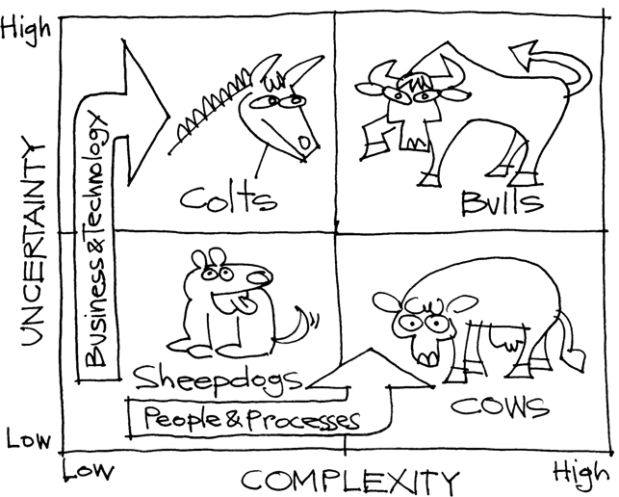
Leadership Development

Slide 35
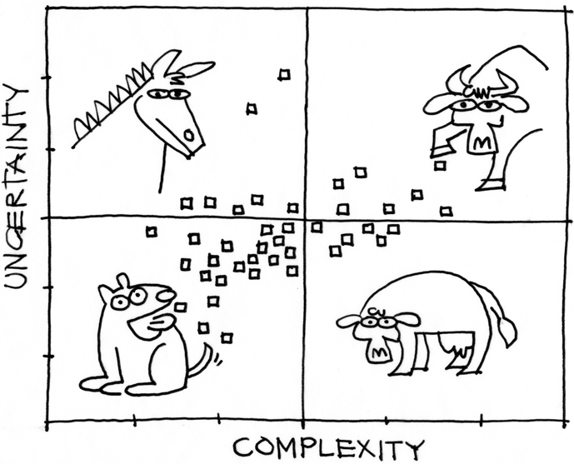
Portfolio Assessment

Slide 36
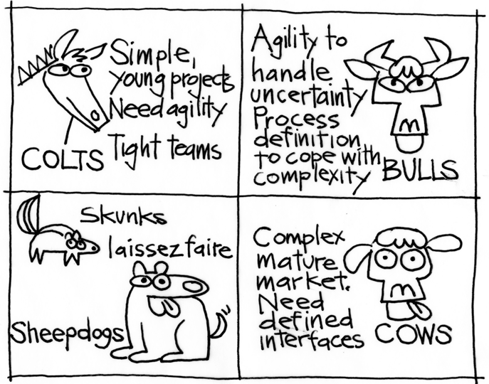
In summary…

Slide 37
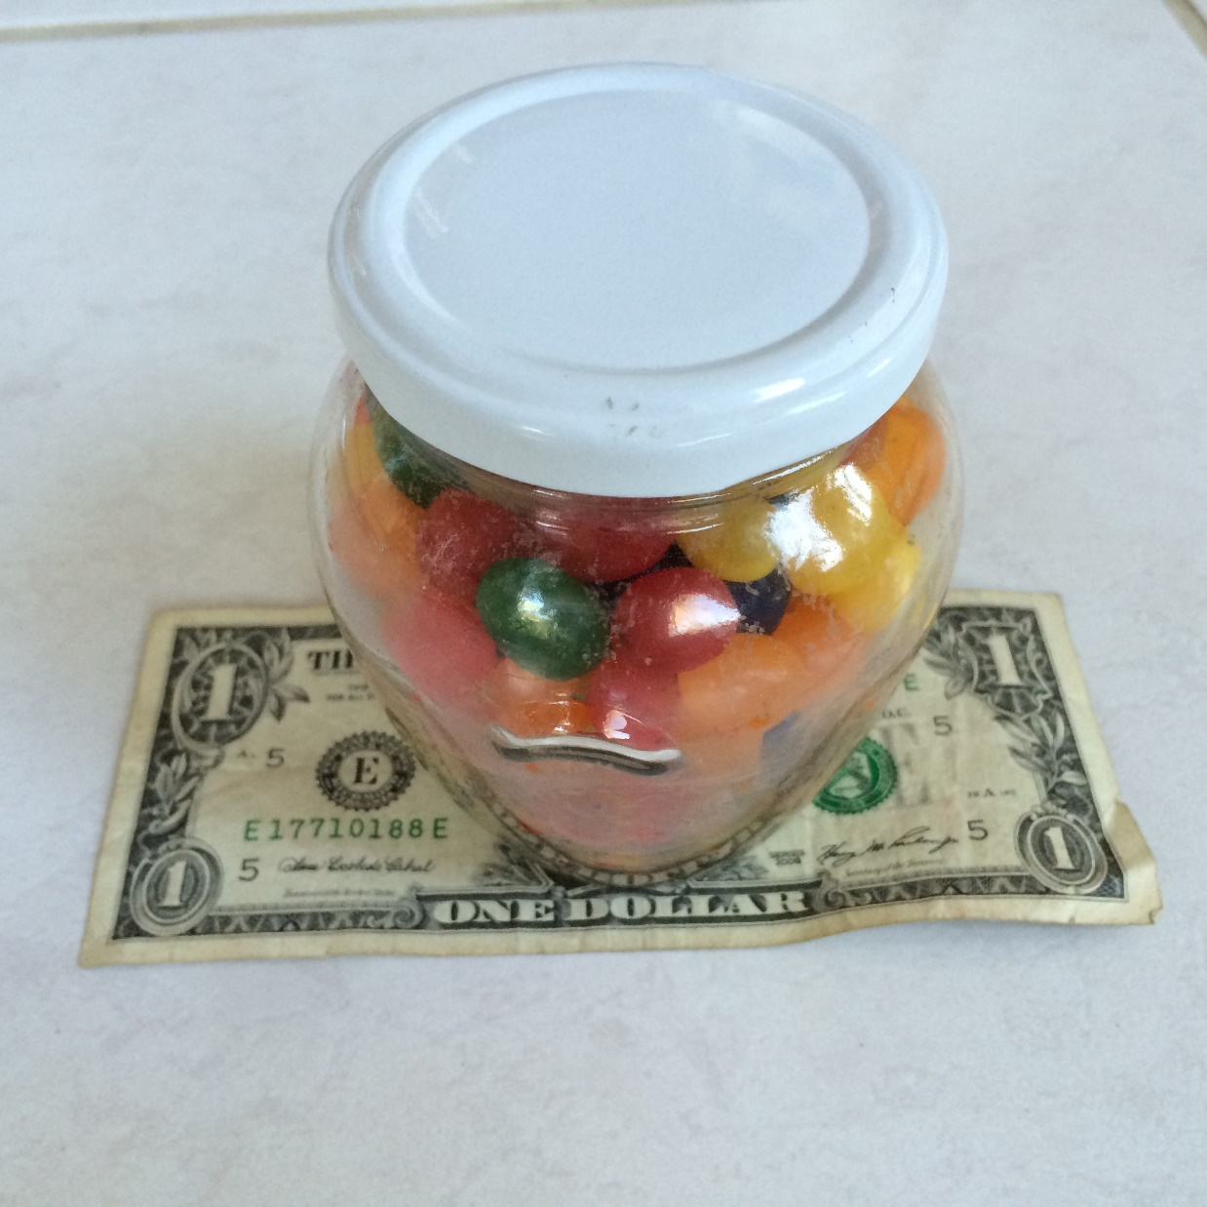
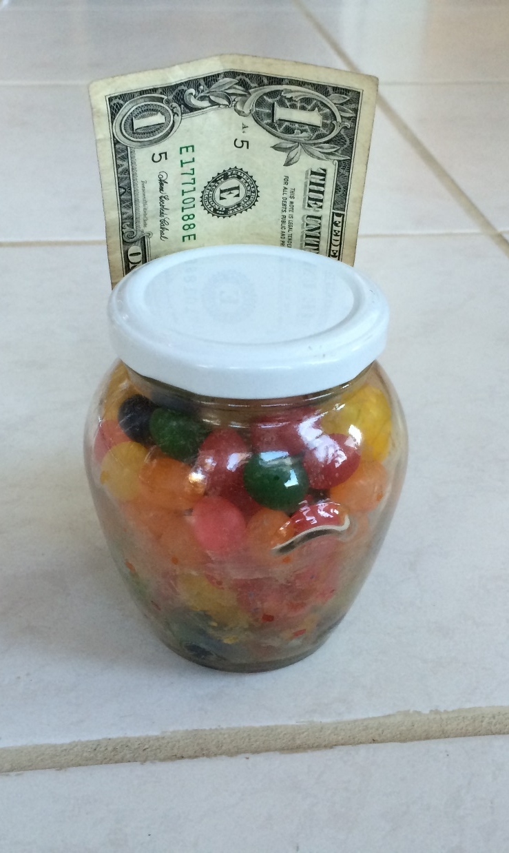
Estimate the # of Jelly Beans

Slide 38
Fools ignore complexity.
Pragmatists suffer it.
Some can avoid it.
Geniuses remove it.
-Alan Perlis
Notes:
Alan Jay Perlis was an American computer scientist and professor at Yale University known for his pioneering work in programming languages and the first recipient of the Turing Award.

Slide 39
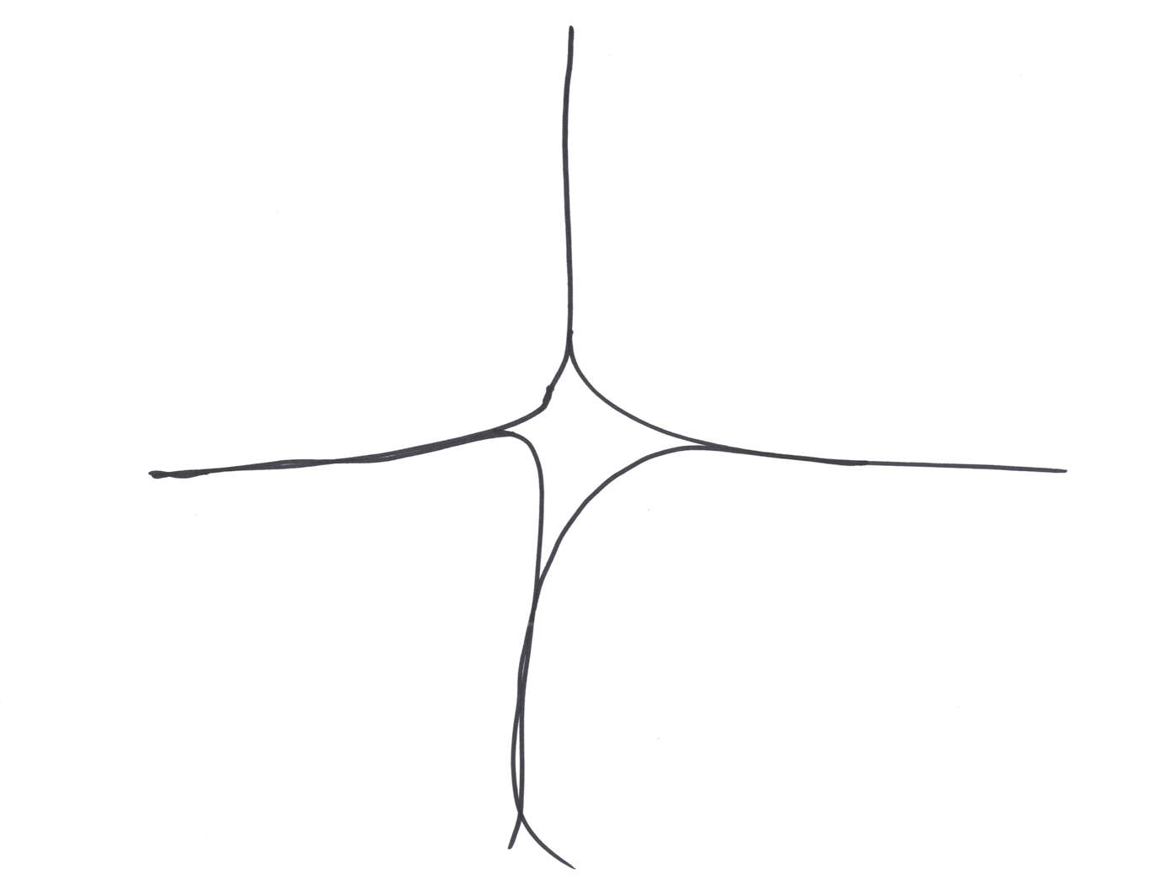
Cynefin
unordered
ordered
THE CAUSE-EFFECT
RELATIONSHIP CAN BE LEARNED ONLY IN RETROSPECT
COMPLEX
CAUSE AND EFFECT ARE
SEPARATED IN TIME AND
SPACE AND CAN BE
RESEARCHED
COMPLICATED
CHAOTIC
NO CAUSE-EFFECT
RELATIONSHIP CAN BE
PERCEIVED
OBVIOUS
THE CAUSE-EFFECT
RELATIONSHIP IS
REPEATABLE AND
PREDICTABLE
Based on work by Dave Snowden
Notes:
Inspired by https://www.flickr.com/photos/aroberts/119747544

Slide 40

Obvious
Distribution
Input
Output
Cause and Effect Obvious to all
Known - Knowns
Sense - Categorize - Respond
apply best practice
Example: Manufacturing

Slide 41
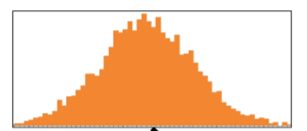
Complicated
Analysis
Input
Output
Distribution
Cause and Effect Requires Analysis
Known - Unknowns
Sense - Analyze – Respond
apply good practice
Example: Incremental Product Development

Slide 42
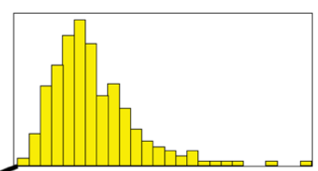
Complex
Distribution
Input
Output
Cause and Effect perceived in retrospect
Unknown - Unknowns
Probe - Sense – Respond
sense emergent practice
Example: New Product Development

Slide 43
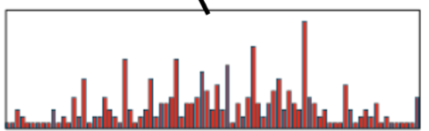
Chaotic
Output
Distribution
Input
No Relationship between Cause and Effect
Unknowables
Act - Sense - Respond
discover novel practice.
Example: Medical Emergency

Slide 44

Photo Credits
Images from
Unsplash.com
Stand Back and Deliver (Jim Lewis, illustrator)

Slide 45
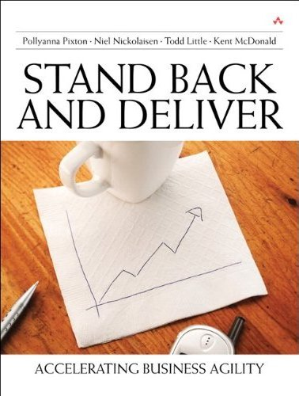
Questions?
Kent J. McDonald
kent@kbp.media
Todd Little
toddelittle@gmail.com
Niel Nickolaisen
nnick@octanner.com
More Info:
www.kbp.media/agile-leadership

