Slide 1

Performance Reviews that don’t Suck
Todd Little, CEO Lean Kanban

Slide 2
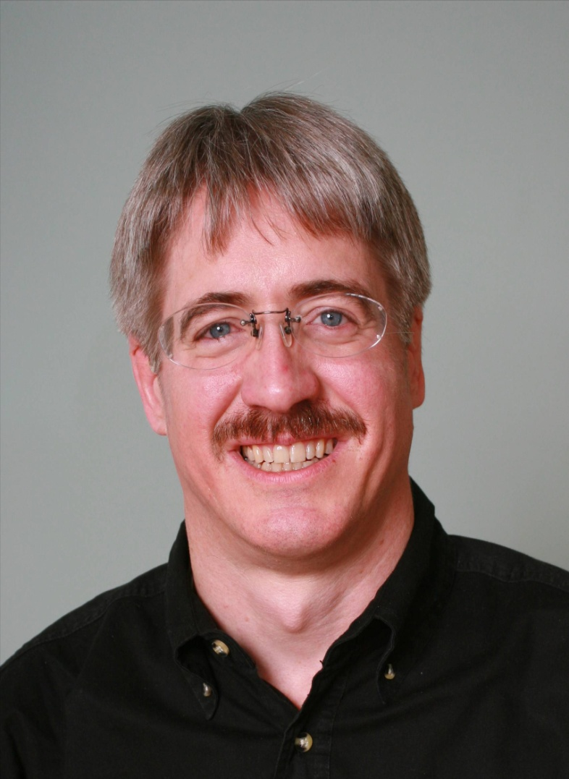




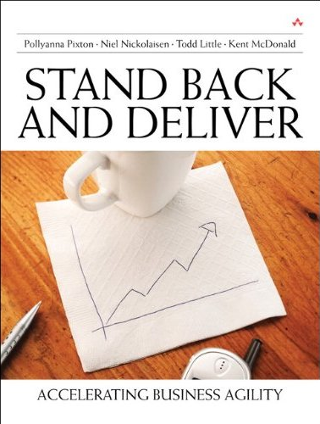



About Todd and Andrew Tuttle
CEO at Lean Kanban
Executive roles as VP Product Development, Director of Software & Technology
@toddelittle
Executive Director of Product Development
10 years of people management experience
Notes:
Director – company called IHS until a few days ago
Just merged – 9,000 – 15,000
Information & analytics company, verticals
Performance reviews 10 years – mistake
Stopped laughing – launch
3 years ago – working off and on

Slide 3
Audience Participation
Who loves performance reviews?
What challenges have you seen with performance reviews?
What have you seen that has worked well with your performance reviews?

Slide 4
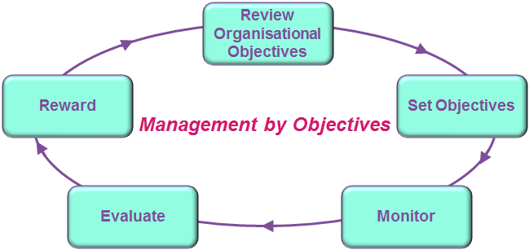
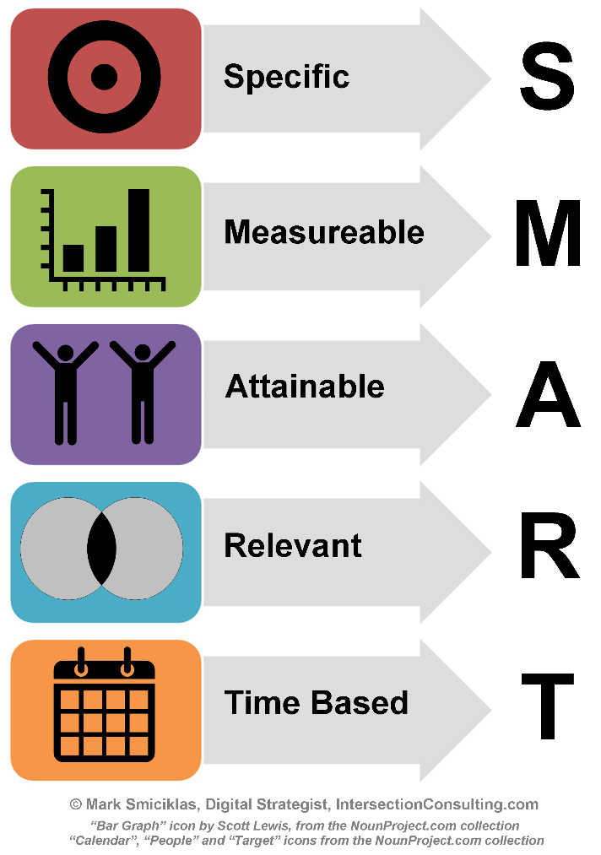
Traditional Approach to Objectives
Notes:
A big problem many of us face is that traditional HR systems push us into approaches that don’t work well for modern software development
Most systems push for SMART objectives and Management by Objective

Slide 5
Problems with SMART Objectives
Increase code production rate to __(#) lines of code per __(unit of time) by __(date)
Notes:
Helpful library of templates
Here’s one they suggest for software developers…
What could go wrong? The mind runs wild with other possibilities….

Slide 6
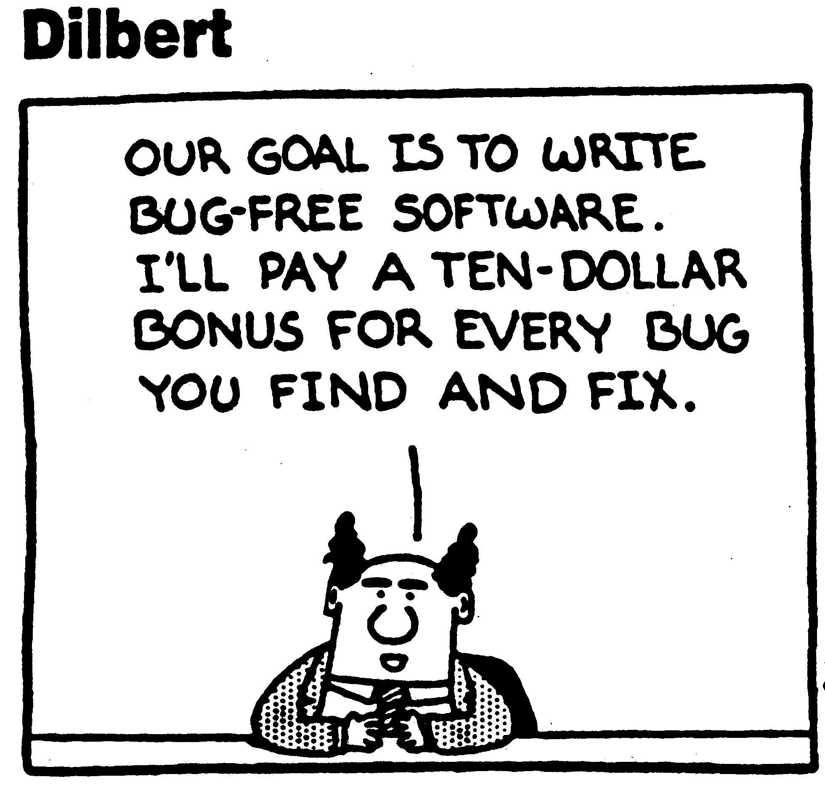
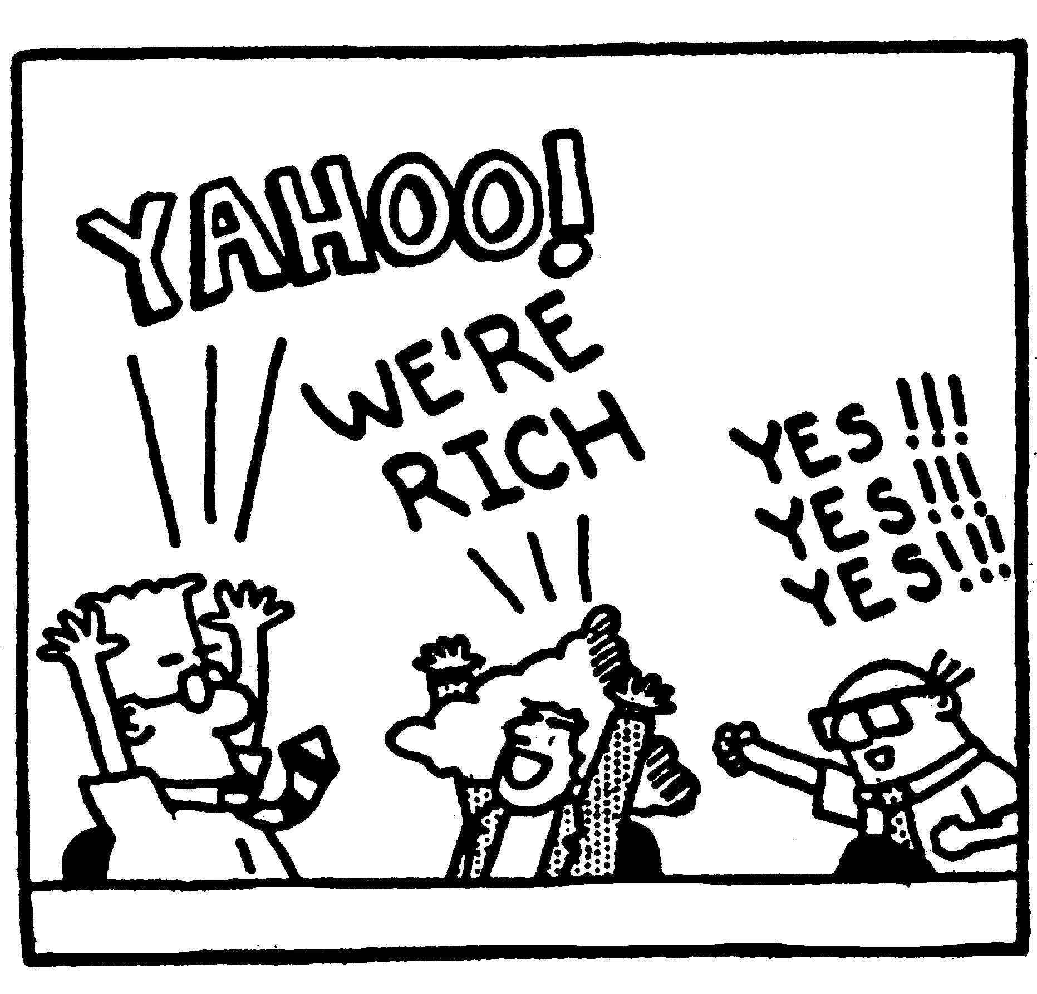
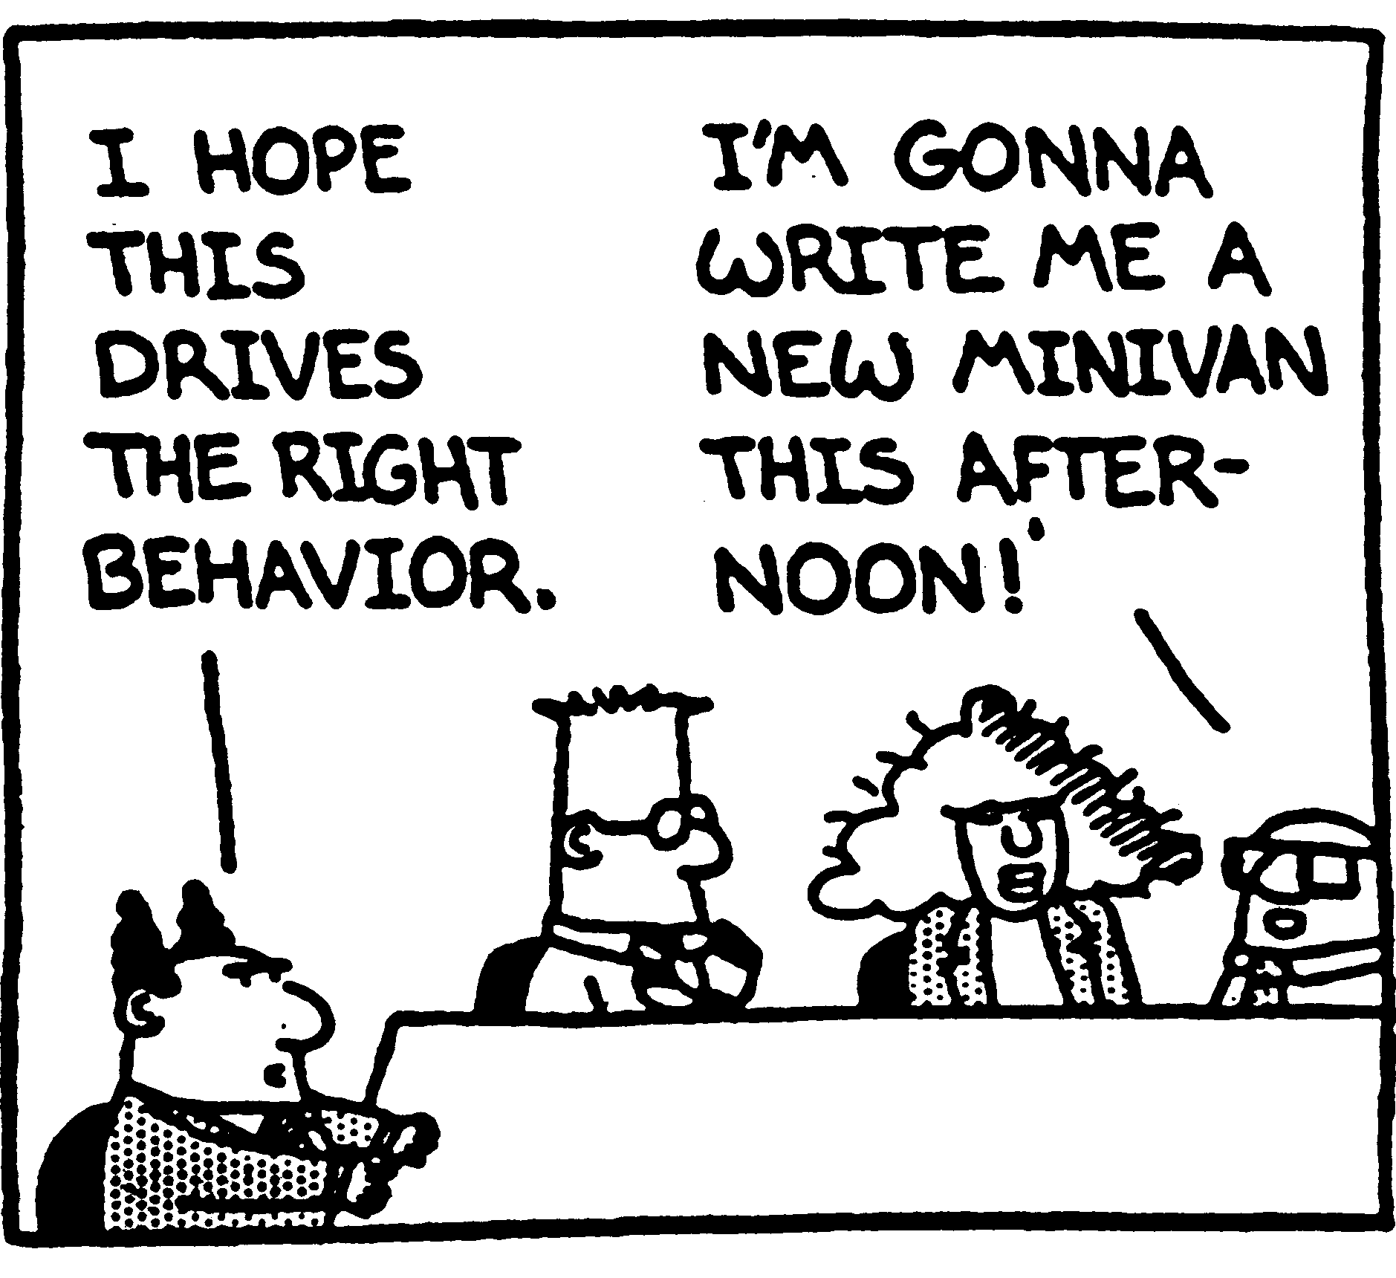
SMART Objectives and unintended consequences
Notes:
Fix N defects by date D
Create Y unit tests per day
- Provide comments on X% of lines of code
Common pattern - “Deliver feature X by date Y”.
Problems: changing priorities
dis-incentivizing teamwork and long term thinking

Slide 7

SOS - SMART Objectives Suck
Do not comprehend uncertainty
Unintended consequences
Myopic approach to career coaching
Behind every objective is a subjective
Notes:
They are poorly suited to the constantly changing nature of software development. What a developer is asked to work on often changes weekly or even more frequently.
Managers struggle with this mismatch, finding work-arounds that are idiosyncratic and inconsistent across the org.
SMART objectives offer little insight into the difference between a colleague’s performance and the expectations of the next level up. Hence, very little support for career development.
SMART objectives often tend to steer colleagues to aim for individualistic achievements.
SMART objectives applied to software development try to force false objectivity onto inherently subjective efforts.
- SMART objectives are a solution to a problem we already have a better solution for. We use the tight feedback loops of agile development practices to build accountability into our work on a daily basis.

Slide 8
SOS - SMART Objectives Suck
Do not comprehend uncertainty
Unintended consequences
Myopic approach to career coaching
Behind every objective is a subjective
Notes:
They are poorly suited to the constantly changing nature of software development. What a developer is asked to work on often changes weekly or even more frequently.
Managers struggle with this mismatch, finding work-arounds that are idiosyncratic and inconsistent across the org.
SMART objectives offer little insight into the difference between a colleague’s performance and the expectations of the next level up. Hence, very little support for career development.
SMART objectives often tend to steer colleagues to aim for individualistic achievements.
SMART objectives applied to software development try to force false objectivity onto inherently subjective efforts.
- SMART objectives are a solution to a problem we already have a better solution for. We use the tight feedback loops of agile development practices to build accountability into our work on a daily basis.

Slide 9
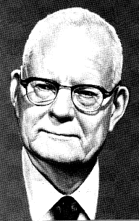
Abolish management by objective and annual performance reviews
W. Edwards Deming
Notes:
Demming wrote about abolishing performance reviews in his book “Out of the Crisis” and also included the message in his 14 points as point #12.
But he never really said what to do instead…

Slide 10
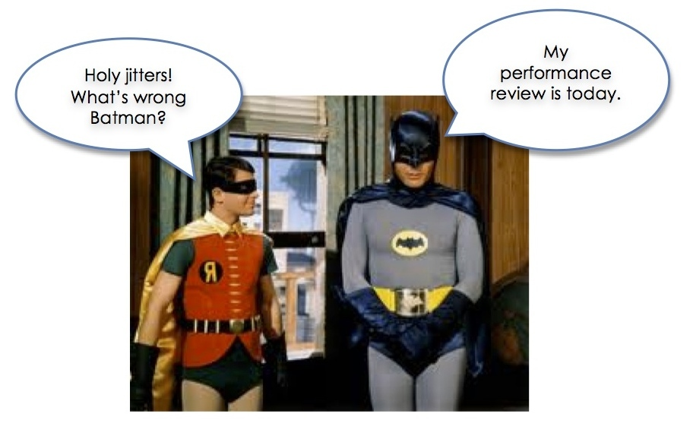
Do performance reviews have to suck?
Notes:
Todd and I are here because we believe that no – they do not have to suck.
Conversation:
- What’s expected of them
- How they are doing against those expectations
- What they can do to grow their career
Align - rewards and promotions - agile value system
That wouldn’t suck!
Brian
make a difference in people’s lives

Slide 11
Guiding principles
Notes:
Along our journey to find something better, some guiding principles emerged.

Slide 12
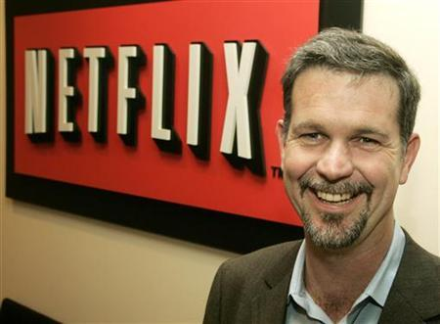
Values are what we value
Notes:
Here’s one of them, inspired by Reed Hastings’ presentation on Netflix Culture:
Values are what we value
That is: the things we say we value should also be the things we reward and use when making decisions like promotions or letting people go.

Slide 13
Discovering the Core Responsibilities
Delivery
Business Engagement
Teamwork
Quality
Initiative and Innovation
Deliver technical solutions
Partner with customer stakeholders
Collaborate with teammates
Build quality into software from the ground up
Take initiative and innovate
Notes:
Todd for years – great success
Merged with clusters - put together a set of Core Responsibilities
The critical ways that software developers create value for our business.

Slide 14




Value is what we value
Impact is the primary measure of career growth
Impact = Behaviors + Skills + Opportunity
Coach
Evolve
+
=
Foster
Develop
+
Create
Seize
Notes:
Another guiding principle we used is:
Value is what we value…
Impact is our primary measure of career progression. To grow impact:
- Managers coach behaviors, foster skill development and create opportunities
- Colleagues evolve behaviors, develop skills and seize opportunities

Slide 15
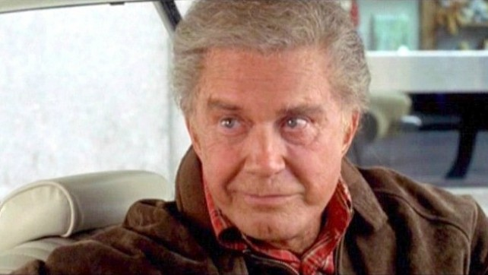
With a promotion comes higher expectations
Notes:
A third guiding principle:
With a promotion comes higher expectations
In general as colleagues progress through the levels of a particular career path, it's not the core responsibilities that change but rather expectation levels and scope of responsibility.
A promotion is not a reward for past work or loyalty, but rather a reflection of an increased level of responsibility.

Slide 16
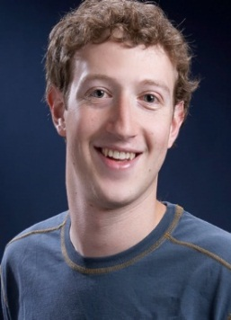
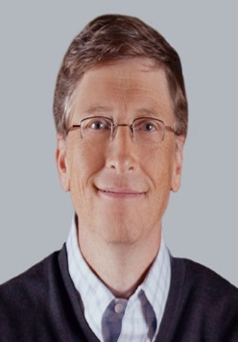
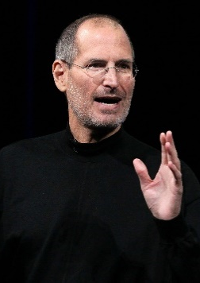
Delivery against Expectations
Associate
Senior
Sr. Principal
Core Areas

Slide 17

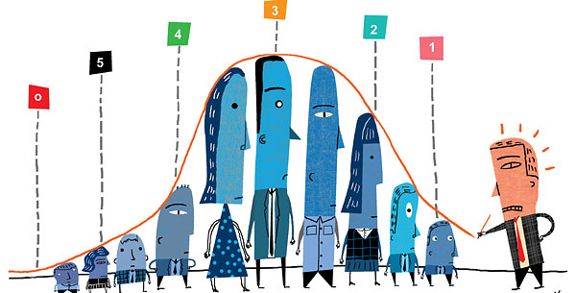
We value career development over performance ratings
Notes:
Our fourth guiding principle is:
We value career development over performance ratings
Supporting career development is our primary goal; integration with HR rating systems is a secondary goal.
Our company like many others has had an organizational mandate to produce performance ratings that feed into HR systems meant to provide accountability. Although we’re interested in finding better ways to support that need, the real reason we’re here is because we passionately believe that people leaders can make a difference in people’s lives – and overall business success - by investing in career development coaching.

Slide 18
What we did
Notes:
So let’s spend a bit of time talking in practical terms about how we built a new kind of framework and rolled it out.
At a high level we:
- Discovered the Core Responsibilities
Designed a set of expectation levels that mapped to our existing corporate job levels
Partnered with HR to gain stakeholder buy-in
Rolled out a pilot program
Let’s look at each of those steps in a little more detail…

Slide 19
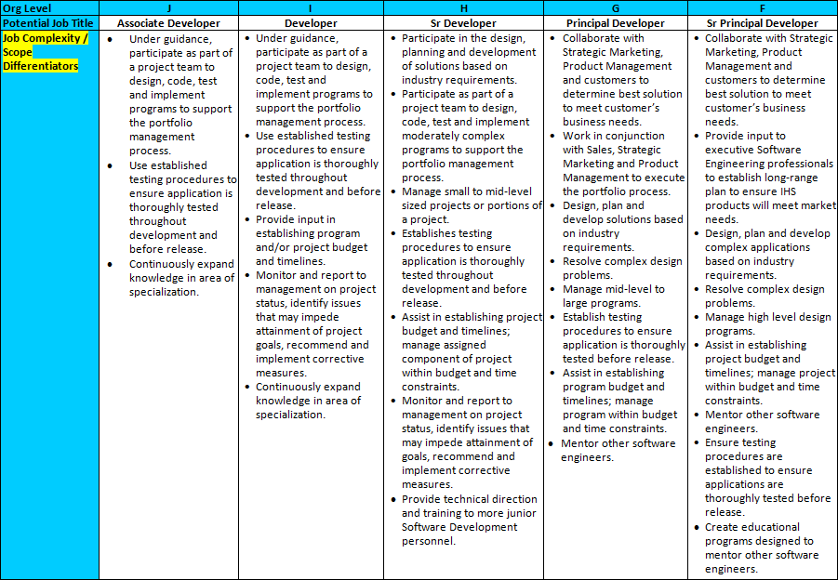
Discovering the Core Responsibilities
Testing
Notes:
Iterative, collaborative - directions
jumbled mess of corporate speak and confusing content
lack of clarity and support around career progression
job descriptions no help at all.

Slide 20
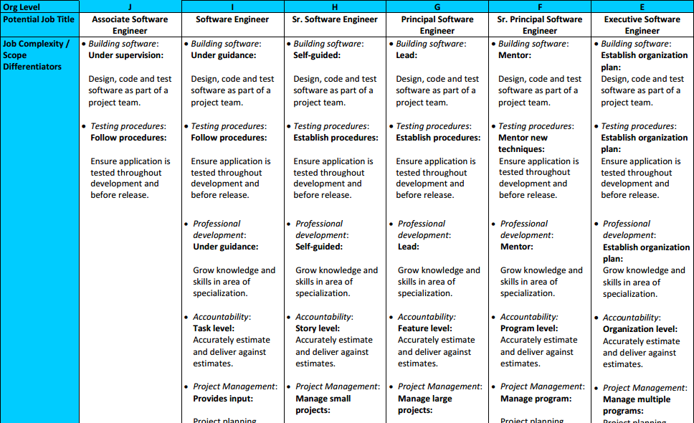
Testing
Notes:
We figured - cleaning up, clearly laying out expectations for each level
Frustrated with SMART – better way?
Andy suggested – evaluate based on what’s in there
Clusters!

Slide 21
Discovering the Core Responsibilities
Delivery
Business Engagement
Teamwork
Quality
Initiative and Innovation
Deliver technical solutions
Partner with customer stakeholders
Collaborate with teammates
Build quality into software from the ground up
Take initiative and innovate
Notes:
Todd for years – great success
Merged with clusters - put together a set of Core Responsibilities
The critical ways that software developers create value for our business.

Slide 22

Build quality into software from the ground up
Key contributions to consider:
  Clean code
  Automated unit & integration tests
  Peer review
  Reduction of technical debt
Notes:
Here’s one of them – Quality
“Key Contributions to consider” – important aspects
manager give feedback - how contributing
Cheat sheet

Slide 23
Expectations by level
Associate Software Engineer | With direction
Software Engineer | With support
Senior Software Engineer | Self-directed
Principal Software Engineer | Leader
Senior Principal Software Engineer | Mentor
Executive Software Engineer | Visionary
Notes:
Patterns – generalized expectation levels
Behavior-focused, all 5 – evaluate on own contribution levels, contrived
Promotion – expectations go up

Slide 24
Core Responsibility Framework
Delivery
Customer Focus
Teamwork
Quality
Initiative & Innovation
Impact
Behaviors
Recognized
Corporate
Resource
Leader /
Extraordinary
Contributor
Deep and/or
Broad
Leader /
Extraordinary
Contributor
Feature
Self-Directed
User Story
With Support
Simple User Story
With Direction
Notes:
5 CRs…
Set of expectations by level…
Suddenly we had a framework on our hands
Accomplish
What we expect
Performing against
Where to focus - improving
Next level up
Opportunities to grow

Slide 25

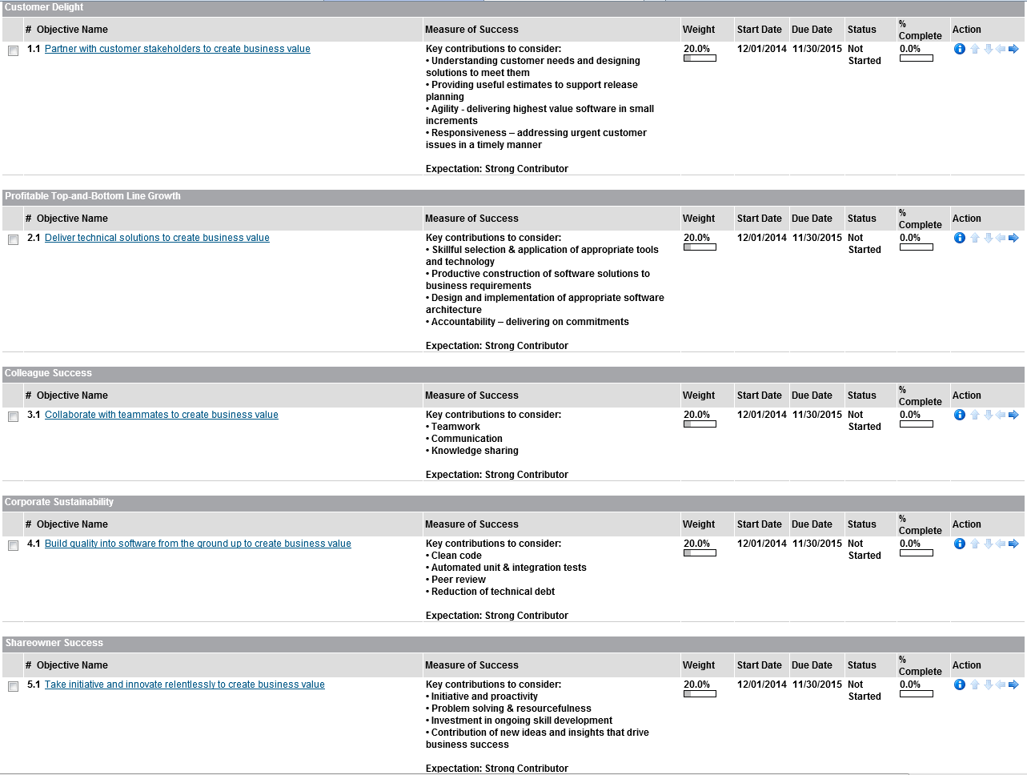
Partnering with HR
Abby Britt,
Sr HR Manager
Notes:
This is Abby Britt – side by side – great sponsor
Convince this audience
HR org - substitute

Slide 26
Review Organizational Strategic Intent
Measure Results of individuals relative to job expectations
Establish Projects and Initiatives aligned with Intent
24 hours
1-4 weeks
Iteration Backlog
Release Backlog
Backlog tasks
Potentially Shippable
Product Increment
Notes:
- Software developers experience constant change; they may not know what they’ll be working on from one week to the next.
Also our agile development process already provides a robust mechanism for driving clarity of goals and accountability
In Agile development we already have a good framework so another approach could work better

Slide 27
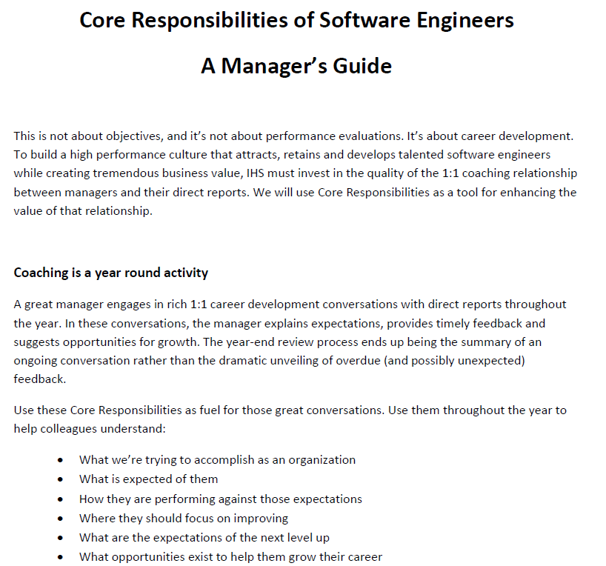
Pilot program rollout
Notes:
So we were ready.
pilot program in 2015, 200 software developers.
Support materials, training, 1:1 coaching
The experiment began…

Slide 28
Performance Evaluation Model
Delivery
Customer Focus
Teamwork
Quality
Initiative & Innovation
Impact
Behaviors
Recognized
Corporate
Resource
Leader /
Extraordinary
Contributor
Deep and/or
Broad
Leader /
Extraordinary
Contributor
Feature
Self-Directed
User Story
With Support
Simple User Story
With Direction
Notes:
Blue columns – 5 CRs
Orange gradients – progressively higher levels of behavior and impact
Illustrate & communicate – dots
Dean the Coding Machine – delivery, productivity – above and beyond
1995 – legacy app – tech debt – no interest in learning, automation fad
Sr SW Eng – stuck? Next level?
Red line – expectations – self directed, chasing, initiative, provide tests
Manager – sit down, coaching msg, visualization

Slide 29
John the Journeyman
Get to know the character in your handout – develop a little backstory
Think about the dot positions – do they meet expectations?
What’s your coaching message?
Delivery
Customer Focus
Teamwork
Quality
Initiative & Innovation
Impact
Behaviors
Recognized
Corporate
Resource
Leader /
Extraordinary
Contributor
Deep and/or
Broad
Leader /
Extraordinary
Contributor
Feature
Self-Directed
User Story
With Support
Simple User Story
With Direction
Notes:
Can they choose from what is on the table?
Can we give them the latitude to adjust the dots for their story?

Slide 30
How do managers like it?

Slide 31
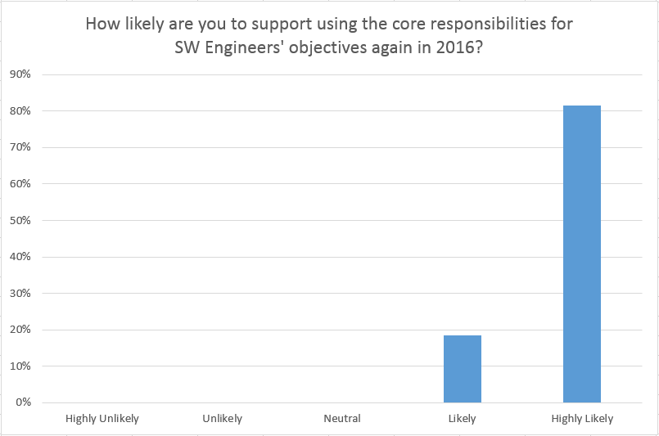
Manager Feedback
100%
Notes:
This is an overwhelmingly positive response. Clearly a good indicator that the managers found it to be an improvement.
…unless they were just saying that because they knew the system had executive support. But I don’t think that was the case We have a rather open trust environment where if there were issues the managers were not afraid to speak up.

Slide 32
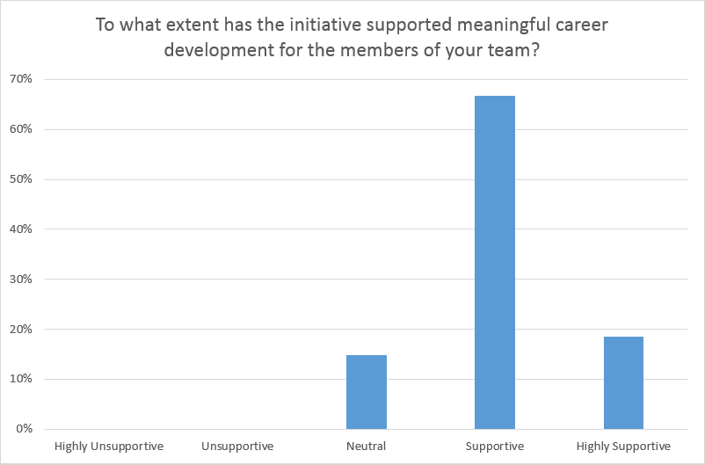
Manager Feedback
85%
Notes:
Not bad for a first year of the program. Certainly we would like to move the needle on this one a bit more.

Slide 33
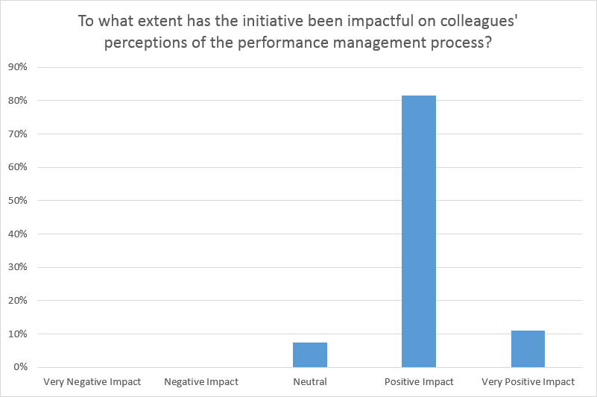
Manager Feedback
92%
Notes:
Maybe the managers liked the system because it simplified their life. They no longer had to come up with SMART objectives. So we asked the managers to give their perception of the impact on our colleagues. They felt that overall it was positive.
So we could declare victory!!!!!
But maybe not yet. Maybe we should survey some of our other stakeholders, namely our customers, our colleagues. What do they think of the new system?

Slide 34
How do colleagues like it?

Slide 35
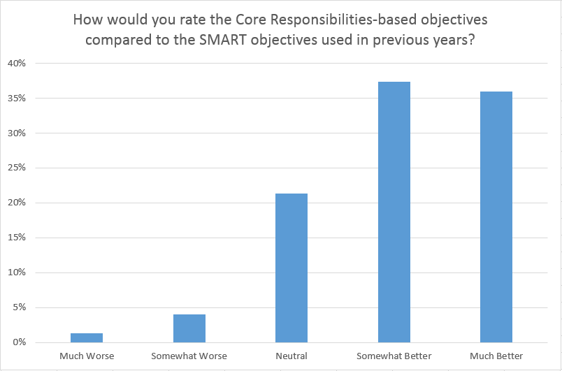
Colleague Feedback
73%
Notes:
What does the survey show? Some people have long toes! Some people will hate performance reviews no matter what. Or maybe they loved or felt comfortable with the old SMART objectives. But overall we had positive response from our colleagues.

Slide 36
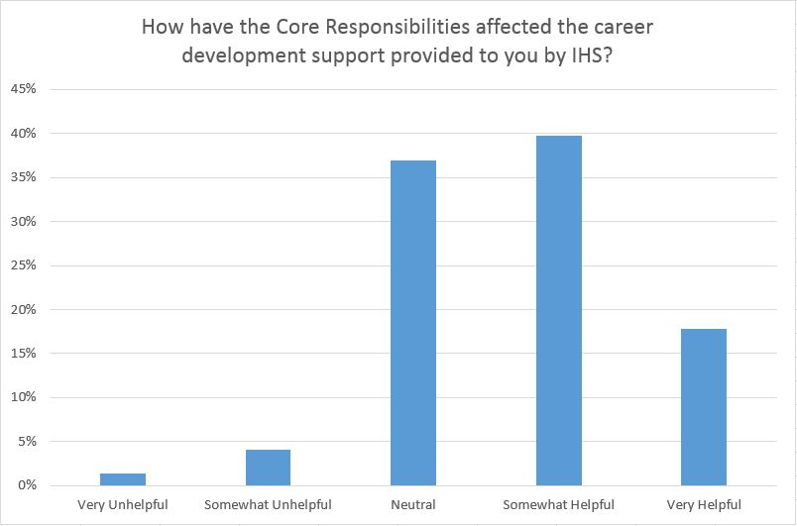
Colleague Feedback
57%
Notes:
This is the one we really want to see grow. Pretty darn good for a first year rollout. But we know we can improve we will continue to monitor how this evolves.

Slide 37
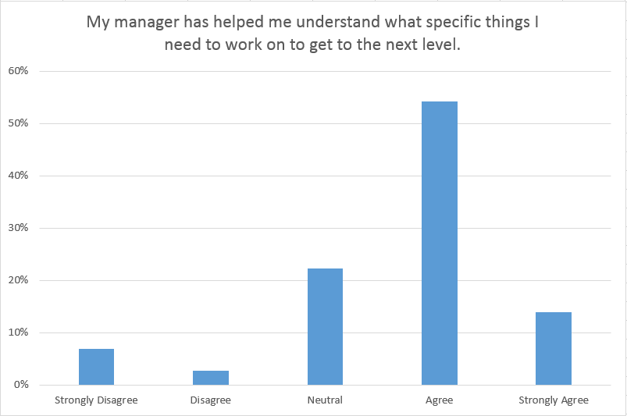
Colleague Feedback
68%
Notes:
Again a generally positive reaction from our colleagues. Even though the descriptions are subjective, the colleagues now have something more concrete to look at relative to job expectations. This enables the critical conversations that we want to have.

Slide 38
Inspecting and adapting

Slide 39
Challenges integrating with HR systems
HR rating model emphasizes “performance” over career growth
Coarse-grained HR performance ratings
Redundancies in paperwork
Title inconsistencies across the company
Notes:
Concerns that 3.0 is a “poor” rating when in reality it might be perfectly applicable to a great performer who just got promoted.
The range of useful ratings is very narrow for the scoring model, making it very difficult to achieve appropriate overall ratings.

Slide 40
Refining the Structure
 | Behavior | Impact
Associate Software Engineer | With direction | Simple User Story
Software Engineer | With support | User Story
Senior Software Engineer | Self-directed | Feature
Principal Software Engineer | Leader / Extraordinary Contributor | Broad and/or Deep Impact
Senior Principal Software Engineer | Leader / Extraordinary Contributor | Recognized Corporate Resource
Notes:
As you’ve seen in the exercise, we’re now expressing the expectation levels in terms of both behaviors and impact.
This has brought greater expressive power to our framework, which helps us better address the development needs of colleagues growing into the higher levels. One of the things we’ve always emphasized is that this is just a framework – managers need to adapt it to each individual’s context.
One of the things we’re already seeing is that the more we add to the system – for example, better support for special cases – the more complex it gets. The more complex it gets, the less accessible it is.
In short, we are increasingly suspecting that less is more.

Slide 41
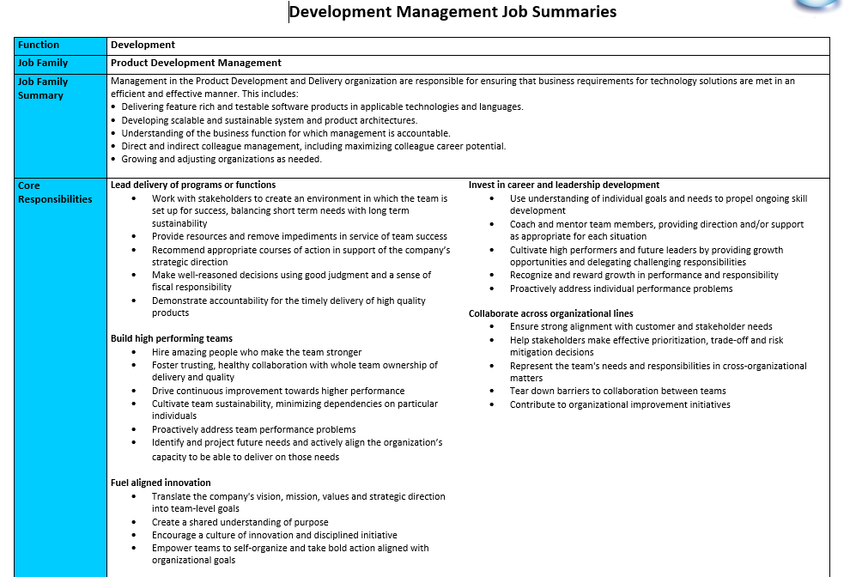
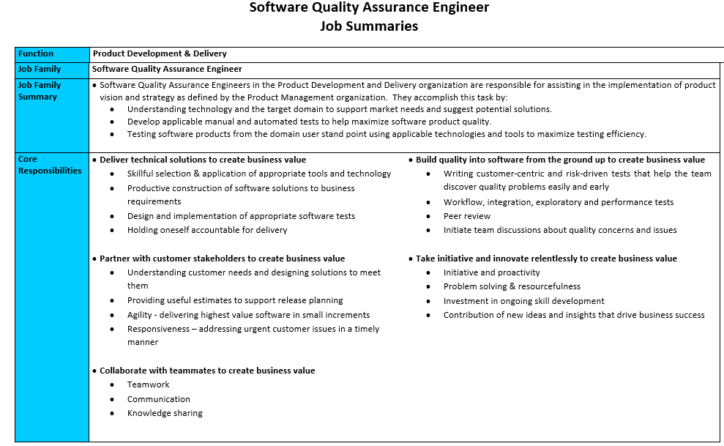
Beyond software developers
Notes:
2 more roles
Different directions
Mgrs – ground up
SQA similar

Slide 42
Shared Core Responsibilities
Delivery | Deliver technical solutions
Business Engagement | Partner with customer stakeholders
Teamwork | Collaborate with teammates
Quality | Build quality into software from the ground up
Initiative and Innovation | Take initiative and innovate relentlessly
Notes:
agile teams - shared responsibilities - whole team ownership
CRs reinforce that philosophy - more similar than different

Slide 43
Quality: Build quality into software from the ground up to create business value
Key contributions to consider:
Developer | SQA
Clean code | Write and execute tests to detect issues early
Automated unit & integration tests | Workflow, integration, exploratory and performance tests
Peer review | Peer review
Reduction of technical debt | Be a quality advocate on the team
Notes:
Customize - highlight the specific ways - shared team goals.

Slide 44
Do performance reviews have to suck?
Notes:
No, ours don’t suck.
We use them to help people get better at the things that create business value.
Everybody wins – colleagues, managers and the company itself.

Slide 45
Contact
Todd Little
  todd@leankanban.com
  toddelittle@gmail.com
  www.toddlittleweb.com
  www.linkedin.com/in/toddelittle/
  @toddelittle
Andrew Tuttle
  andrew.tuttle@ihsmarkit.com
  www.linkedin.com/in/andrewltuttle

Slide 46
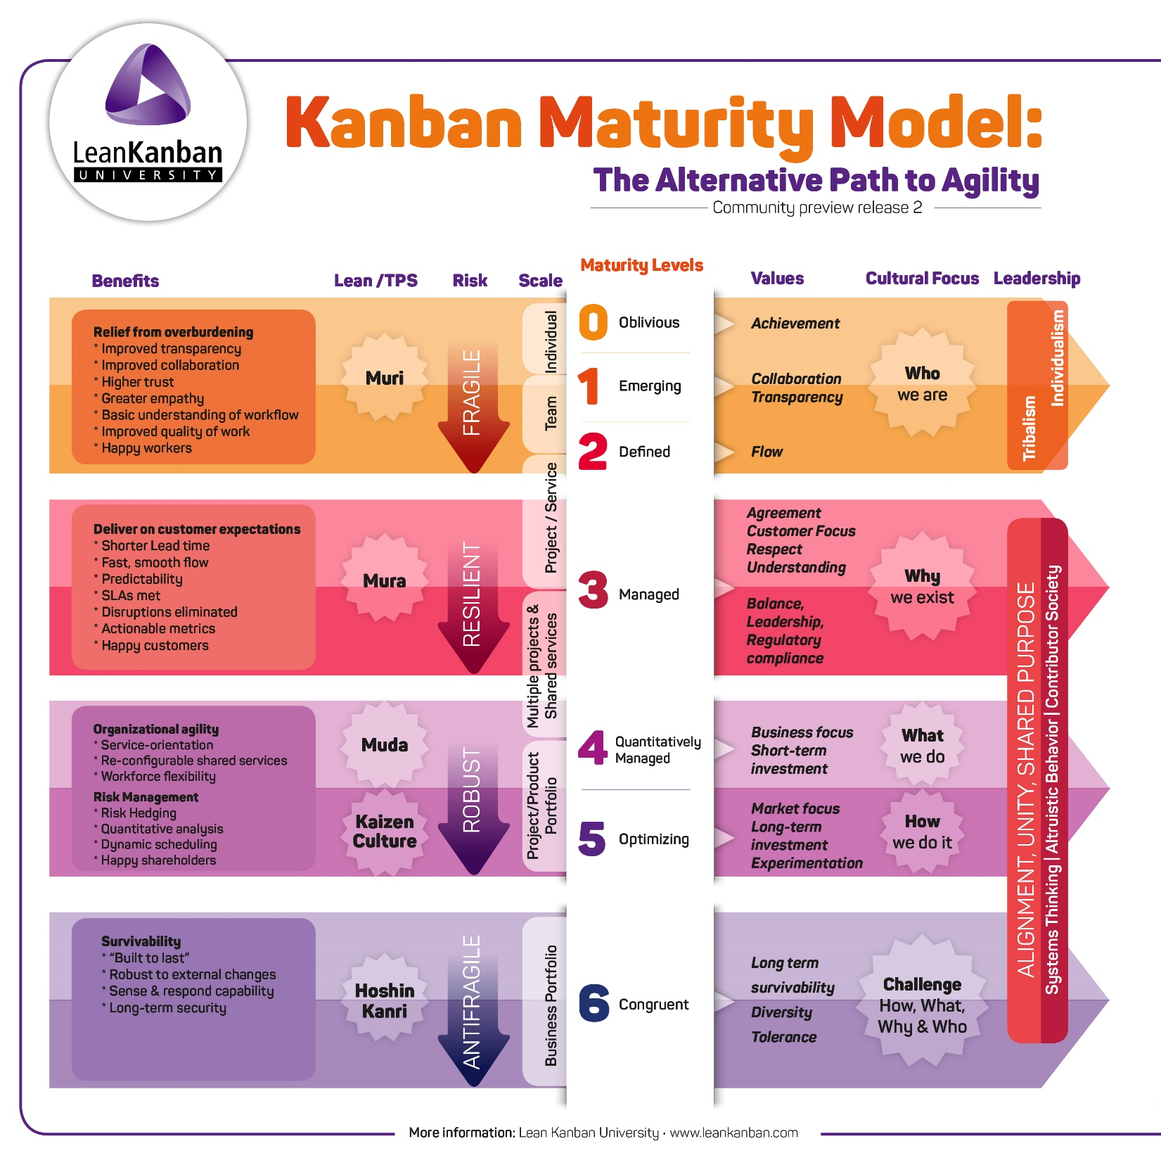

Slide 47
Questions?

Slide 48
Exercise
Notes:
Cast of 11 characters
You be the manager
Time to prepare for a perf review!

Slide 49
John the Journeyman
Gather into groups
Get to know the character in your handout – develop a little backstory together
Think about the dot positions – do they meet expectations?
What’s your coaching message?
Delivery
Customer Focus
Teamwork
Quality
Initiative & Innovation
Impact
Behaviors
Recognized
Corporate
Resource
Leader /
Extraordinary
Contributor
Deep and/or
Broad
Leader /
Extraordinary
Contributor
Feature
Self-Directed
User Story
With Support
Simple User Story
With Direction
Notes:
Can they choose from what is on the table?
Can we give them the latitude to adjust the dots for their story?

Slide 50
Heather the Hero
Impact
Behaviors
Delivery
Customer Focus
Teamwork
Quality
Initiative & Innovation
Recognized
Corporate
Resource
Leader /
Extraordinary
Contributor
Deep and/or
Broad
Leader /
Extraordinary
Contributor
Feature
Self-Directed
User Story
With Support
Simple User Story
With Direction

Slide 51
Ivan the Individualist
Impact
Behaviors
Delivery
Customer Focus
Teamwork
Quality
Initiative & Innovation
Recognized
Corporate
Resource
Leader /
Extraordinary
Contributor
Deep and/or
Broad
Leader /
Extraordinary
Contributor
Feature
Self-Directed
User Story
With Support
Simple User Story
With Direction

Slide 52
Tessy the Team Angel
Impact
Behaviors
Delivery
Customer Focus
Teamwork
Quality
Initiative & Innovation
Recognized
Corporate
Resource
Leader /
Extraordinary
Contributor
Deep and/or
Broad
Leader /
Extraordinary
Contributor
Feature
Self-Directed
User Story
With Support
Simple User Story
With Direction

Slide 53
Irene the Innovator
Impact
Behaviors
Delivery
Customer Focus
Teamwork
Quality
Initiative & Innovation
Recognized
Corporate
Resource
Leader /
Extraordinary
Contributor
Deep and/or
Broad
Leader /
Extraordinary
Contributor
Feature
Self-Directed
User Story
With Support
Simple User Story
With Direction

Slide 54
Quincy the Quality Evangelist
Impact
Behaviors
Delivery
Customer Focus
Teamwork
Quality
Initiative & Innovation
Recognized
Corporate
Resource
Leader /
Extraordinary
Contributor
Deep and/or
Broad
Leader /
Extraordinary
Contributor
Feature
Self-Directed
User Story
With Support
Simple User Story
With Direction

Slide 55
Paula the Perfectionist
Impact
Behaviors
Delivery
Customer Focus
Teamwork
Quality
Initiative & Innovation
Recognized
Corporate
Resource
Leader /
Extraordinary
Contributor
Deep and/or
Broad
Leader /
Extraordinary
Contributor
Feature
Self-Directed
User Story
With Support
Simple User Story
With Direction

Slide 56
Tim the Enchanter….er Technologist
Impact
Behaviors
Delivery
Customer Focus
Teamwork
Quality
Initiative & Innovation
Recognized
Corporate
Resource
Leader /
Extraordinary
Contributor
Deep and/or
Broad
Leader /
Extraordinary
Contributor
Feature
Self-Directed
User Story
With Support
Simple User Story
With Direction

Slide 57
Alex the Architecture Astronaut
Impact
Behaviors
Delivery
Customer Focus
Teamwork
Quality
Initiative & Innovation
Recognized
Corporate
Resource
Leader /
Extraordinary
Contributor
Deep and/or
Broad
Leader /
Extraordinary
Contributor
Feature
Self-Directed
User Story
With Support
Simple User Story
With Direction

Slide 58
Doug the Domain Expert
Impact
Behaviors
Delivery
Customer Focus
Teamwork
Quality
Initiative & Innovation
Recognized
Corporate
Resource
Leader /
Extraordinary
Contributor
Deep and/or
Broad
Leader /
Extraordinary
Contributor
Feature
Self-Directed
User Story
With Support
Simple User Story
With Direction

Slide 59


Stan the Shy Guy
Impact
Behaviors
Delivery
Customer Focus
Teamwork
Quality
Initiative & Innovation
Recognized
Corporate
Resource
Leader /
Extraordinary
Contributor
Deep and/or
Broad
Leader /
Extraordinary
Contributor
Feature
Self-Directed
User Story
With Support
Simple User Story
With Direction

Slide 60
John the Journeyman
Impact
Behaviors
Delivery
Customer Focus
Teamwork
Quality
Initiative & Innovation
Recognized
Corporate
Resource
Leader /
Extraordinary
Contributor
Deep and/or
Broad
Leader /
Extraordinary
Contributor
Feature
Self-Directed
User Story
With Support
Simple User Story
With Direction

Slide 63


