Slide 1

PMI AGILE CONFERENCE · 2026
Think In Systems,
Deliver At Scale
Agile/Lean Lessons from AI in Energy
Ahsan Rahi · Managing Partner, heuristIQ LLC
Event · Washington D.C. Area
(National Harbor, MD)
Todd Little · Former Chairman, Kanban University
Notes:
Open the talk. State the single idea the audience should leave with.

Slide 2
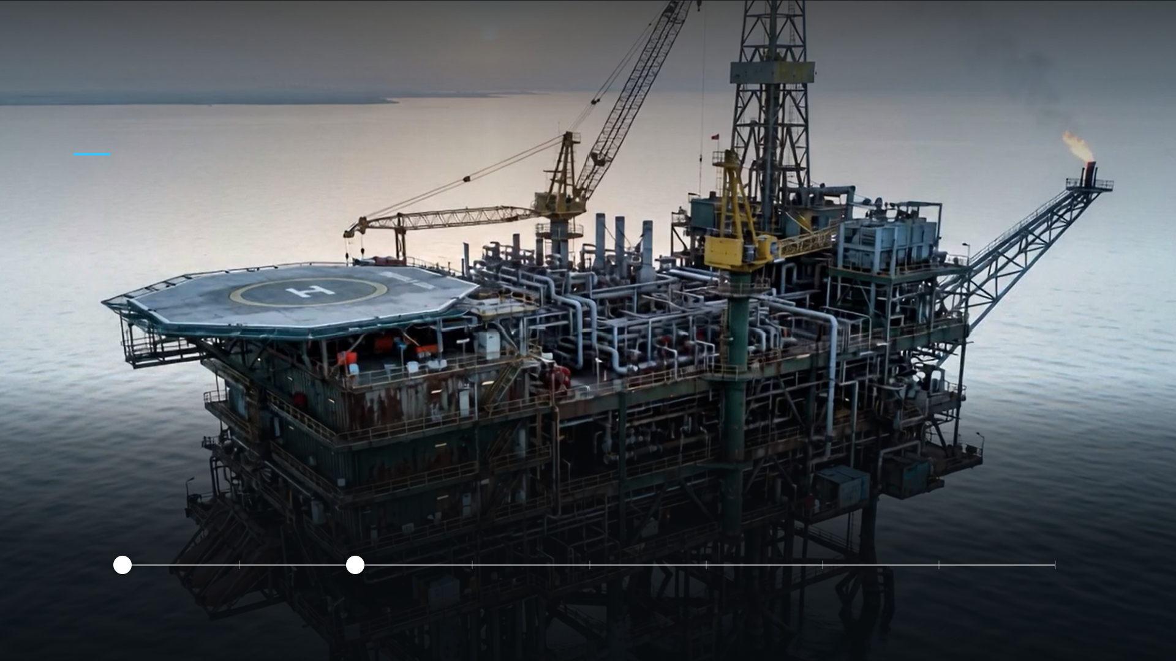

STARTING STATE
Forward Deployed
DAY 0
6 MONTHS
Project started
8 MONTHS
I joined
The Standup
Month 12
Month 24

Slide 3
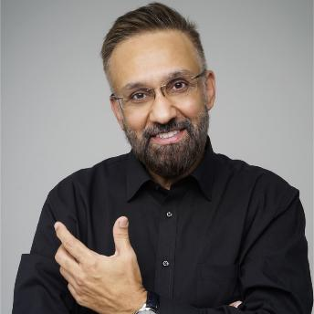
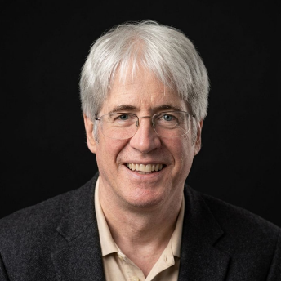

YOUR HOSTS TODAY
Who We Are
Ahsan Rahi
Todd Little
Managing Partner / heuristIQ LLC
Former Chairman / Kanban University
Project Director of the case study in this talk.
Engineering/tech background, PMP, Lean/Six Sigma BB
Co-founder of the Agile Development Conference.
40+ years in petroleum engineering & software
heuristiq.io

Slide 4
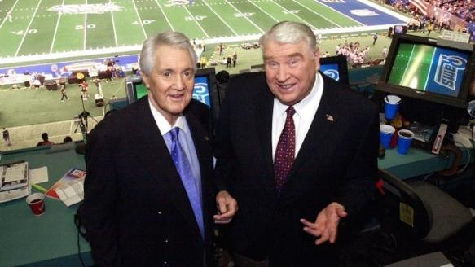

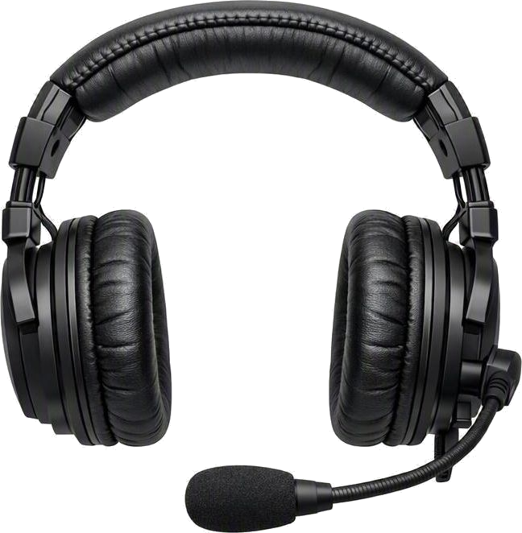
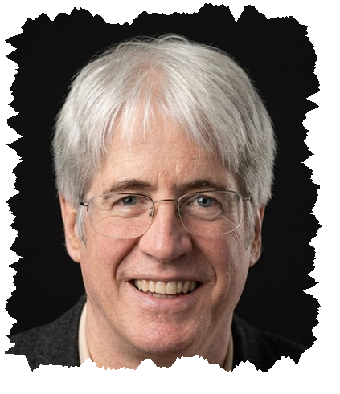
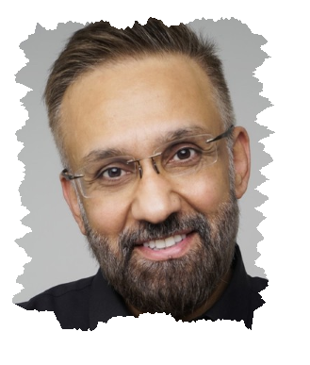
READY FOR PLAY
Presentation Style
Color Commentary
Play by Play

Slide 5
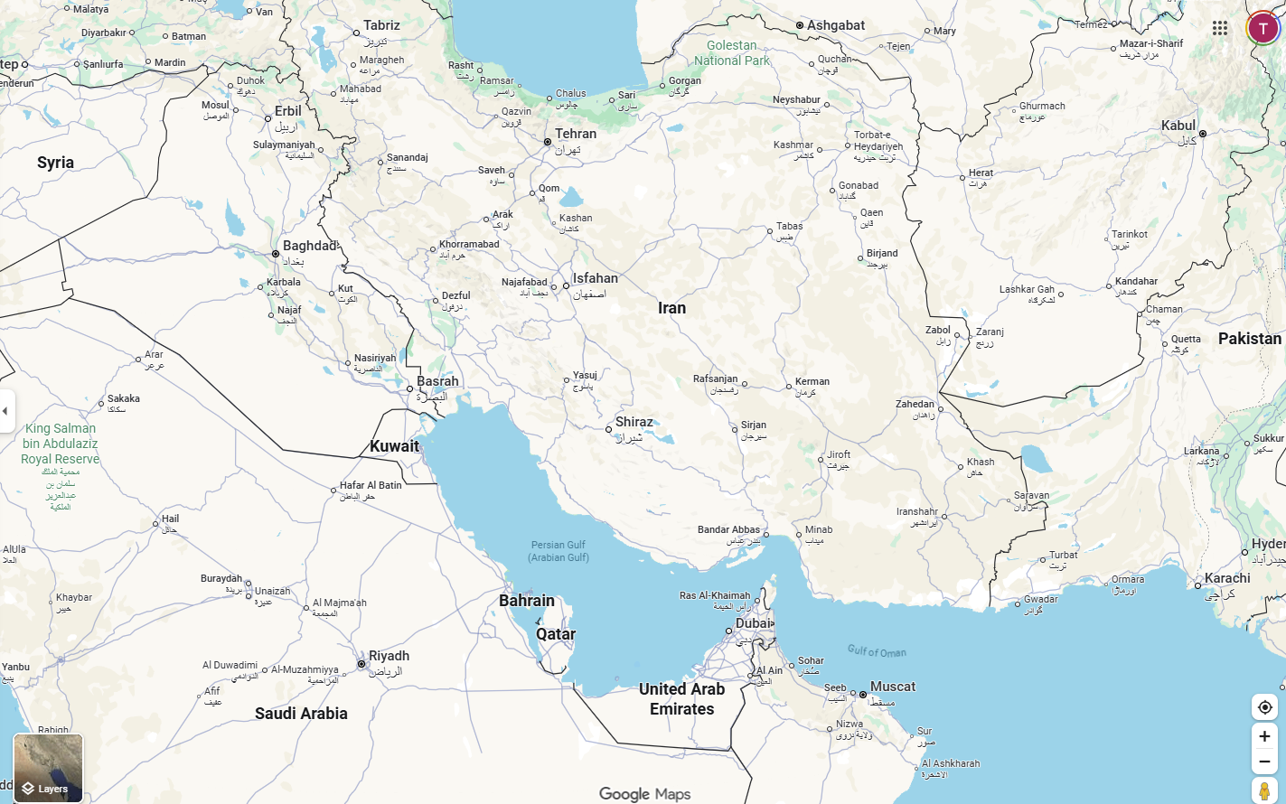






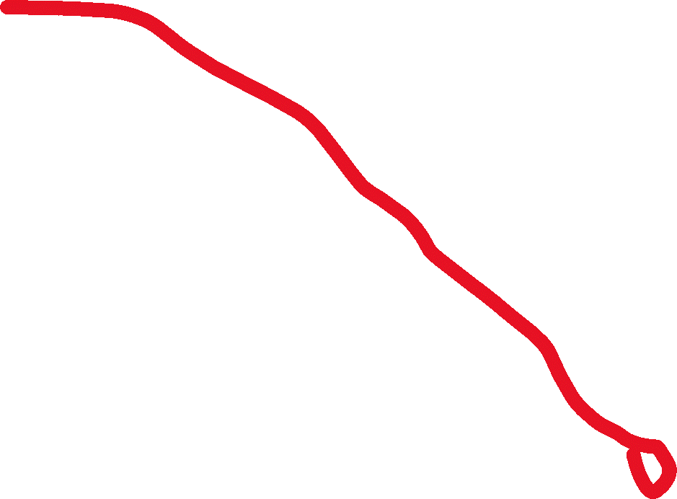
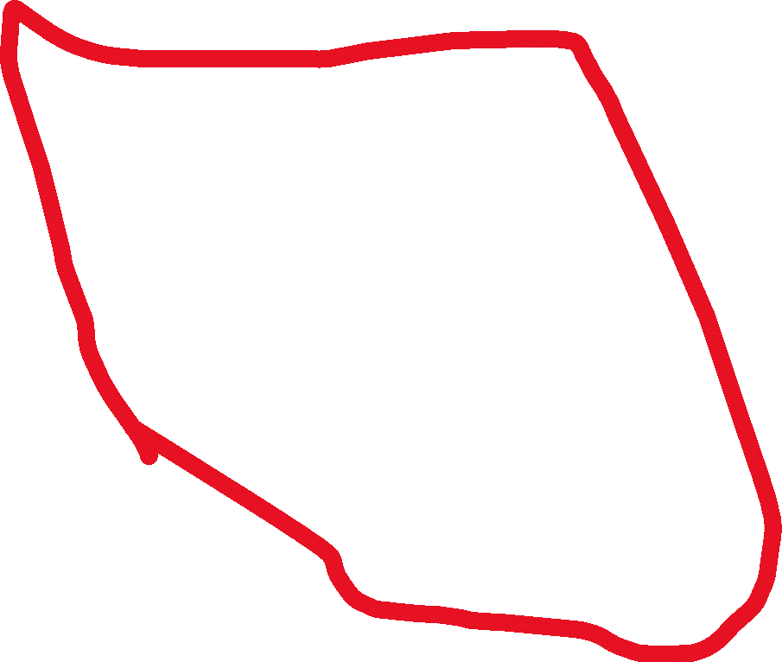

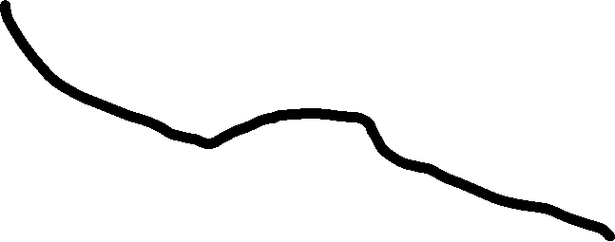

Slide 6
SECTION ONE
01
The Operational Context
Project environment & complexities

Slide 7


WHO ARE WE PLAYING FOR
The Key Stakeholders
THE CUSTOMER
THE CONTRACT HOLDER
One of the world's largest state-owned energy producers — a national operator whose output and workforce sit at true global scale.
An AI venture built inside the energy sector — formed in strategic partnership with the customer.
$1B+
unicorn valuation
$50B+
3M+
50K+
1st
of its kind, born as a national JV
annual revenue
barrels produced daily
employees worldwide
Failure here would be visible at national — and industry — scale.
heuristiq.io
Notes:
“Who were we doing this project for and what did it mean to them?” …an operator of national and global significance, and a fast-growing AI venture built to serve it. Everything that follows happened under that pressure. Global Scale Meets Category-Defining Pressure….

Slide 8
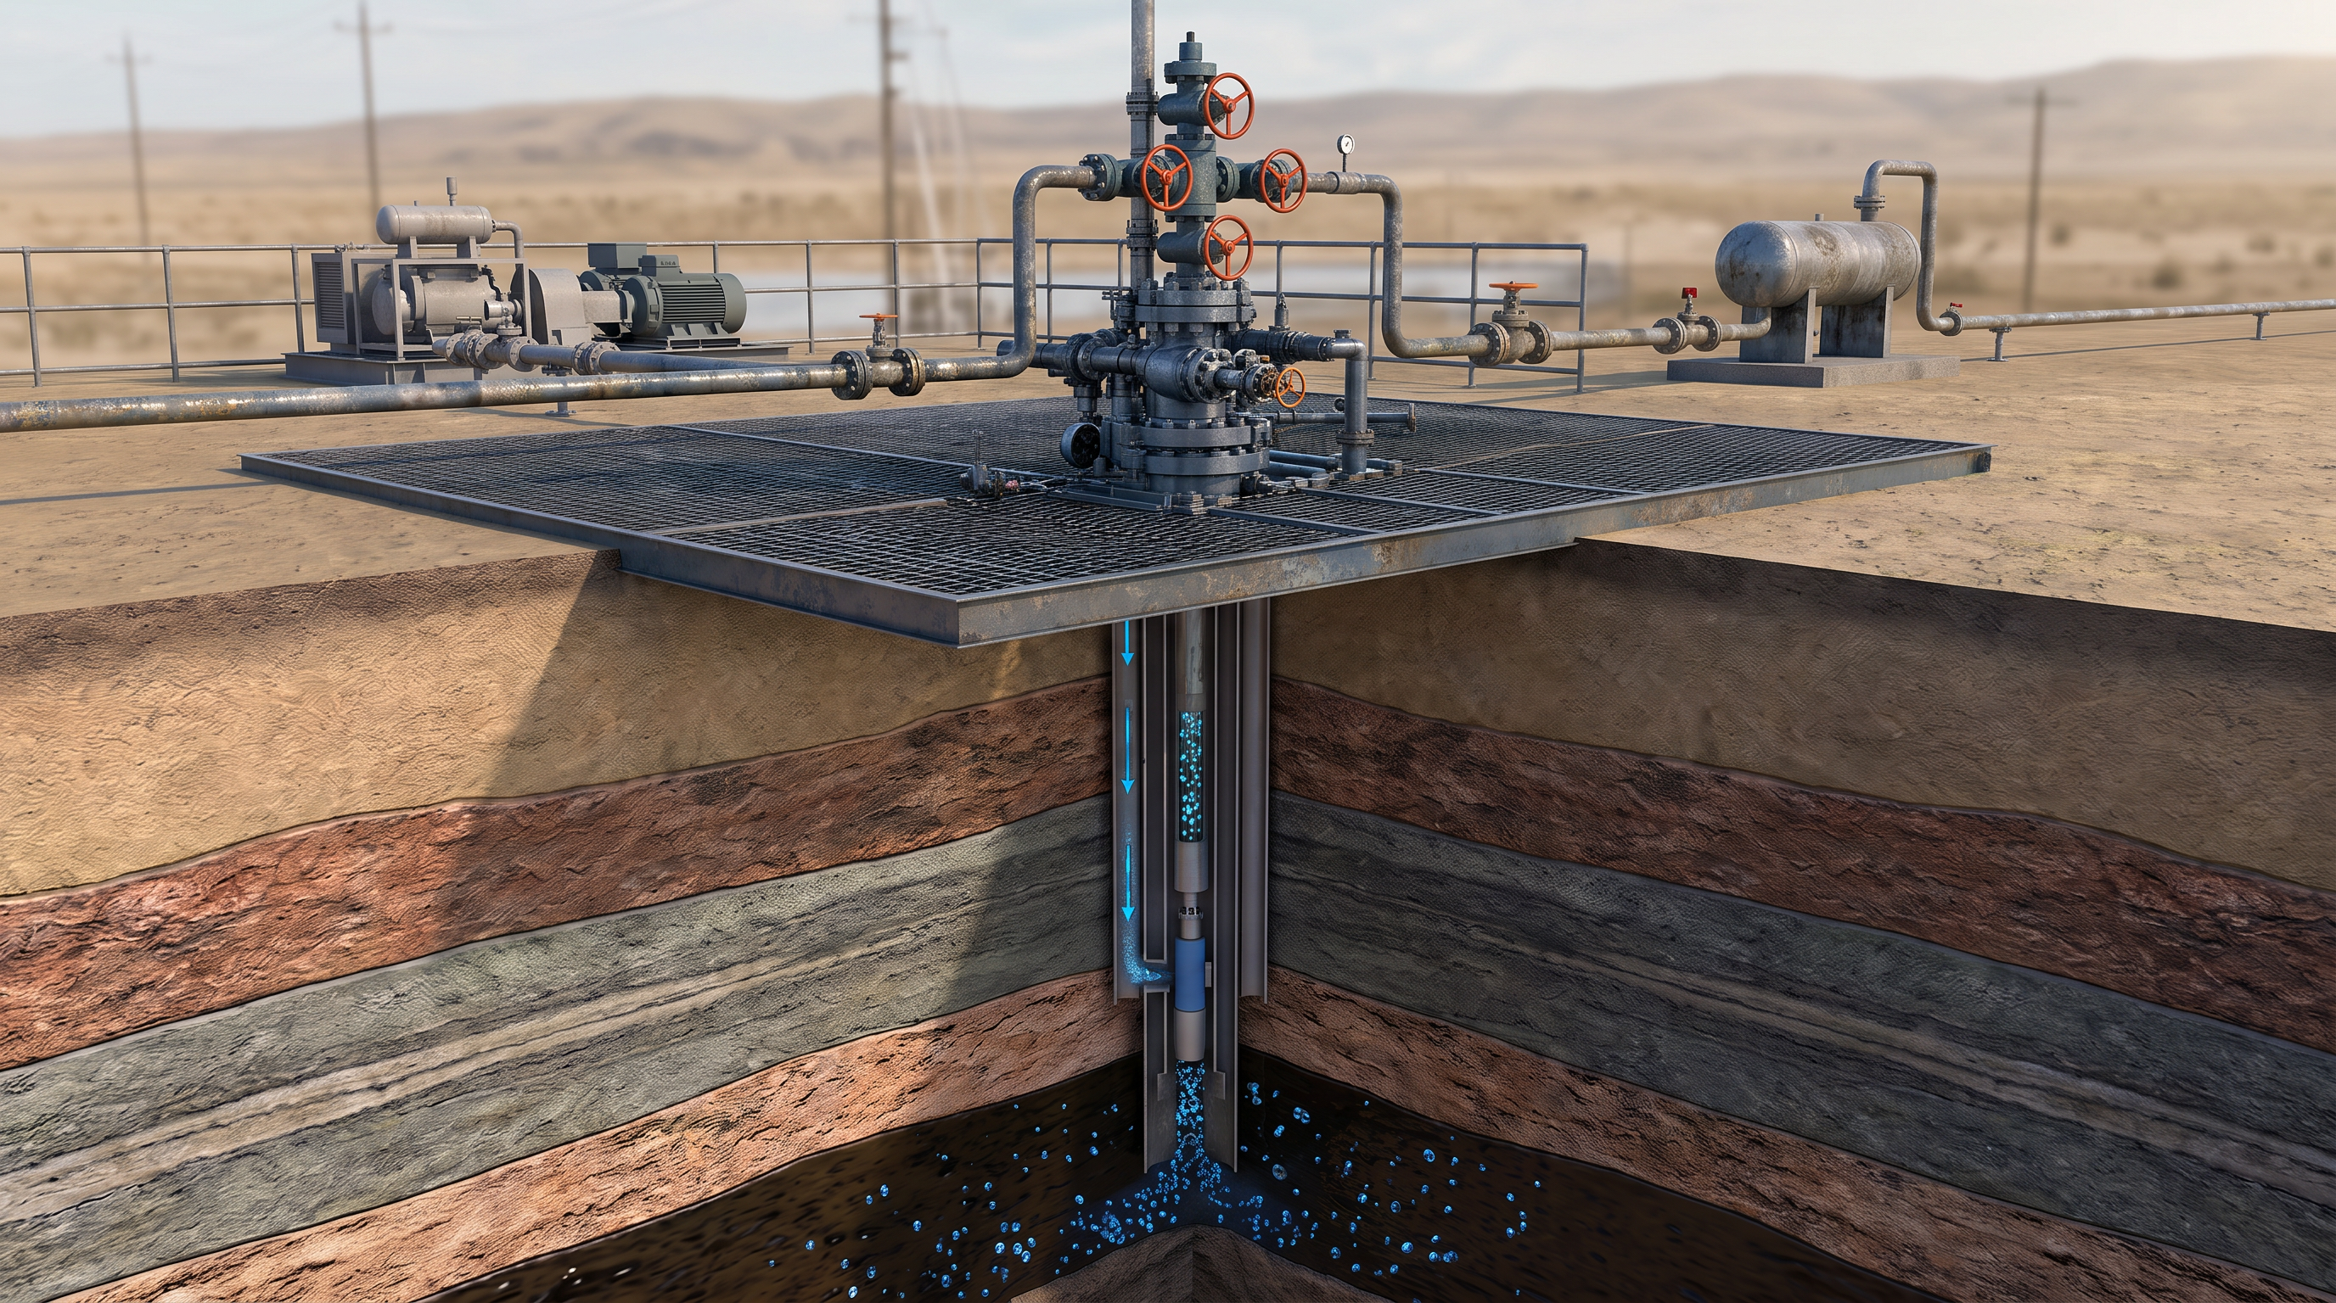
WHAT ARE WE DELIVERING
A Typical Well On Land
heuristiq.io
Notes:
The wells we dealt with were in one field but monitored and controlled from two separate operations rooms because they were dispersed across a very wide area, mostly desert.
Talk about gas-lifted wells, the type we’re dealing with here – 2 controls – which were the focus of the AI/ML solution being developed & deployed……

Slide 9
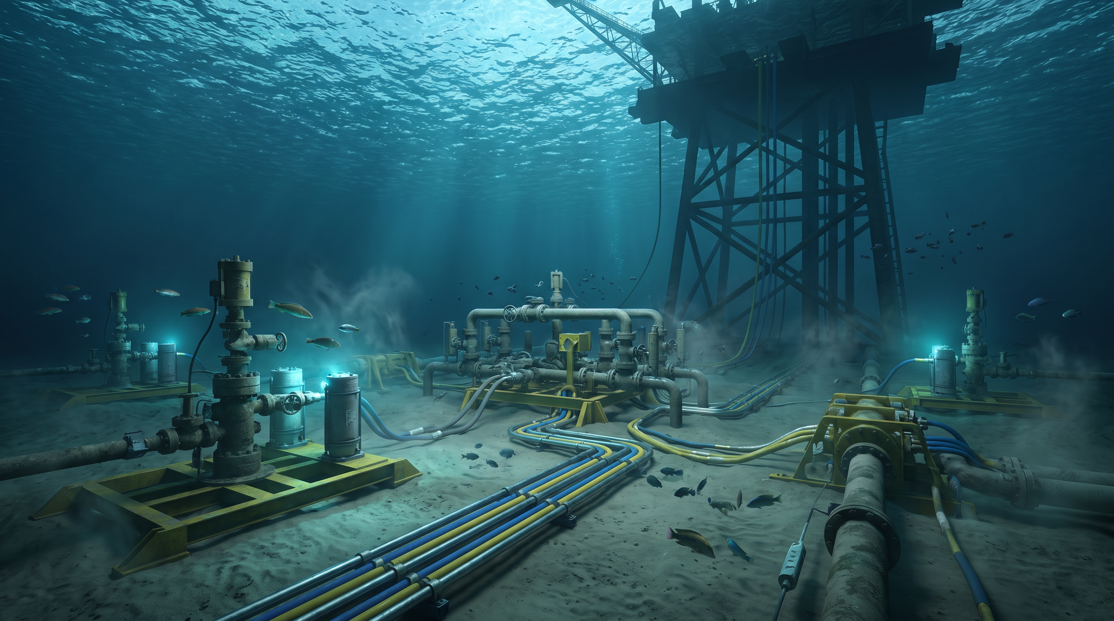
WHAT ARE WE DELIVERING
1/3rd Of Wells On The Seabed
heuristiq.io
Notes:
The offshore wells we worked with were spread across two separate fields, each managed by its own offshore operations platform.
Just the offshore logistics completely changes the complexity – from scheduling to HSE to ….

Slide 10
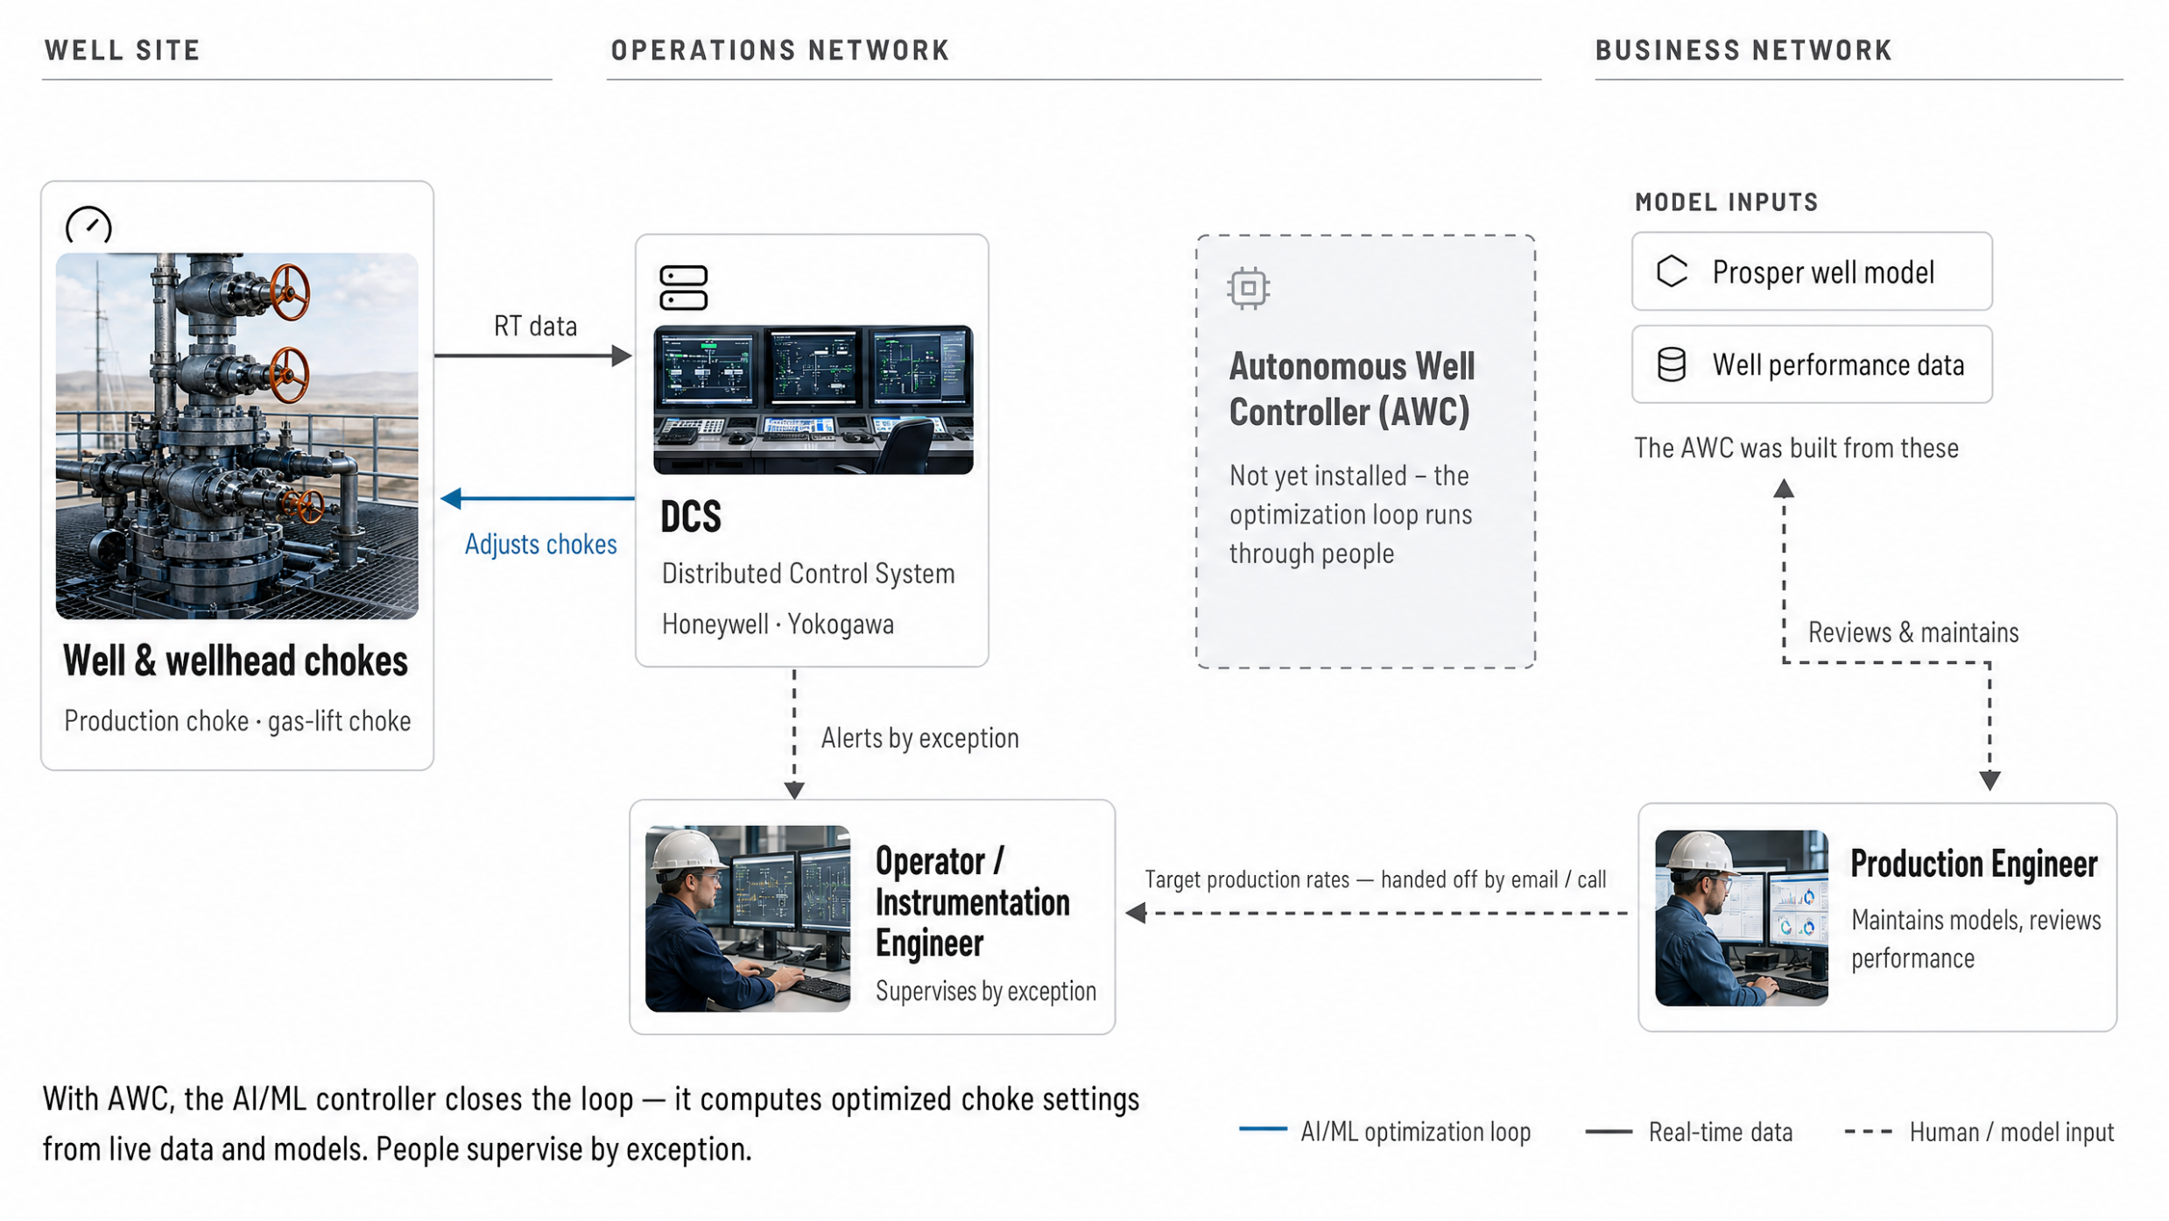
CONTROL LOOP
Before Deployment
Need to overwrite with before state text

Slide 11
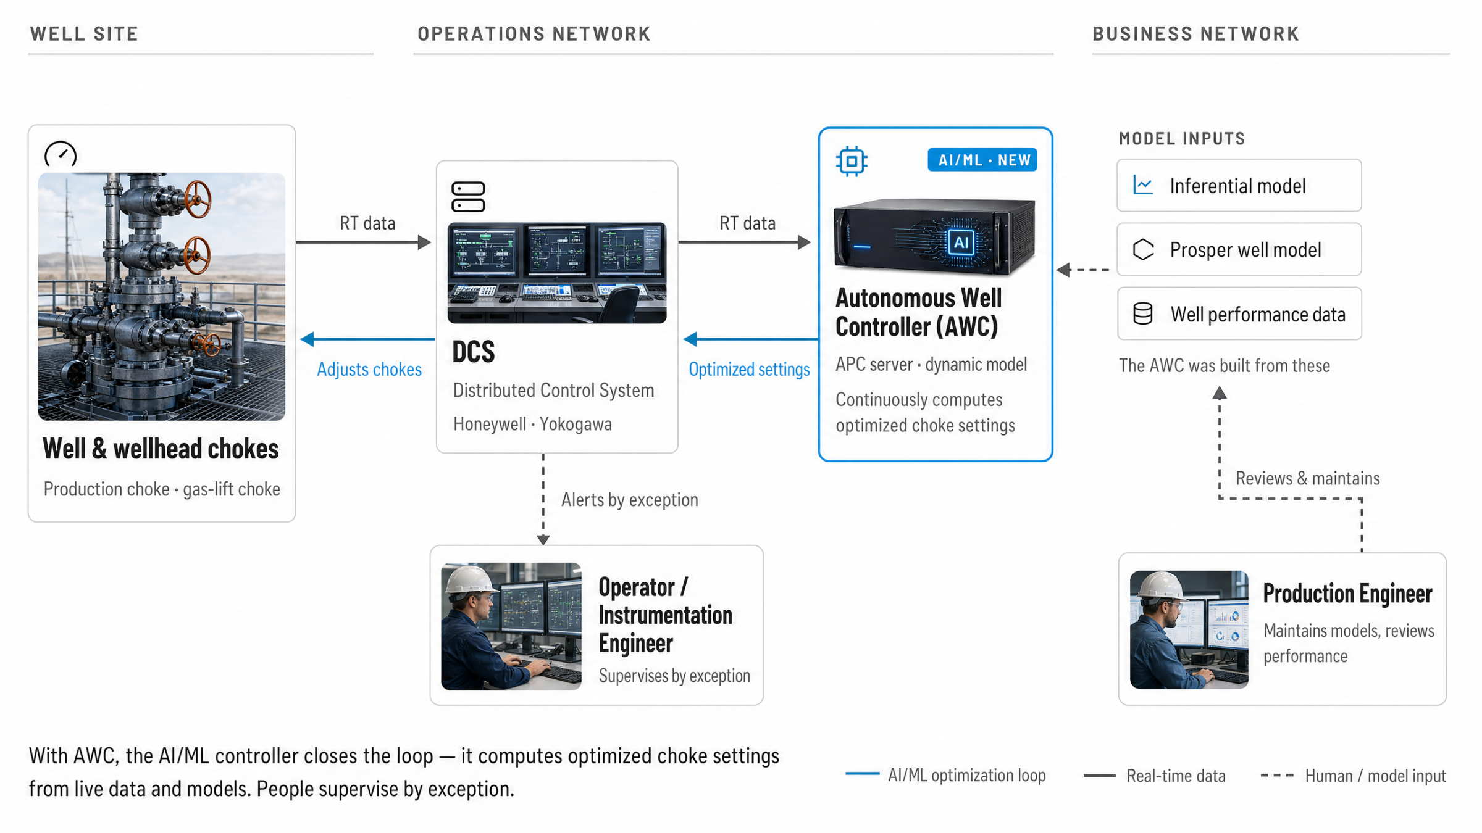
CONTROL LOOP
Where AI/ML sits in the control loop
Notes:
Ahsan: Walk through the system L-to-R.
Call out the Control Loop & how each model is being used.
Explain Control, Manipulated, and Disturbance variables with room temperature example.
Its not 1 well - its dozens or hundreds in a field.

Slide 12


BUSINESS VALUE & BENEFITS
What AWC improves
01
Production
02
Quality & compliance
Keeps every well flowing at its target rate, regardless of backpressure changes.
Achieves and holds the oil-rate target within the operating envelope.
Optimises and reduces gas-lift consumption per barrel produced.
Minimises operating-guideline violations across the field.
03
Operator workload
04
Safety & people
Mimics the expert action plan and removes repetitive manual intervention.
Autonomous control reduces exposure to human error and reports CV violations.
Simplifies well management from many set-points to a single target file.
Shares expert knowledge across cross-functional teams.
heuristiq.io
Notes:
Frame the four areas AWC improves: production, quality and compliance, operator workload, safety and people. Lead with outcomes; the next slides show the evidence.

Slide 13
STARTING STATE — COMPLIANCE & PRODUCTIVITY
±1%
Holds the target rate through backpressure swings
AWC held to target; operator case fell to −8%
AWC (APC)
Operator
Target 3,000 bbls
Anonymised sample: one well, ~7 days
Oil production (bbls/d)
APC on — target reached
Backpressure rises — AWC opens choke
Operator re-tunes well
3,000
2,750
Operator production shortfall
2,500
30
Gas-lift choke (%)
20
Day 1
Day 3
Day 5
Day 7
heuristiq.io
Notes:
Sample well data. AWC holds the target rate within about one percent through a downstream backpressure event by opening the gas-lift choke automatically. The operator case drifts eight percent below target until the well is manually re-tuned days later.

Slide 14
COMPARISON
Is it worth it? Value per well
ASSUMPTIONS
VALUE CREATED
$4.11MM
Oil rate
3,000 BOPD
Oil price
$75 / bbl
per year
5%
$11,250
Improvement
per day
Exact annual figure: $4,106,250 across 365 days.
One well, one modest uplift — the annual value clears the cost of the improvement well before it is repeated across the field.
heuristiq.io
Notes:
One well, concrete numbers: 3,000 BOPD at $75 with a 5% uplift is $11,250 a day, $4.1M a year.

Slide 15
SECTION TWO
02
Baseline State
What I inherited
Notes:
Transition. Signals a new part of the story. All is “perfectly Agile”…(?)
The Local Optimization Trap (10–12 minutes):
The core challenge is examined: local optimization across disciplines (engineering, operations, reservoir, governance) created delays, excessive focus on anomalies, and decision paralysis. The session explicitly names common Agile and Lean heuristics—such as “stop starting, start finishing”—and demonstrates how they became disabling constraints under conditions of high uncertainty, where “done” could not be objectively determined.
A brief audience reflection invites participants to identify where similar local optimization patterns have limited flow or learning in their own organizations.

Slide 16
Customer approves wells,
provides physics models
ENGINEERING WORKFLOW TO DEPLOY A WELL
Customer conducts Step Tests
Expensive test —
Iterative Process: “Learn from each well”
requires well to be down 3-4 days
Build AWC controllers
Customer updates models —
in batches
timeline often unknown
Every well ran the full deploy → test → tune → root-cause loop before moving on — Customer Engineering team needed to understand well behavior & error root cause.
Told to reuse an old model
→ fails later in the field
Deploy one well
MPFM field tests to calibrate
test · tune · troubleshoot
— takes days
iterate
Root-cause analysis
Well still in approved batch:
per Customer Engineering
postpone or deploy fewer
Update current production rate
Process flow
Update controller
Issue / delay branch
& re-deploy
PMI Agile 2026
Notes:
MAIN MESSAGE: Because it’s a regulated, safety-critical environment where the cost of a bad well is not only dollars but could be life-threatening, Engineering has been trained to follow an agile, iterative process where they learn from each controller that is installed, adapt, and then move on to the next well.
Full body text: Sequential well installs — the team built AWC controllers in batches, then followed a sequential process to deploy one: test it, tune it, troubleshoot with root-cause analysis (per Customer Engineering demands), then update the AWC controller and re-deploy — or else postpone the well (but still had to report follow-ups and resolution to the Customer). This mindset was not only evident in the customer BUT ALSO my team of engineers: 'can't leave controllers in an incomplete state, very dangerous, can't take that responsibility & we must leave well performance accountability with the customer.' Delivery notes: walk the sequential loop, then show how issues shoot off at every step — model freshness/timeline, old-model workarounds, MPFM calibration delays, postponements. Land the quote.

Slide 17
BASELINE STATE
Standard Agile Deployment; “Stop Starting, Start Finishing”
106 wells accepted across 11 months, against 166–230 available for deployment.
Uneven acceptance rate due to variable times for fixing issues.
88
wells deployed in 230 days
DEPLOYMENT RATE
88 / 230 ≈ 0.38 wells per day
1 well every 2.63 days
heuristiq.io
Notes:
Promoted heavily by all parties – it was good, andl eading the industry….

Slide 18


PROJECT COMPLEXITY
HSE and Regulatory Complexity; Sovereign Mandates
HSE & regulatory
Sovereign mandates
Every controller, software, or hardware reaching the field had to carry FAT and SAT evidence — no shortcuts.
Energy production underwrites national security and daily life.
Alarm and control changes to operations control panels are rigorously controlled.
National budgets are set against production targets, so schedule is fiscal policy.
Permits and shutdown windows set the cadence; the sprint does not.
Deviation is unacceptable outside force majeure — scope flexes, output does not.
Documentation is a deliverable, not overhead — it is what the regulator inspects.
Delivery is judged on uninterrupted operations, not on velocity charts.
heuristiq.io
Notes:
Two hard constraints that shape every delivery decision in the field: safety/regulatory sign-off per controller, and sovereign production targets that make schedule slip a national-budget issue.

Slide 19
REGULATED ENVIRONMENT
Compliance & Alignment Challenges
Three independent compliance regimes. Each locally correct; jointly, multiple approval gates on one field release.
Engineering
Operations
Infrastructure
REGULATION
REGULATION
REGULATION
Safety-related changes need design-authority sign-off and a functional-safety impact assessment before merge.
Permit to work and management of change gate every field intervention, including software-only ones.
OT/IT segregation and data-residency rules forbid a direct path from field network to cloud.
POLICY
POLICY
POLICY
One change-advisory board per week. Anything missing the packet waits seven days, not seven minutes.
Frozen periods around production windows and turnarounds removed roughly a third of the calendar.
Field-to-Operations dashboard fully owned by Contract Holder.
PRACTICE
PRACTICE
PRACTICE
Full regression re-run on every configuration change. Long-term well performance & health was prioritized.
Well safety and monthly production targets were highest priority. Operators have last word on field operations.
Contract Holder owned dashboards development – Deployment was deemed incomplete until this was completed.
Every rule above was written to prevent a real failure.
heuristiq.io
Notes:
Conflicting compliance / accountability story
Emphasize the core message that:
Departments were tight on compliance to avoid being blamed for production/safety issues.
This led to suboptimization: each group setting its own “fear boundary” instead of optimizing for the whole system.
Make sure the slides frame this as a system problem (no one owning the whole) rather than individual incompetence or bad intent.

Slide 20
PROJECT COMPLEXITY
Organization and Contractual Complexity
CUSTOMER
Fixed price
Time & materials
HQ / Engineering
Long-horizon outcomes
Operations
Here-and-now production
Long-term support & maintenance
Honeywell
Unknown / not shared
Contract Holder
Yokogawa
GENERAL CONTRACTOR
Halliburton
DELIVERY ENVIRONMENTS
Office / Engineering
Engineering
Consulting Firm
Land Operations
Offshore Operations
heuristiq.io
Notes:
7 companies: Customer HQ/Engineering, Customer Operations, Contract Holder, General Contractor (Halliburton) over Honeywell, Yokogawa, and an Engineering Consulting Firm. Four contract models: Customer–Contract Holder unknown/not shared; Contract Holder–Halliburton fixed price; Halliburton to Honeywell/Yokogawa/Eng Consulting on Time & Materials; Customer direct to Honeywell & Yokogawa for long-term support and maintenance. Three delivery environments: office/engineering, land operations, offshore operations. The General Contractor did not control all partners, and some key engineers operated under contradictory contract models (e.g. a Honeywell lead engineer doing service delivery for us versus HON's long-tailed support model).

Slide 21
“I will not be responsible for a drop in production or quality.”
“
Operations Lead· Customer Offshore Platform
“ We can’t leave a well in an incomplete state — each AWC controller must be tuned and fixed so that well-performance accountability remains with the customer. ”
Lead Engineering Architect· General Contractor Team
Notes:
Reflects the “fear boundary” – real or perceived – that individuals were not willing to cross….

Slide 22
KEY POINTS
Why alignment was a guessing game
Different compensation structures drove different priorities.
Fixed-price, time-and-materials, and long-term support contracts each reward different behavior. Individuals optimized for their own contract, not the shared outcome.
The Customer was effectively two organizations.
HQ / Engineering optimized for long-horizon outcomes; Operations cared only about this month's production. The program was pulled in two directions at once.
The Contract Holder's metrics were never shared.
With no visibility into what they were measured on, aligning incentives across the chain was a guessing game.
heuristiq.io
Notes:
Why didn't we simplify by swapping partners for equivalents on more aligned contracts? First, the skillsets weren't readily available — the FDE had to be mobilized from India, with no local alternatives. Second, the process was a mess with totally inconsistent cadence, so whatever useful experience existed lived in people's heads. Replacing them would have lost that experience before it could be transferred into the process.

Slide 23
STARTING STATE
100%
Understanding the
Challenges
92%
134
123
81%
80% threshold
Summary of issues from first 6 months of the project.
Highest frequency issues not in our direct control.
63%
70
33%
46.5
32
Field
Wells
Mobilization
Client Internal
Unanticipated Work
Operations
Data
Delays
Alignment
Scope
Total delay (person-days)
Cumulative %
Notes:
“I worked with the project leads to understand where the challenges were, where we were getting delayed….”
Pareto has some caveats: sometimes you have more control or can effect change on the lower frequency issues more than the higher, so its not a guide as to how you go about improving quality.
---
Two or three sentences explaining what the image shows and the single takeaway you want the audience to hold onto.
Show, don't tell. The caption carries the point.

Slide 24
KEY POINTS
Summary
Project was widely publicized because of innovation (by customer, contract holder, and Halliburton).
Erratic deployment was reluctantly accepted as par for a new technology, perhaps?.
However – remember the contract structures – we were losing our shirt!
Fixed Price contract meant we paid for engineers and running expenses regardless of progress
heuristiq.io
Notes:
Three or four points, no more. Talk to each one.

Slide 25
SECTION THREE
03
Revisiting the Workflow
From perfect outputs to system knowledge
Notes:
Transition. Signals a new part of the story.

Slide 26
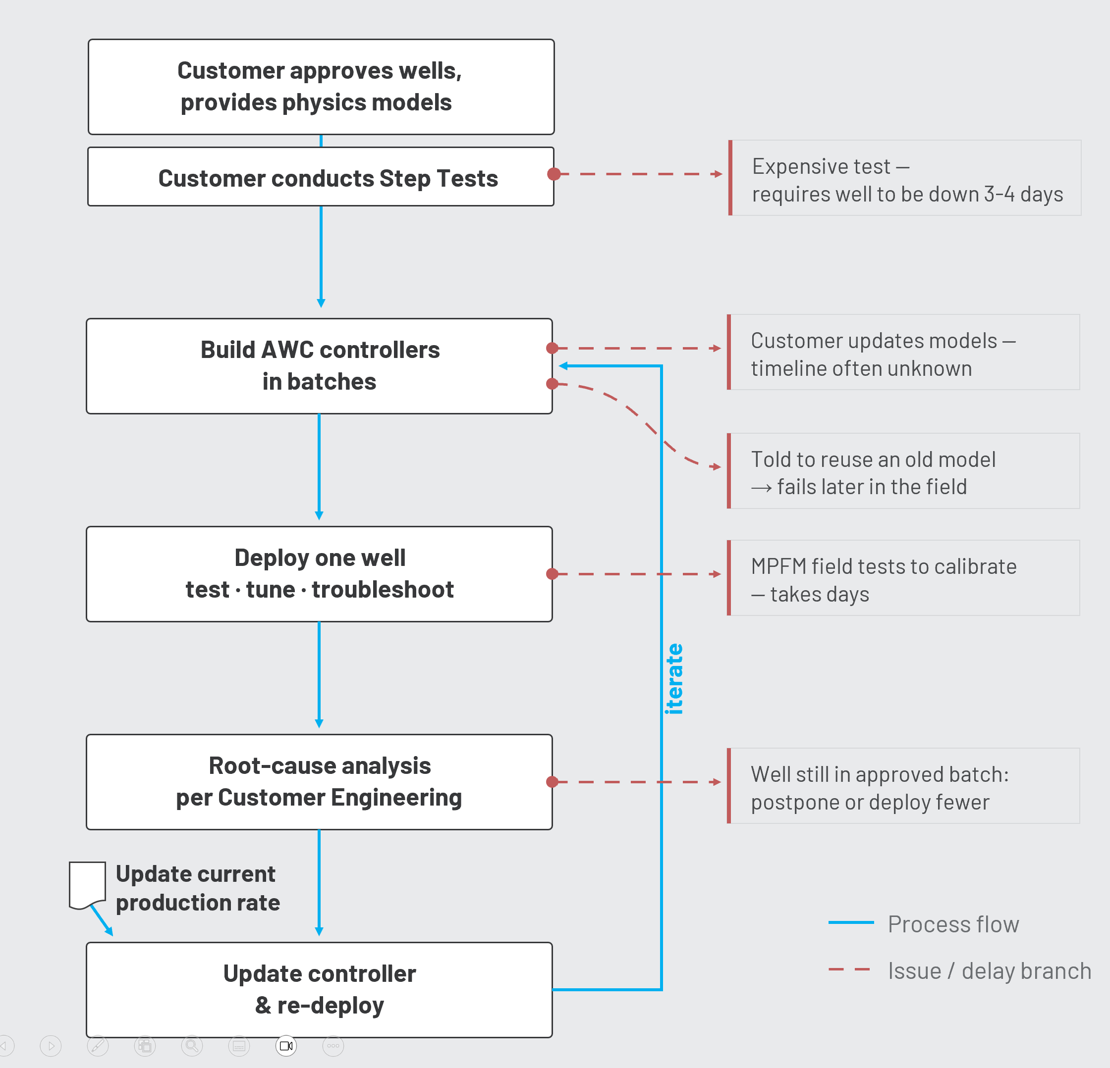
REVISIT: ENGINEERING WORKFLOW TO DEPLOY A WELL
Side Effects of The Iterative Process
01
Root-cause analysis was done for every issue – the most troublesome ones took the longest.
02
An opinion began to form: perhaps this is normal for the technology?
03
Customer continued to extensively publicize their success, but internally they considered re-calibrating expectations.
heuristiq.io
Notes:
02: the question is: was this opinion correct? Did we have enough data points to definitively say that AI/ML controllers on wells take this much effort & time to get working???

Slide 27
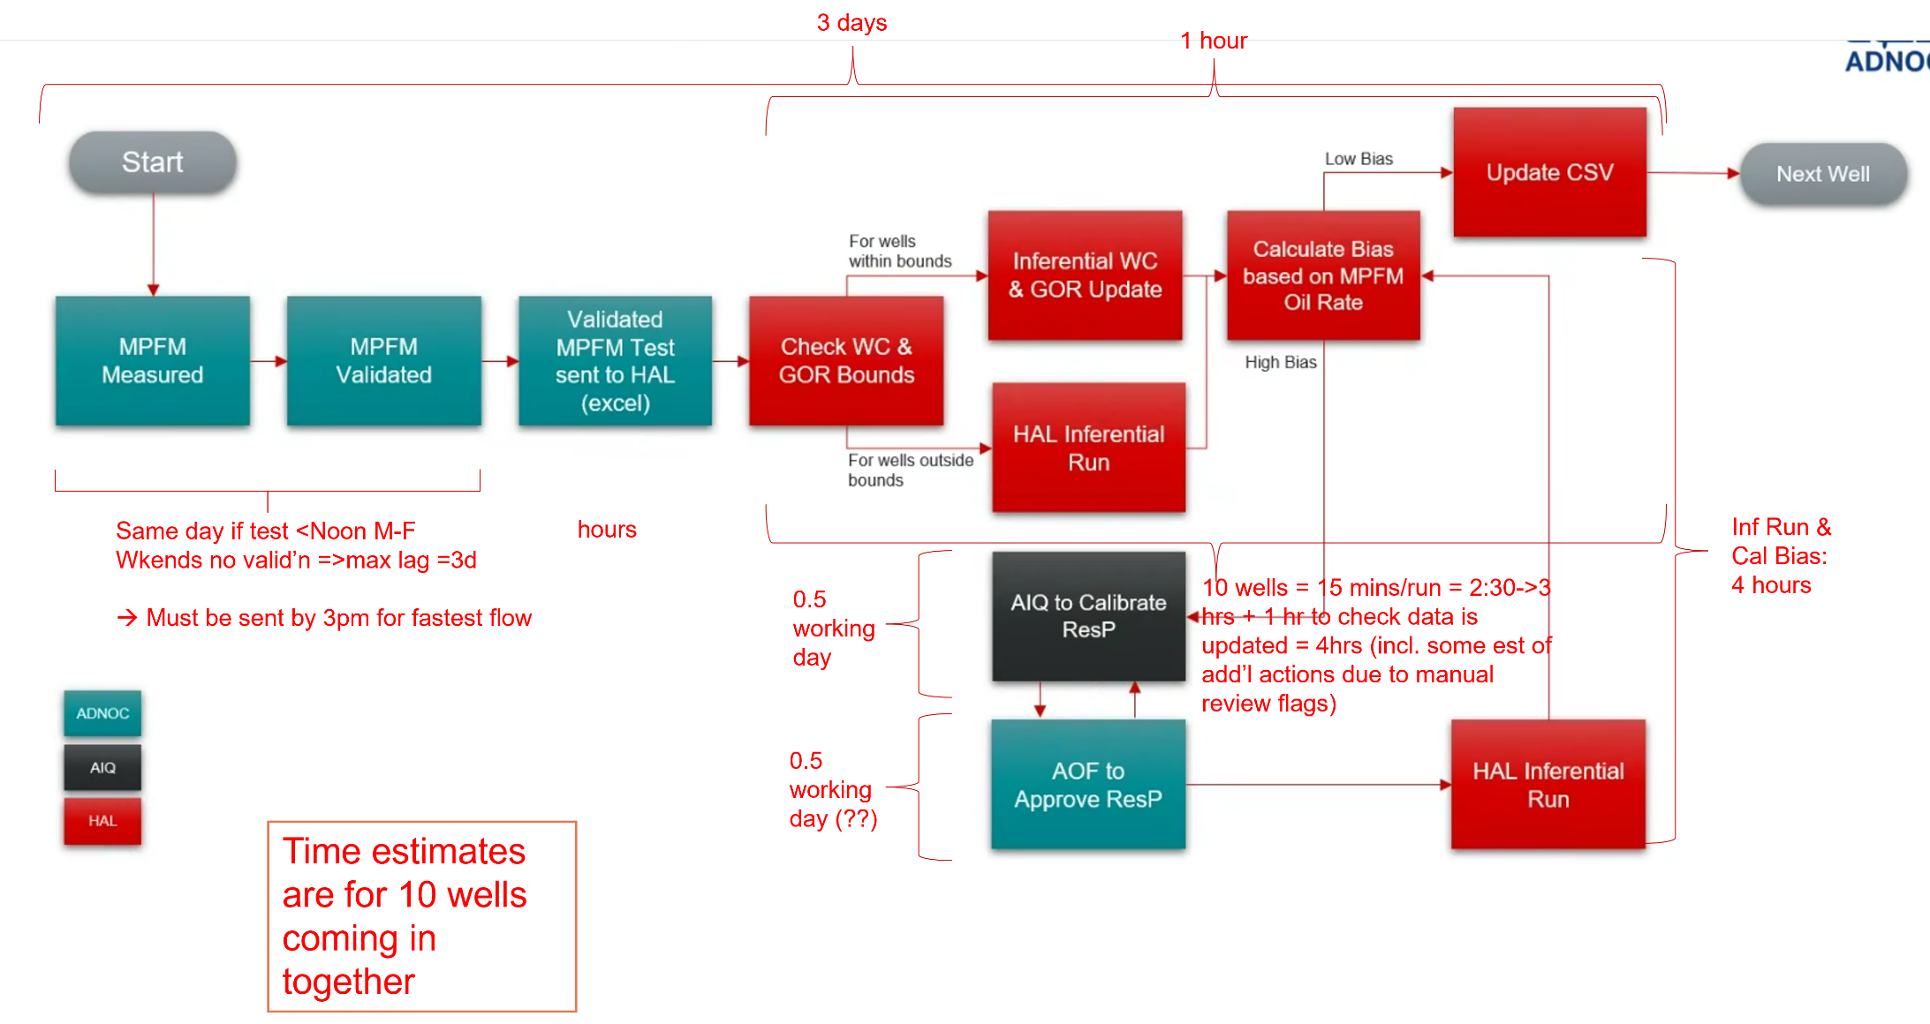
REVISIT: ENGINEERING WORKFLOW TO DEPLOY A WELL
Don’t Assume The Team Knows – Measure!
heuristiq.io
Notes:
My team thought the technology & the complicated environment just had a lot of variance. So I sat with every engineer and walked through their work with them – VSM (like interrogating murder suspects…each one separately). When we reviewed the VSM, we noticed some things:
Some wells are installed in hours, others take days (3 – 4+ days!).
Most wells get installed fast, only some are bad, and a handful are truly the “ugly” – no replicable root-cause identified! These were never gonna work….

Slide 28
CORE WORKFLOW
Value Stream Mapping: The Happy & Not-So-Happy Paths
within bounds
low bias
Check WC &
GOR bounds
Update inferentials
with WC & GOR
Calculate bias vs
MPFM oil rate
Update
CSV file
next well
GENERAL
CONTRACTOR
out of bounds
in-bounds path: ≈ 1 hour
re-run + bias: 4 hrs (10 wells)
hours — send by
3pm for fastest flow
Re-run
inferentials
high bias
MPFM
measured
MPFM
validated
Validated test
sent to HAL (excel)
AOF approve
ResP
Ten wells arriving together.
One step has no number.
CUSTOMER
same day if test < noon M–F · weekend test: no validation, up to 3 days
0.5 working day (??)
Recalibrate
ResP
CONTRACT
HOLDER
0.5 working day
heuristiq.io
Source: Coefficients update process maps
Notes:
[My note: this is basically one of many VSM exercises I did with the teams]
[Same map, now with the measured durations. Let them find the question marks themselves if you can - someone usually does.]
So we baselined it. We walked this process with the people who run it and put a number on every step. Here's what came back.
[Point at the validation note, bottom left.]
Start on the left. If the well test lands before noon on a weekday, validation happens same day. If it lands on a weekend - nothing happens. No validation team. The test waits up to three days before the process even begins.
[Point at the transfer note.]
Then the handoff to HAL: a spreadsheet, sent by email. Hours - and there's a 3pm cutoff for the fastest flow. We have time-of-day rules inside an AI deployment.
[Point at the in-bounds chip.]
Once HAL has it, the happy path is about an hour. With a re-run and bias calculation, four hours for a batch of ten wells - and the actual compute in there is fifteen minutes per well.
[Point at the recalibration and approval chips.]
The exception loop: half a working day for AIQ to recalibrate. And then the approval step. [Pause.] Look at what the team wrote next to it. Half a working day - question mark, question mark. This is the only step in the entire process that nobody could put a number on. No SLA. No one watching the clock.
[Landing.]
Ten wells arriving together, one unmeasured step, and a calendar doing most of the waiting. Now let me show you what all of that adds up to.

Slide 29
KNOWLEDGE AS AGILE DESIGN
"When you come to a fork in the road, take it"
Technical mindset: “When a well is deployed and we don’t get the expected results we need to understand the root cause and fix it before we move on.”
Business mindset: “ When a well is deployed and we don’t get the expected results we have new information and a new set of options. We could put our efforts into understanding and fixing that well, or we simply revert it to manual control and move on to a new well. Which has the higher expected value? ”
heuristiq.io
Notes:
I talk through this slide, set up Todd to talk about the Monty Hall problem next slide…..

Slide 30
THE MONTY HALL PROBLEM
Why you should always switch
One car, two goats, three closed doors. You pick a door; the host — who knows what is behind each — opens a different door to reveal a goat, then offers you the switch. The three equally likely starting cases show the answer.
IF YOU SWITCH, IN EVERY CASE…
YOUR PICK
HOST OPENS
SWITCH TO
WIN PROBABILITY
1⁄3
Case 1
LOSE
Stay
1 in 3 chance
CAR
GOAT
GOAT
YOUR PICK
HOST OPENS
SWITCH TO
2⁄3
Case 2
WIN
Switch
1 in 3 chance
GOAT
GOAT
CAR
YOUR PICK
SWITCH TO
HOST OPENS
The two-thirds chance that your first pick was wrong doesn’t disappear — switching hands it to you as a two-thirds chance of winning.
Case 3
WIN
1 in 3 chance
GOAT
CAR
GOAT
heuristiq.io
Notes:
The two-thirds chance you picked wrong at the start becomes a two-thirds chance of winning when you switch.

Slide 31
DECISION OUTCOMES
Decisions, decisions
Percent success by outcome, cumulative across every deployment.
Success on deploy
70%
Success after analysis and redeploy
20%
Unable to improve
10%
0
10%
20%
30%
40%
50%
60%
70%
80%
90%
100%
PERCENT SUCCESS
heuristiq.io
Notes:
Seven in ten deployments succeed outright. Two more recover after analysis and redeploy. One in ten cannot be improved — that is where judgment, not process, decides.

Slide 32
KNOWLEDGE AS AGILE DESIGN
New information, new decisions
Fix the failed well
Move on to a new well
A fix has a 67% chance of success.
New wells succeed on deployment 70% of the time.
Predominantly an engineering task, taking 3 to 10 days.
Including rework, total success reaches 90%.
A 33% chance the well cannot be improved at all.
Deployment is now possible in half a day.
Will the customer buy the story?
heuristiq.io
Notes:
Two live options. Fixing carries a one-in-three chance of no improvement. A new well deploys in half a day at seventy percent first-pass success, ninety with rework. The open question is whether the customer accepts the reasoning.

Slide 33
SECTION FOUR
04
From Local to System Level
Optimization
Moving towards business value
Notes:
Transition. Signals a new part of the story.

Slide 34
REDESIGN
Conceptual Reframe – Set the Foundation
Validate Data
Up-to-date, standardized physics-based models of all wells
Obtain DCS Screens & tag mappings
Historical information of all wells
Check Field Readiness
Operational readiness of all wells confirmed; shutdown & maintenance plans communicated
Instrumentation health confirmed
Operating envelopes limits provided
Prepare
Conduct Step Tests
Approve step tests candidates & plan
Conduct step tests
Deploy
Inferential Models & Dynamic Linear Models implemented
APC Controllers are built and deployed to APC server
Operator screens are functioning
DCS Watchdog Logic Configuration; Watchdog logic test
APC Functionality Check; well responds to model-based control
Deploy
Tune
Well behavior monitored over a period
Any well-specific variations identified & behavior tuned
Operator learning curve completed
Tune
Sustain
AWC sustaining support structure in place for field
Operator owns AWC operation & oversight in field
Sustain
heuristiq.io
Notes:
Msg for this slide: We had to change the vocabulary to change the mindset - position Tune as a distinct step in the process rather than part of Deploy.

Slide 35




REDESIGN
The Dual Delivery Line Model
delayed configuration*
Prepare
Deploy
Tune
Sustain
Engineering Prepare flows in once; Deploy runs the models at cadence, Tune redirects problem well to a separate root-cause lane, and Sustain incrementally hands steady-state operation back to the field.
Process flow
Delivery line
Throughput — constant velocity in Deploy
heuristiq.io
Notes:
Increasing velocity allowed us to collect more data since more wells could be deployed => increase signal
Remember the product were were making: The AWC controller – there was one final change I made - and this was most consequential for the engineering team:
Decoupling of engineering data from the controller development: we created all controllers with “dummy” configuration data => allowed junior engineers to rapidly create controllers for all possible wells – and worry later about if the well would be available for installation and tuning. This way the engineering team didn’t expend effort into finalizing the controller in case the well suddenly became unavailable – or behaved badly – during deployment when the FDE was on the platform. WHY COULD WE DO THIS? (1) because the dummy values were chosen to trigger the underlying DCS failsafes in case they were accidentally switched on before the final configuration, and (2) because we already had a procedure in place to enter the last-known production rate into the controller from the original process (so no new process / testing was required).

Slide 36
STARTING STATE
Remember This Starting State?
106 wells accepted across 11 months, against 166–230 available for deployment.
Uneven acceptance rate due to variable times for fixing issues.
88
wells deployed in 230 days
DEPLOYMENT RATE
88 / 230 ≈ 0.38 wells per day
1 well every 2.63 days
230 days
heuristiq.io
Notes:
Promoted heavily by all parties – it was good, andl eading the industry….

Slide 37
DUAL ASSEMBLY LINE: FIRST ITERATION
Deployment Closes the Gap
80
79
78
78
70
69
Wells were accepted in smaller daily increments, mostly 1–3 per day.
Cumulative acceptance reached 78 by Aug 19, matching the total wells available.
68 wells deployed in 32 days
Deployment Rate
= 68 / 32
~ 2 wells per day
1 well every 12 hours
Jul 17
Jul 22
Jul 27
Aug 1
Aug 6
Aug 11
Aug 16
Aug 19
32 days
Wells Accepted (Daily)
Cumulative Total Accepted
Total Wells Available
Notes:
So what actualy happened? → velocity amplified the signal.

Slide 38
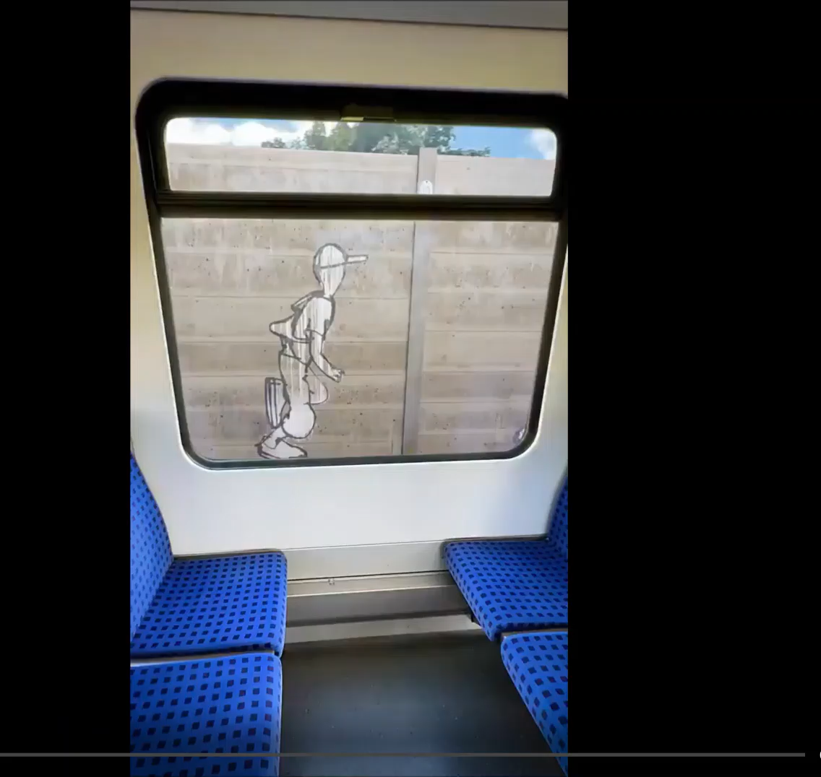
EYEBROW HERE
Title Here
Led a multi-vendor team to deliver an autonomous solution into a 24×7 operational environment, transforming project economics.
Increasing velocity helped amplify the signal.
KEY ACTIONS
Value stream mapping to assess and improve flow
Realignment of the team and delivery processes
Codified a clear methodology for deployment
tbh we stumbled into this realization

Slide 39
“
Delivery velocity and precision fundamentally change when deploying a solution with AI/ML components.
Ahsan Rahi · heuristIQ LLC
Notes:
Let the quote breathe. Precision, not accuracy!

Slide 40
SECTION FIVE
05
And then… magic!
When the student becomes the master
Notes:
Transition. Signals a new part of the story.

Slide 41
PACE OF DEPLOYMENT
SECOND ITERATION
Too rapid to track day–by–day
Too Fast to Chart Daily
All 32 wells
5.5
This second iteration deployed 32 wells in one compressed burst — an average of 5.5 wells per day.
Team was optimizing their respective functions independently of me, finding improvements I had not considered
WELLS PER DAY
Average deployment rate across the run
Steady state velocity of the redesigned system was improving almost daily — further system redesign could be deferred for now.
Day 1 on platform
32
< 7
1
wells deployed
days on platform
FDE, on & off fast

Slide 42
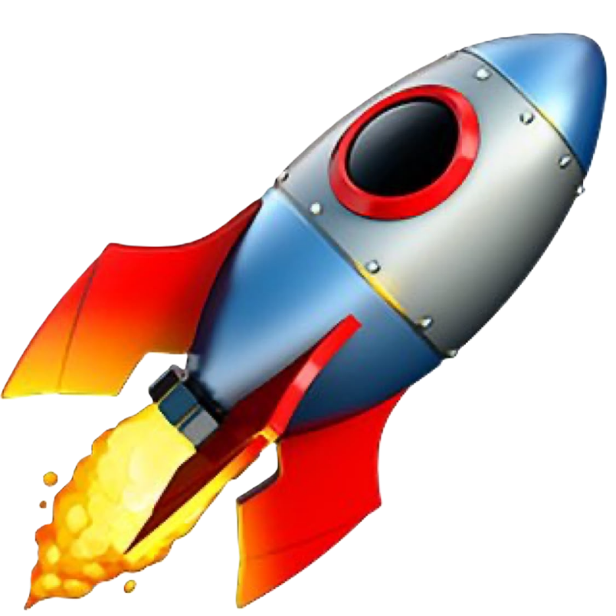
THE RESULT
14
×
faster deployment into a 24×7 operational environment
Customer issues Certificate of Recognition for team. Contract monetization drastically accelerates. Methodology transferred other teams.

Slide 43
SECTION FIVE
06
Outcomes &
Transferable Lessons
takeaways
Notes:
Transition. Signals a new part of the story.

Slide 44
WORKING PRINCIPLES
Mantras to live by
Stop starting and start finishing
Perfection is the enemy of good enough
DAVID ANDERSON
VOLTAIRE
Know when to hold ‘em, when to fold ‘em, know when to walk away, and when to run
Treat exceptions as exceptions
NIEL NICKOLAISEN
KENNY ROGERS
heuristiq.io
Notes:
Four lines that keep judgment honest: finish before starting, ship good enough, know when to walk away, and keep exceptions rare.

Slide 45
TRANSFERABLE LESSONS
Five questions to take back
01
What are you suboptimizing?
02
Where are you stuck in a prior decision and ignoring new information?
03
Are you designed for flow and agility?
04
Is there alignment to a common goal, or do individual and team incentives conflict?
05
Do you know where your delays really are?
heuristiq.io
Notes:
Five questions to take back. They apply to any delivery system, not just wells.

Slide 46
REGULATED AND COMPLEX ENVIRONMENTS
Guiding Principles
01
Do you have some safety nets that allow you move with agility?
02
Which regulations and rules are real, and which have been added out of fear?
03
What heuristics guide you today? Are they actually benefiting you?
04
Are you blindly following heuristic slogans, or “using your brain”?
heuristiq.io
Notes:
In regulated work, the constraint is often assumed rather than real. Separate the regulation from the fear that accreted around it.

Slide 47
SUBOPTIMIZATION IS A BUILT-IN FORM OF RESISTANCE
Dealing with resistance
01
Suboptimization is a built-in form of resistance
02
Provide acceptable alternatives
03
Alignment to a higher good
04
When critical mass is aligned, the friction disappears
heuristiq.io
Notes:
In regulated work, the constraint is often assumed rather than real. Separate the regulation from the fear that accreted around it.

Slide 48
“
The ability to learn faster than your competitors may be
the only sustainable competitive advantage.
Aries de Geus · Former Chairman, Shell
Notes:
Ahsan last slide.

Slide 49

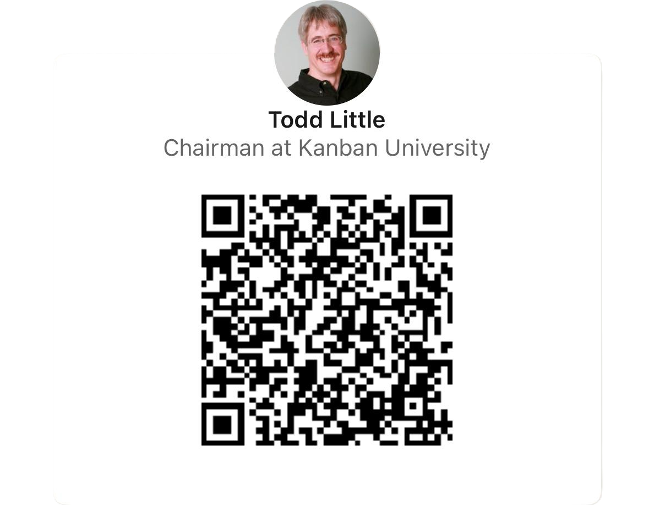
Questions
Notes:
Restate the one idea. Give a clear next step and contact.

