Slide 1

Dealing with Resistance
Todd Little, Agile Earth
Past Chairman, Kanban University

Slide 2
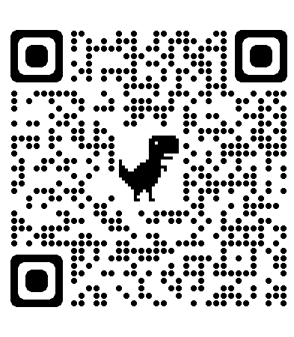
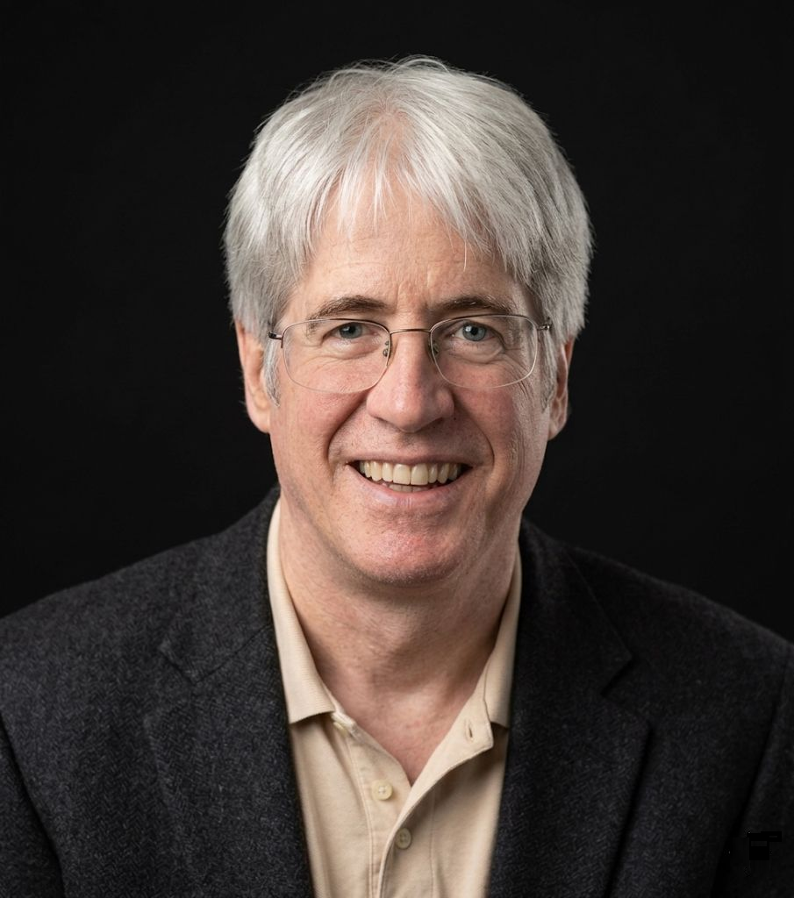



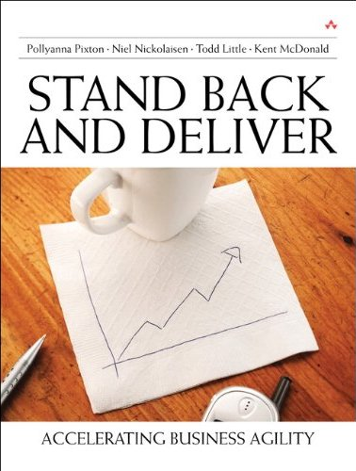


About Todd
Executive roles:
Chairman of Kanban University
VP Product Development
Director of Software & Technology

Slide 3
Outcomes from Agile Transformations
Agile worked for us, and we continue to get better. | Agile helped a bit, but we haven’t gotten much better lately.
Agile has been a disaster. | Agile didn’t really help, but didn’t really hurt either.

Slide 4
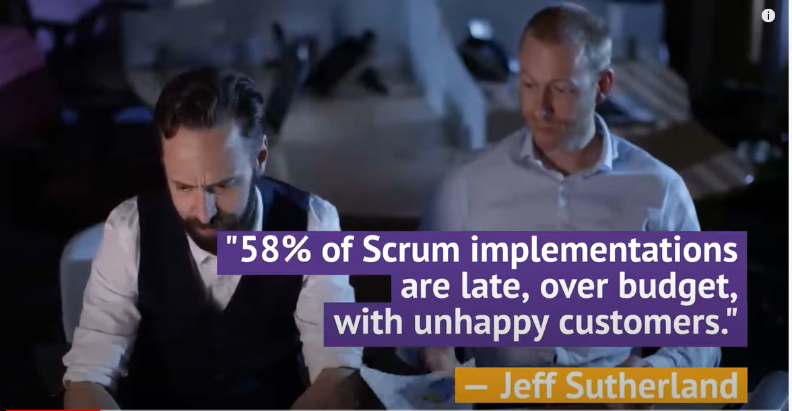

Slide 5
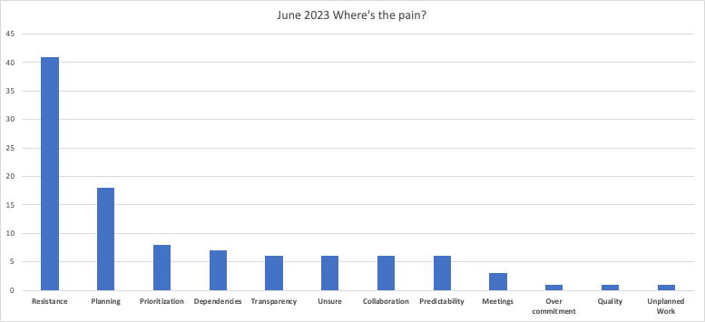
Pains We’ve Discovered
How do I improve flow/predictability
How to I handle resistance

Slide 6
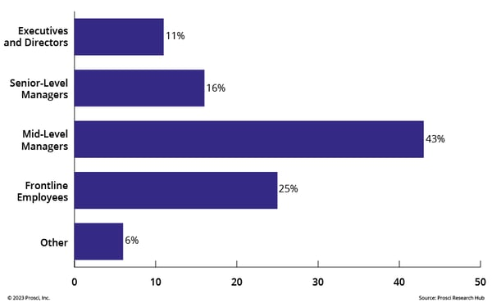
Most Resistant Groups

Slide 7
Our enterprise transformation would have produced meaningful results…

Slide 8
If only…

Slide 9
We had senior executive support!

Slide 10
If only…

Slide 11
People didn’t resist change!

Slide 12
If only…

Slide 13
There was more trust!

Slide 14
If only…

Slide 15
We had better OKRs

Slide 16
If only…

Slide 17
Teams were willing to collaborate with each other

Slide 18
If only…

Slide 19
We had more leadership

Slide 20
If only…

Slide 21
We had fewer dependencies

Slide 22
If only…

Slide 23
Customers were more responsive

Slide 24
If only…

Slide 25
We could prioritize better
We had better, finer-grained requirements or stories
We had direct access to customers
Priorities didn’t change so frequently
Planning wasn’t so painful

Slide 26
If only…

Slide 27
We didn’t measure the wrong things
We were organized differently
We had t-shaped people
We had true cross-functional teams
We had capacity when we needed it

Slide 28
If only …

Slide 29
We can get everyone together and hold a facilitated discussion!

Slide 30
If only facilitated discussions actually fixed any of these problems

Slide 31

Wishful Thinking

Slide 32
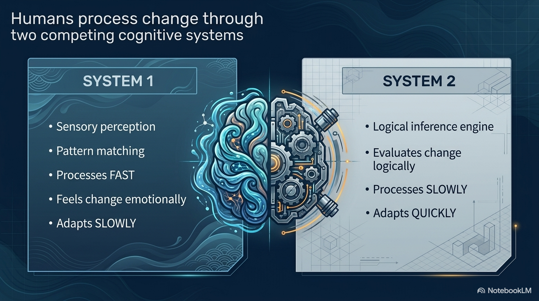
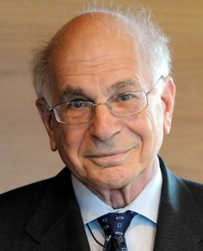

Slide 33
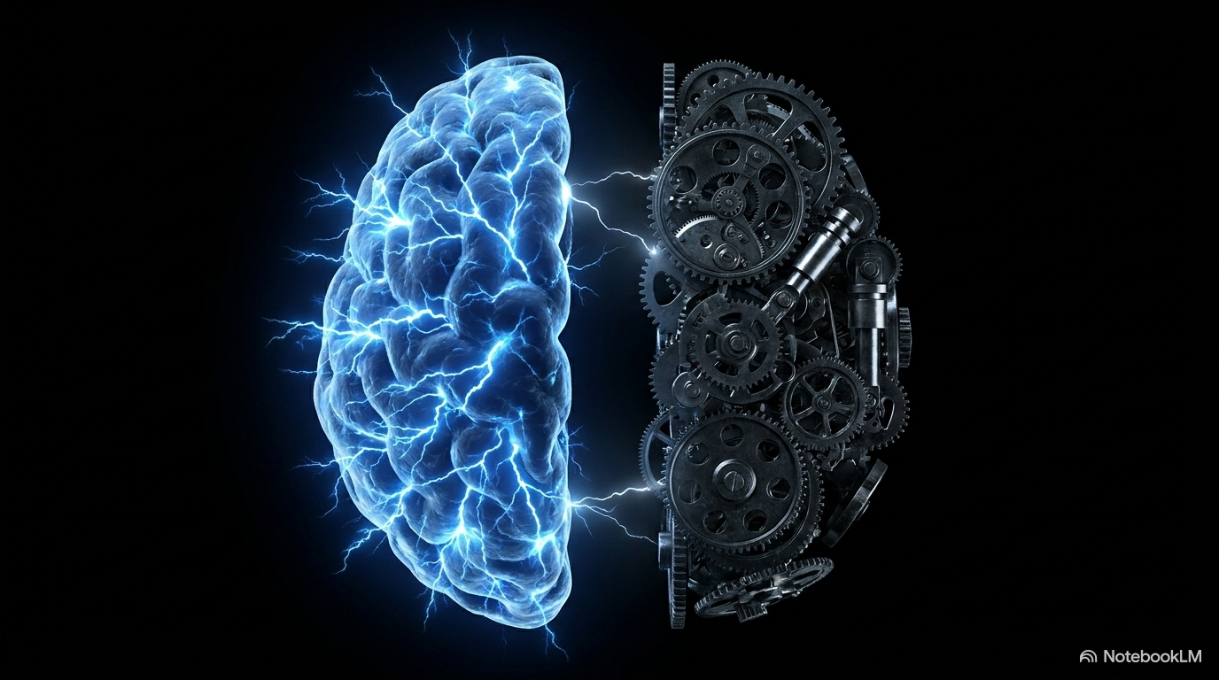

Slide 34


Slide 35
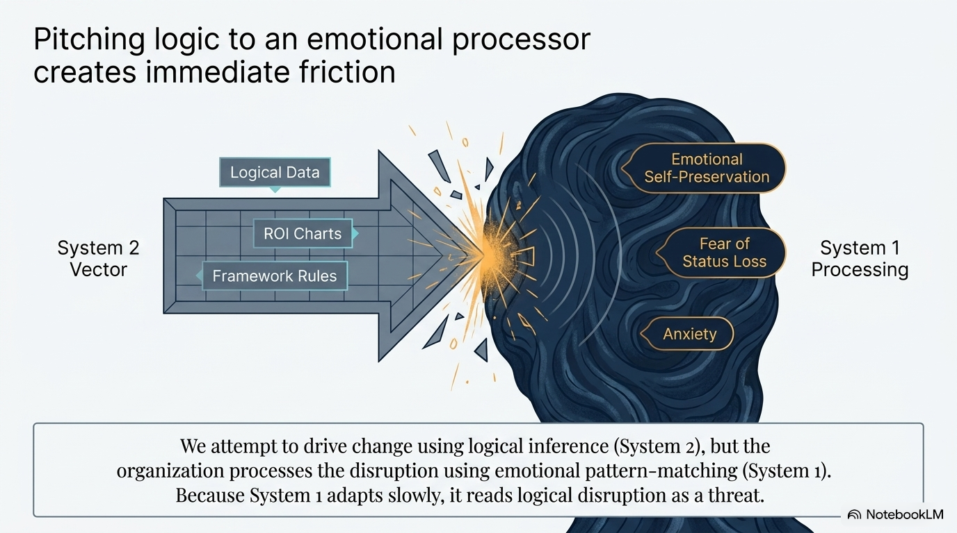

Slide 36
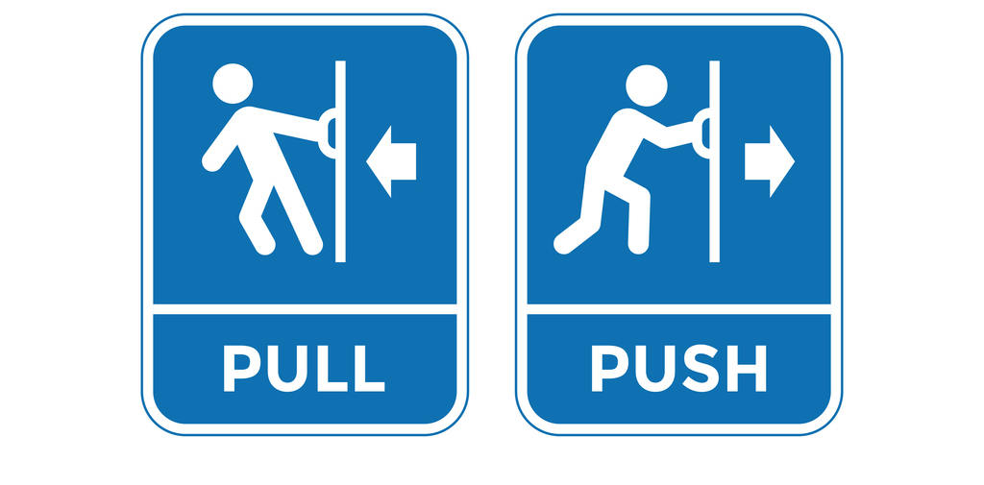
Push vs. Pull

Slide 37

TO CHANGE

Slide 38
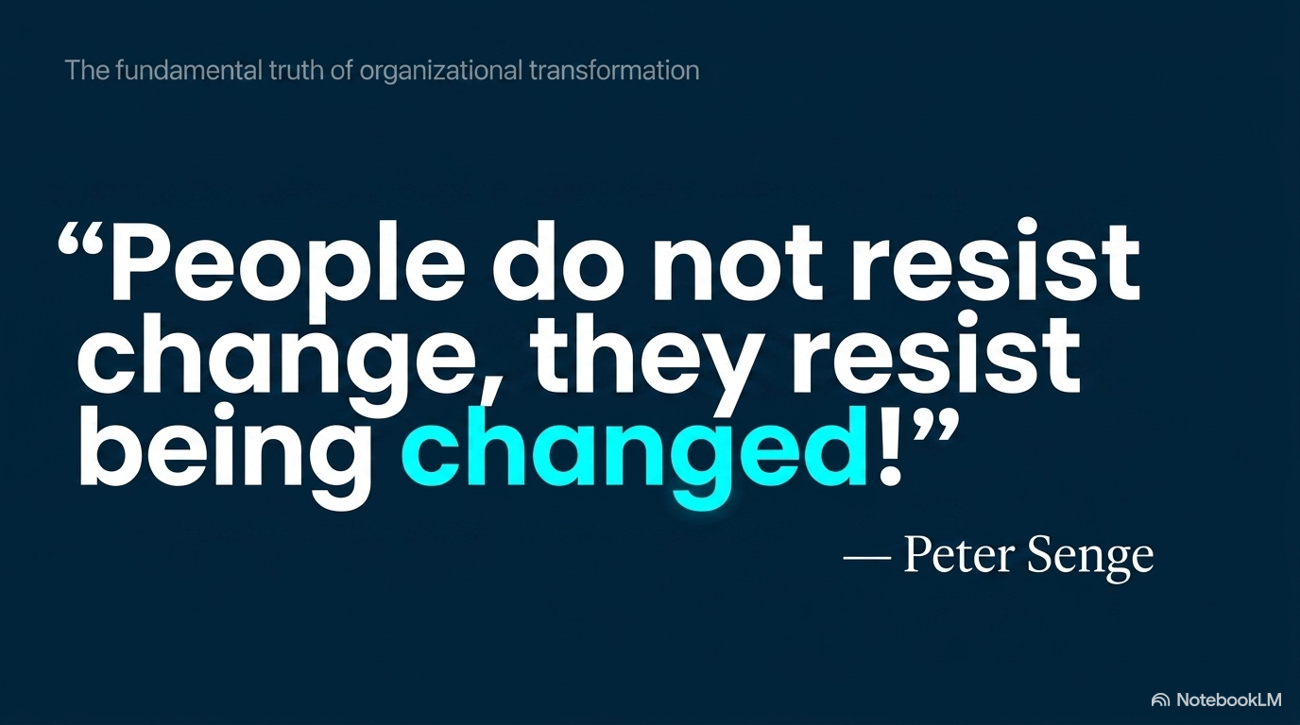

Slide 39

Water flows around the rock
“be like water”
the rock represents resistance
39
Notes:
Goal: Explain the concept in this slide using the information below.
A key teaching in Bruce Lee’s philosophy adapted from Taoism, is "to be like water".
Water flows around the rock.
The rock represents resistance - in fighting, the resistance is from the opponent.
In Kanban, the rock represents resistance to change.

Slide 40
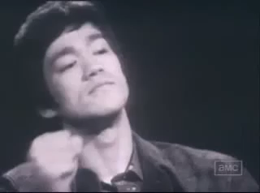
Be Water my Friend

Slide 41

Water becomes the cup
?
We can’t be agile unless we change the culture!
Agile needs to adapt to culture as much as culture needs to adapt to agile.

Slide 42
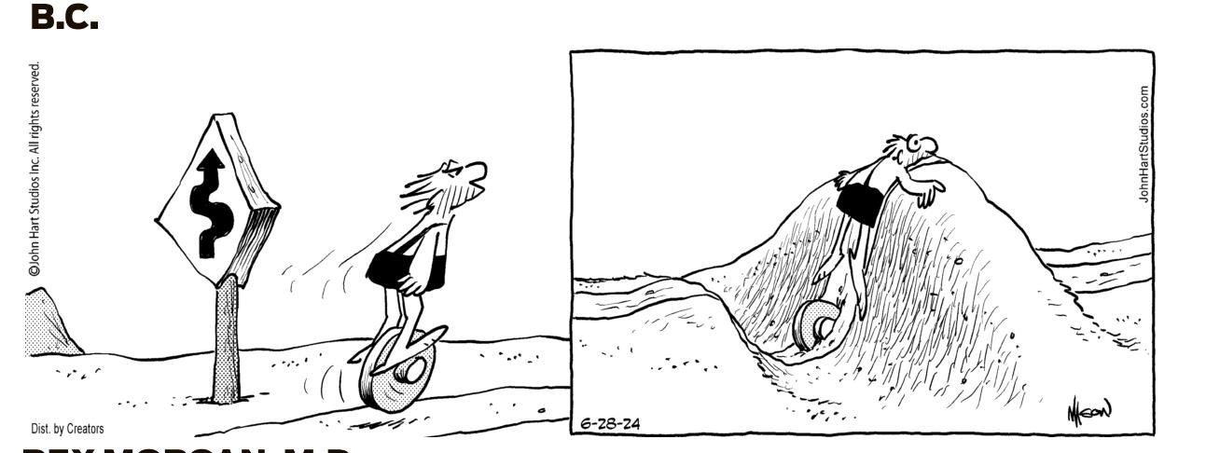
Why Around the Rocks?

Slide 43
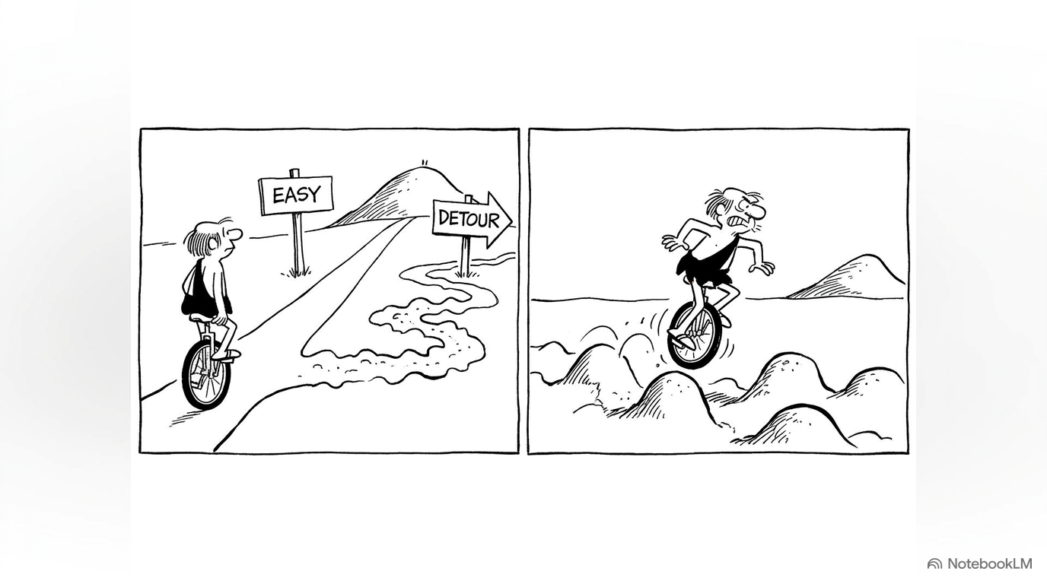

Slide 44
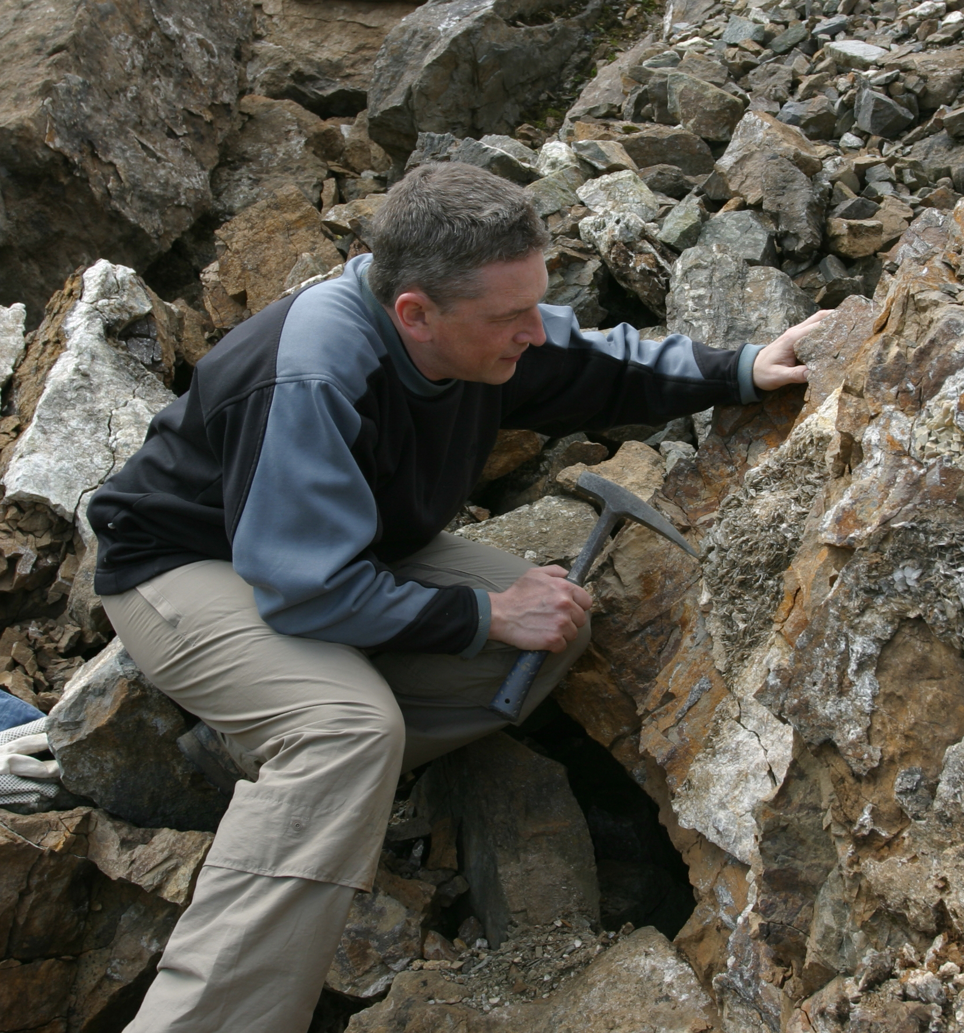

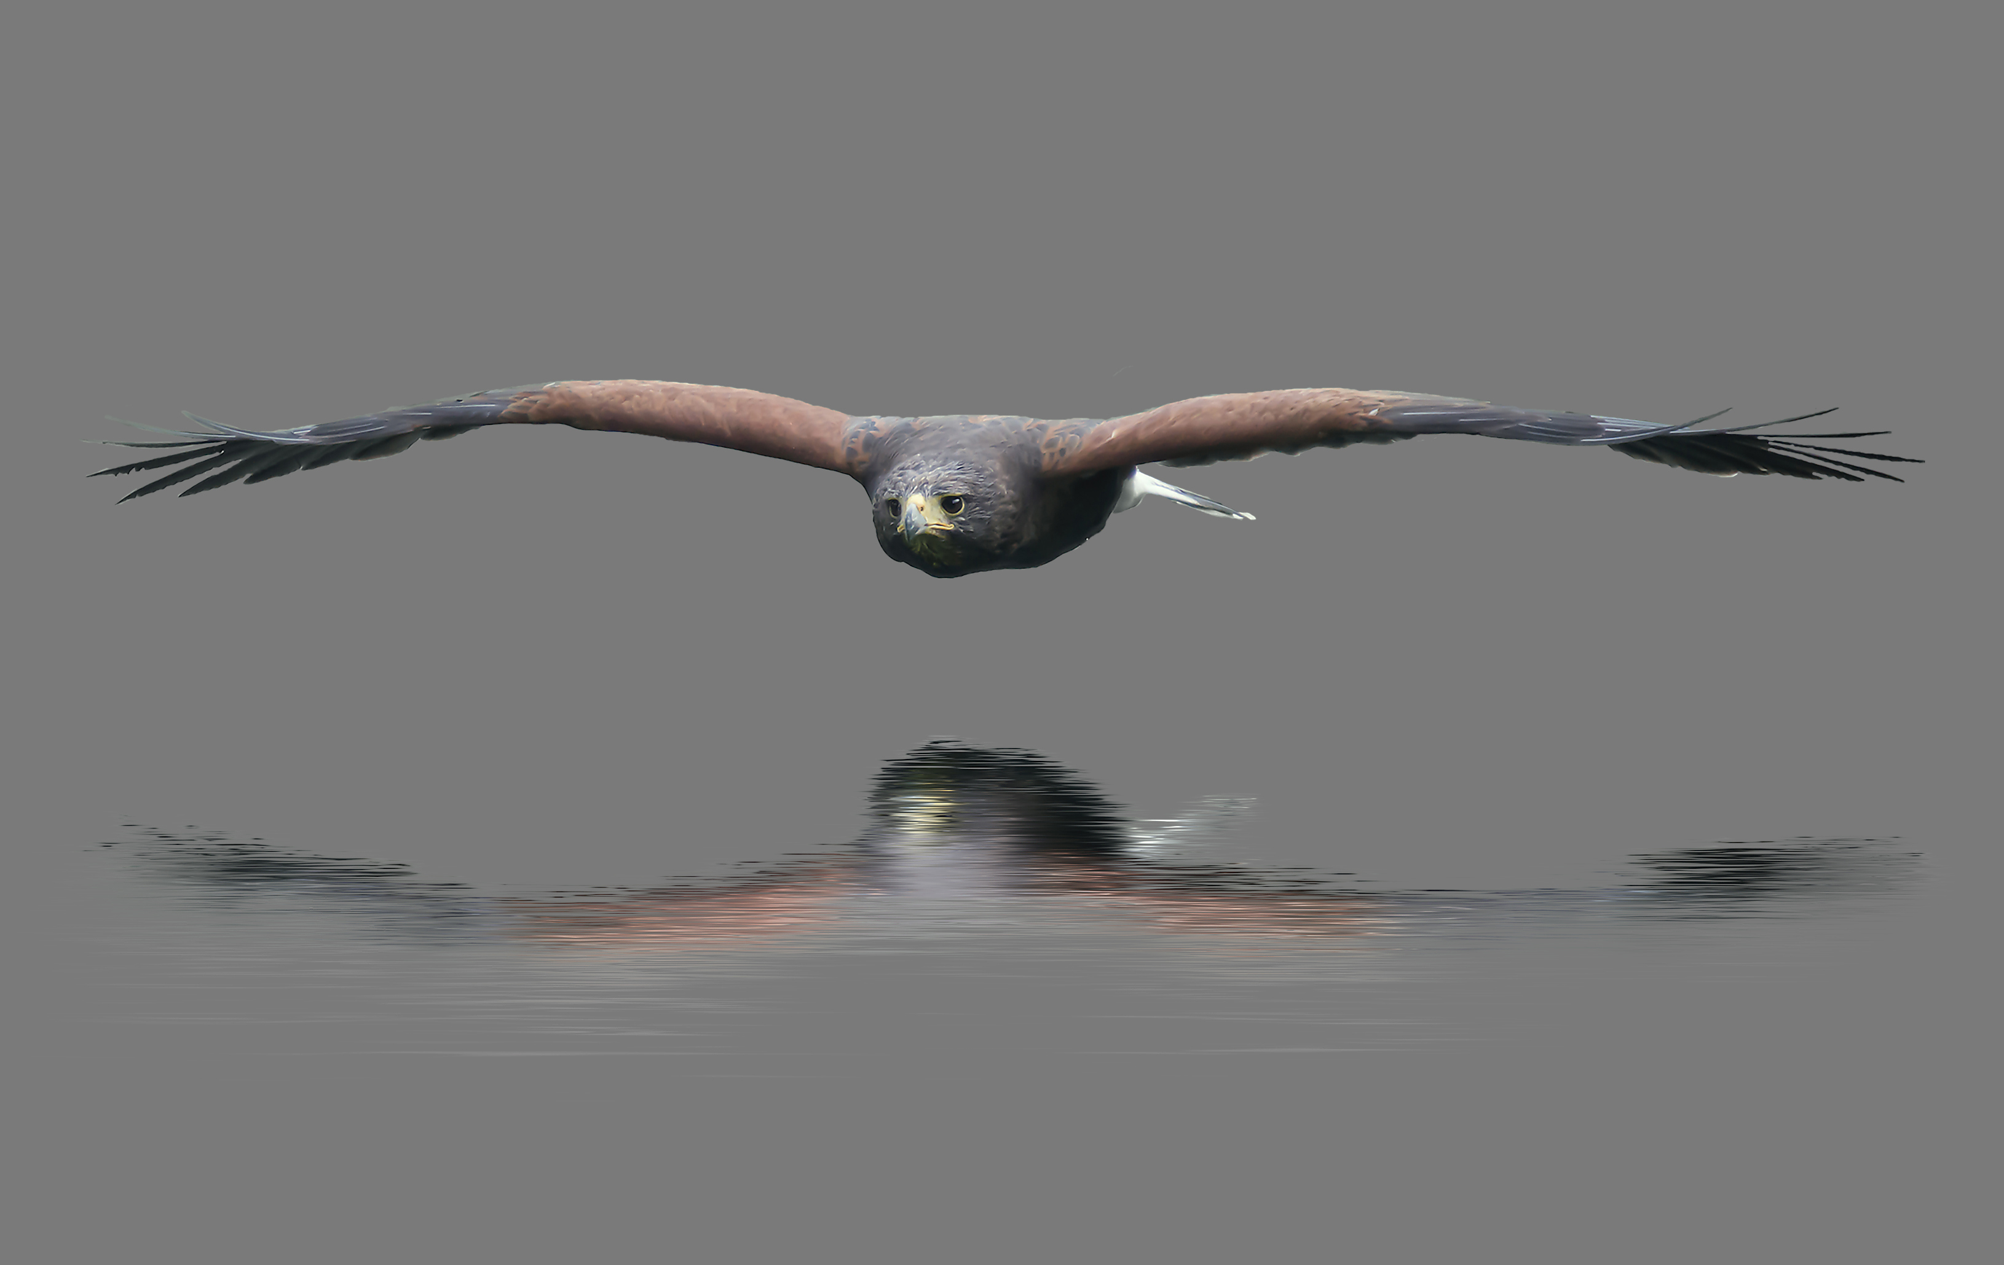
Around the rocks in real life
Under the radar
Break it down
Run experiments

Slide 45
Deeper Dive into Resistance
 | Disagree | Pain
Resistance to the Problem | I don’t agree that is a problem, or don’t think it is important | I actually benefit from the problem
Resistance to the Solution | I don’t agree that the proposed solution will work, or I have a better solution | The solution harms me
Resistance to the Implementation | I don’t agree with how you propose to implement the solution, or I have a better implementation | The implementation harms me

Slide 46

Start with what you do now
Add Kanban principles and practices on top of your existing process or framework
Kanban is NOT a Process Framework!
Kanban IS a method for managing and improving knowledge work service delivery through evolutionary change
Existing Process or Framework

Slide 47

Evolutionary Change is Humane

Slide 48
Change Management Principles
1
Start where you are!
With Kanban, we start by developing and visualizing a joint understanding of the current way of working.
Then, improvements are identified and implemented.
2
Agree to pursue evolutionary change.
3
Acts of leadership at all levels.
Notes:
Goal: explain the change management principles.
Instructions:
These principles are designed to frame an evolutionary approach to improvement.
Briefly walk through each of these principles.

Slide 49
Change Management Principles
1
Start where you are!
Understanding current processes, as actually practiced. Respecting existing roles, responsibilities, and job titles.
2
Agree to pursue evolutionary change.
Make small changes, only as much as you are comfortable
3
Acts of leadership at all levels.
Get comfortable being a bit uncomfortable
Notes:
Goal: explain the change management principles using a slightly different perspective
Instructions:
Start with what you do now! We mean it. If you are currently doing Scrum, then great. We’re going to start with your Scrum and look to improve it through….
Evolutionary change , which means that you only make small changes that you are comfortable with, but
Acts of leadership might make you or team members uncomfortable, so get used to being just a bit uncomfortable.

Slide 50
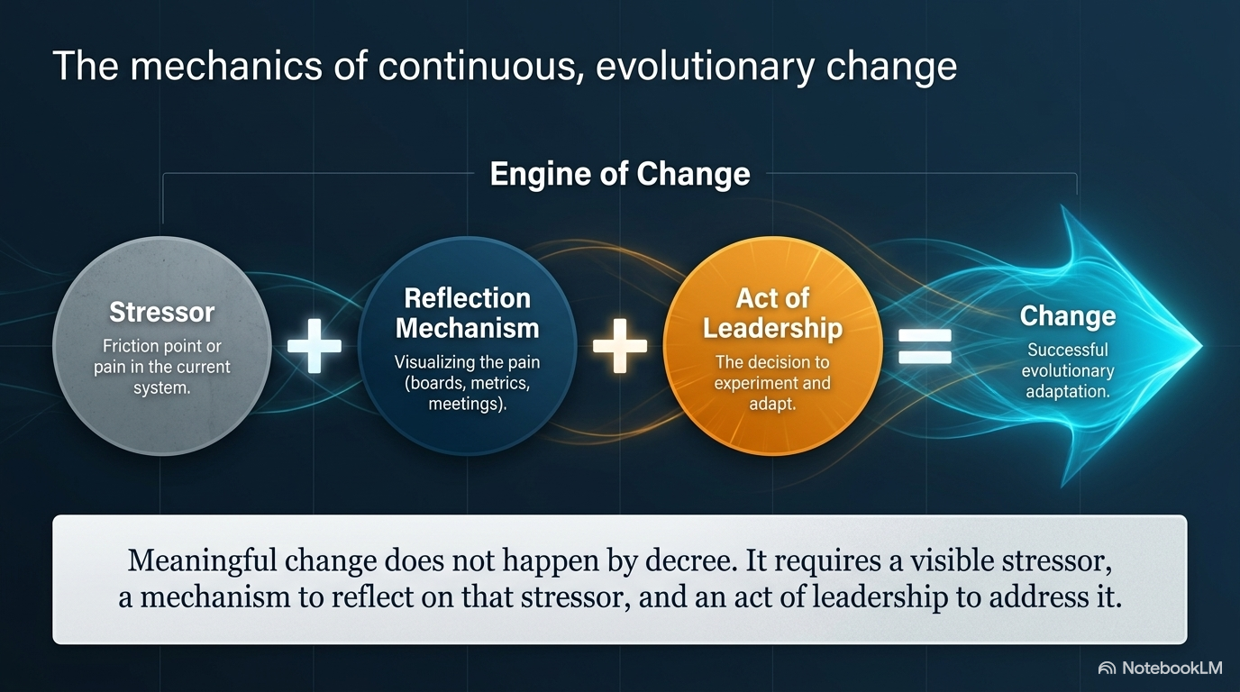

Slide 51
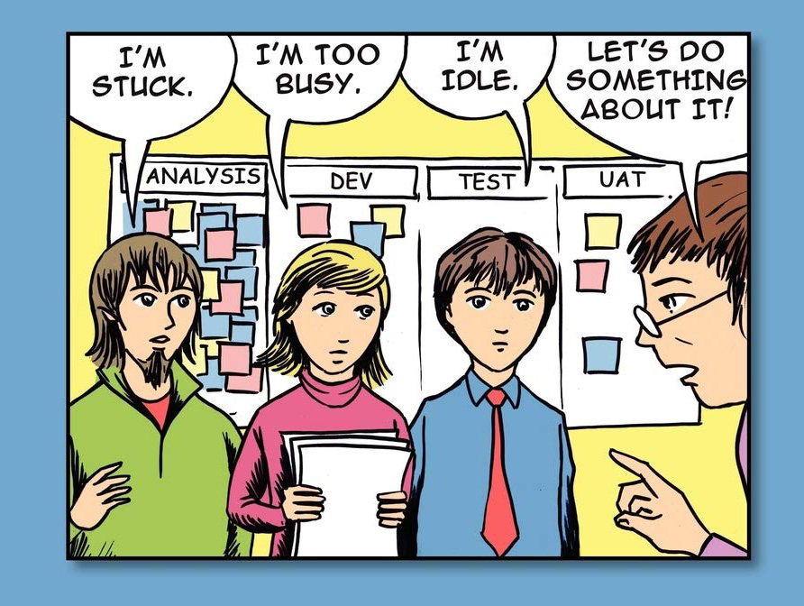

Feedback Loops - Reflection
Feedback
Mechanisms
Feedback
Loop
Communication
Meetings
Board
Acts of
Leadership
Reports and
Metrics
Notes:
Assess this organization – what ML? What problems?

Slide 52
Feedback without action
is not a feedback loop.
Notes:
Goal: to emphasize that one needs to act in order to close a feedback loop.

Slide 53
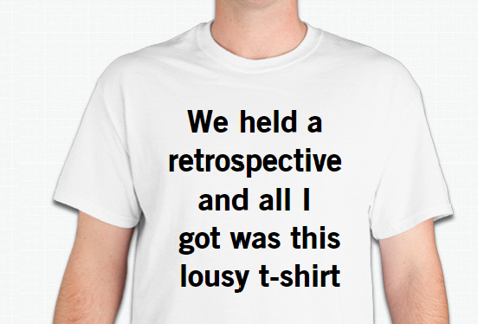
Feedback Loop?

Slide 54
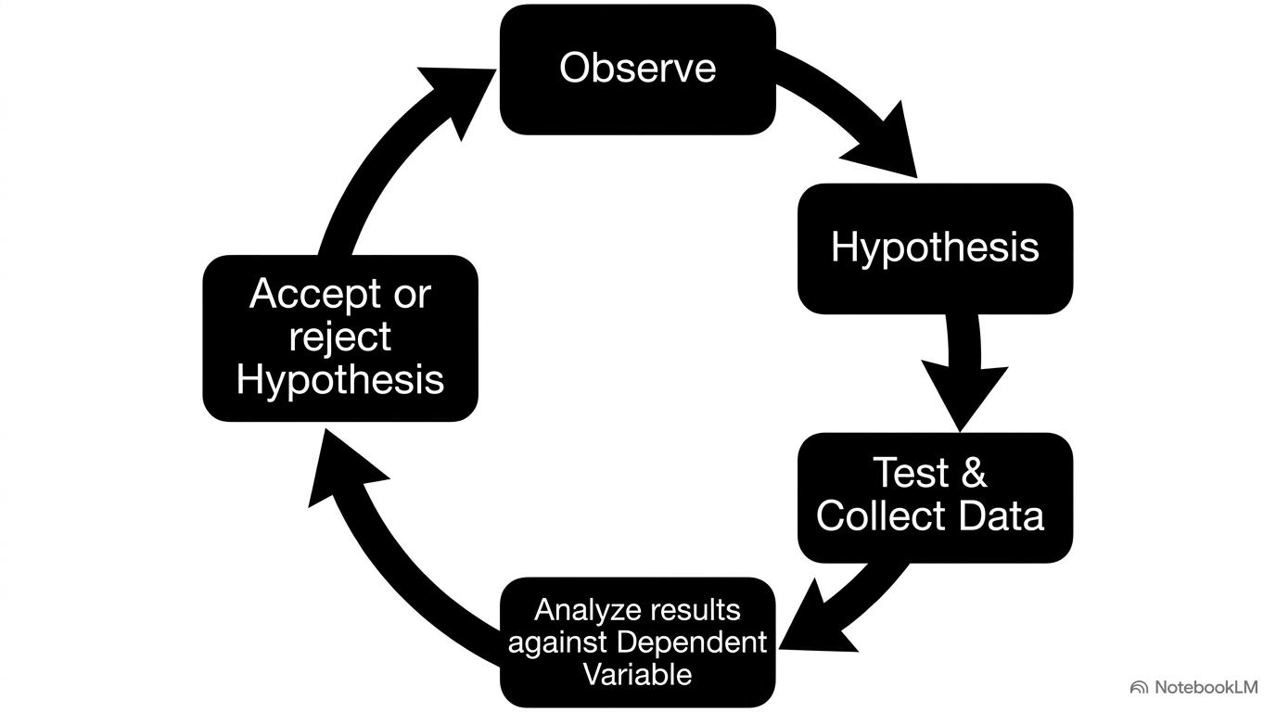

Slide 55
Improve collaboratively, evolve experimentally
Reflect on the problem
Explore solutions
Evaluate difficulty and resistance
Design experiment
Evaluate Fitness
Run Experiment
It Hurts
No longer hurts
Notes:
Goal: When reflecting on the problem, you’re digging deeper. Attempting to find the cause of the problem.
Call out that every step has a feedback loop in itself and can take you back one or more steps in this iterative process.

Slide 56
Improve collaboratively, evolve experimentally
Reflect on the problem
Explore solutions
Evaluate difficulty and resistance
Design experiment
Evaluate Fitness
Run Experiment
It Hurts
No longer hurts
Notes:
Goal: When reflecting on the problem, you’re digging deeper. Attempting to find the cause of the problem.
Call out that every step has a feedback loop in itself and can take you back one or more steps in this iterative process.

Slide 57
Improve collaboratively, evolve experimentally
Reflect on the problem
Explore solutions
Evaluate difficulty and resistance
Design experiment
Evaluate Fitness
Run Experiment
It Hurts
No longer hurts
Notes:
Goal: Explain that once you’ve got a few problems to look at, it’s a great time to start thinking about solutions.
Call out that every step has a feedback loop in itself and can take you back one or more steps in this iterative process.

Slide 58
Improve collaboratively, evolve experimentally
Reflect on the problem
Explore solutions
Evaluate difficulty and resistance
Design experiment
Evaluate Fitness
Run Experiment
It Hurts
No longer hurts
Notes:
Goal: Now that we have some potentially good ideas, we’re going to evaluate them.
Call out that every step has a feedback loop in itself and can take you back one or more steps in this iterative process.

Slide 59

Be like water
Low
Straight
ahead
Assist
Resistance from people
Technical difficulty
Around
the rocks
Defer
High
Low
High
Ability to influence
Notes:
Goal: Orient students to this grid. It should map back to what you’ve previously taught.

Slide 60
Be like water
Rewrite definition of done after looking into it more
Expand the workflow to show visualize what QA is focusing on
Low
Assist
Straight
ahead
Establish a WIP limit of one test per tester
Resistance from people
Technical difficulty
Enforce definition of done
Hire more staff
Around
the rocks
Defer
Implement automated testing
High
Low
High
Ability to influence
60
Notes:
Goal: Describe how Rosie used this grid with her team to assess their ideas.
The green ones indicate they are going to give them a try as an experiment.

Slide 61
Improve collaboratively, evolve experimentally
Reflect on the problem
Explore solutions
Evaluate difficulty and resistance
Design experiment
Evaluate Fitness
Run Experiment
It Hurts
No longer hurts
Notes:
Goal: Now that ideas are in place for one cause, the next step is to put together the design.
Call out that every step has a feedback loop in itself and can take you back one or more steps in this iterative process.

Slide 62
Improve collaboratively, evolve experimentally
Reflect on the problem
Explore solutions
Evaluate difficulty and resistance
Design experiment
Evaluate Fitness
Run Experiment
It Hurts
No longer hurts
Notes:
Goal: Now it’s time to sit, wait, watch, and run the experiment.
Call out that every step has a feedback loop in itself and can take you back one or more steps in this iterative process.

Slide 63
Improve collaboratively, evolve experimentally
Options to consider
Do we roll back a change if it’s not fit?
Even if the pain is there, do we want to keep the change and try something new?
If the pain is gone, we want to explore for another pain.
If there doesn’t appear to be an obvious pain, congratulations! But don’t get complacent. Kanban Maturity Model offers approaches for continued improvements.
Reflect on the problem
Explore solutions
Evaluate difficulty and resistance
Design experiment
Evaluate Fitness
Run Experiment
It Hurts
No longer hurts
Notes:
Goal: When you evaluate fitness, your solution either:
Solved the problem, so it no longer hurts, a new hurt arises.
Did not solve the problem, it still hurts.
Call out that every step has a feedback loop in itself and can take you back one or more steps in this iterative process.

Slide 64
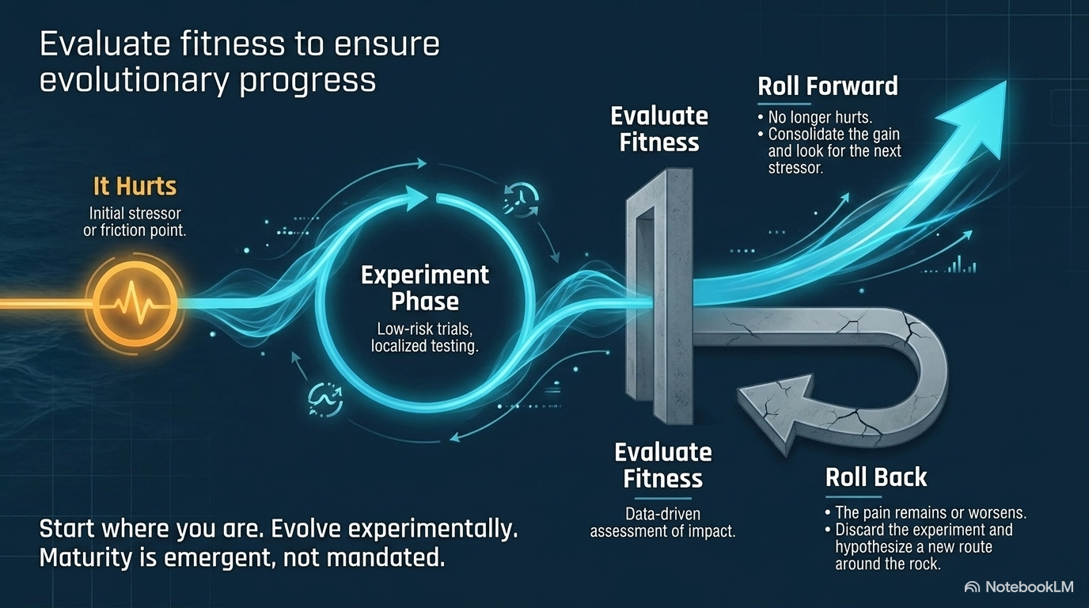

Slide 65
Evolutionary Change
Future maturity
is emergent
Evaluate Fitness
Evaluate Fitness
Evaluate Fitness
Evaluate Fitness
Roll forward
Evaluate Fitness
Roll back
Initial Maturity
Evolving Maturity
Notes:
Kanban uses evolutionary change which makes small steps and evaluates the results. Some changes are rolled back.
Traditional change is an A to B process. A is where you are now. B is a destination. B is either defined (from a methodology definition) or designed (by tailoring a framework).
To get from A to B, a change agency* will guide a transition initiative to install destination B into the organization.
*either an internal SEPG or external consultants
Your capability to change is low at the beginning
As you move forward, your capability improves and you can risk more significant change
You change management capability improves as you go
So does your process
Check out the Kanban Maturity Modell if you want to learn more

Slide 66
Most Resistant Groups

Slide 67
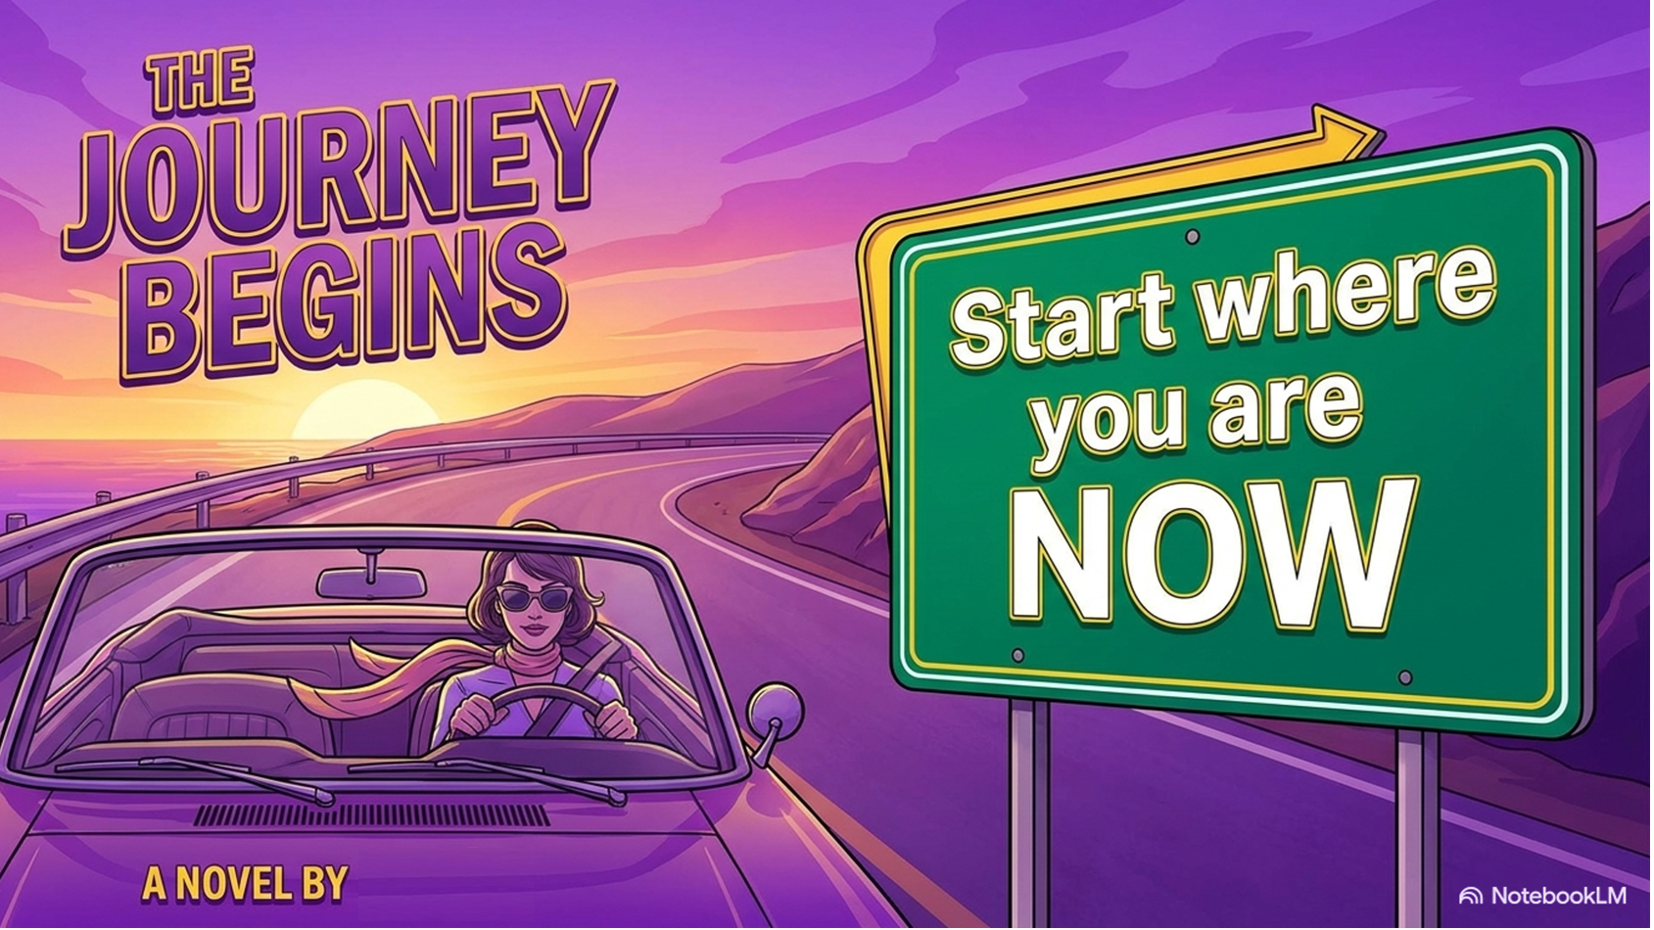
Rosie

Slide 68

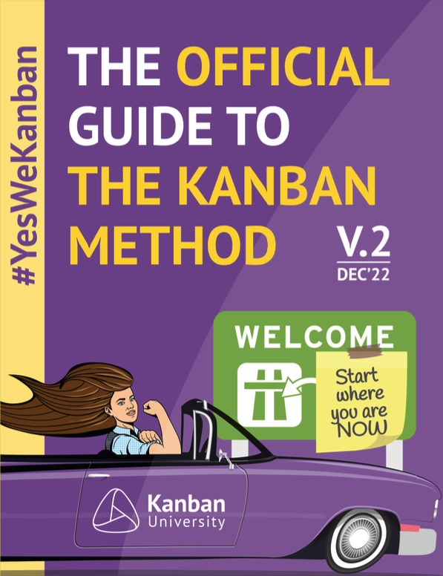
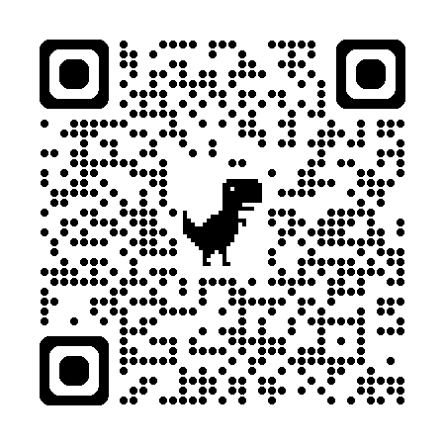
FREE!

Slide 69


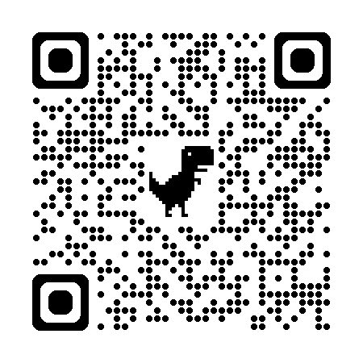
Make Work Visible.
Make Performance Measurable.
Get Better Soon
Agile Earth
01
02
03
Visibility
Flow Improvement
Evolutionary Change
Configure quick custom team workflow, policies, performance dashboards, and flow metrics.
Diagnose and understand barriers to flow. Use metrics and insights to streamline flow and improve predictability.
Start with what you do now, understand the pains and make incremental changes with big results
1

