Slide 1

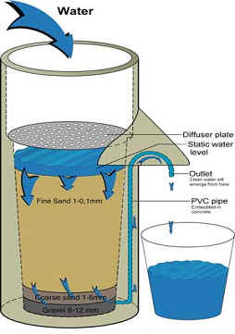
Purpose Alignment Model
Is your Strategy a Bucket or a Filter?
Todd Little

Slide 2

Bad Strategies (Rumelt)
Fluff
Failure to face the problem
Mistaking goals for strategy
Fuzzy or overly complex strategic objectives
  “increase market share”
  "our fundamental strategy is one of customer-centric intermediation."
  “reaching for the impossible to do the impossible"
  47 strategies and 178 action items.
  Action item number 122 was 'create a strategic plan.’

Slide 3
More Crap
We will be the graphics arts services firm of choice.
We will delight our customers with unique and creative solutions to their problems.
We will grow revenue by at least 20% each year.
We will maintain a profit margin of at least 20%.
We will have a culture of commitment. Corporate goals are commitments we all work to keep.
We will foster an honest and open work environment.
We will work to support the broader community in which we operate.

Slide 4
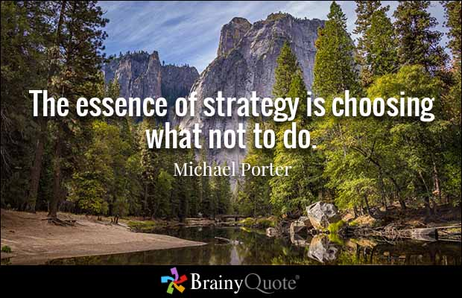

Slide 5
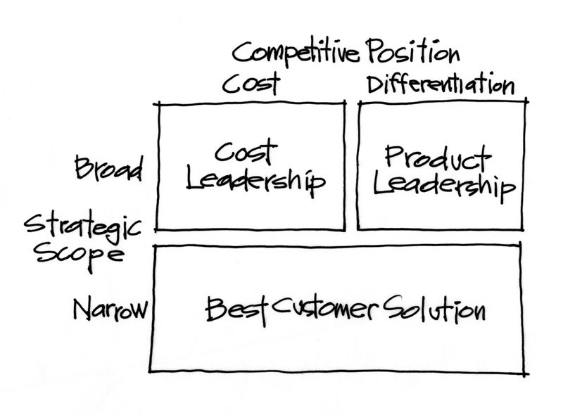
Start with Market Positioning (Tracey & Wiersma)

Slide 6
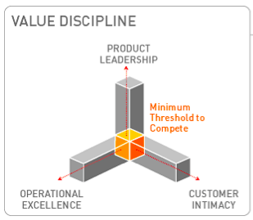
Start with Market Positioning (Tracey & Wiersma)

Slide 7
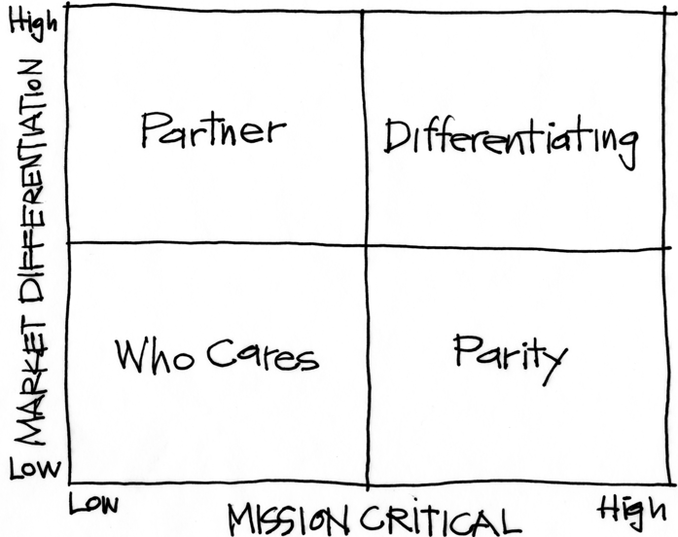
Purpose Alignment Model (Nickoliasen)
Notes:
[Purpose of slide] [#]
[Information]

Slide 8
Purpose Alignment Model (Nickoliasen)
CAN WE
CREATE A
DIFFERENTIATED
PARTNERSHIP?
INNOVATE,
CREATE
ACHIEVE AND
MAINTAIN PARITY, MIMIC, SIMPLIFY
MINIMIZE /
ELIMINATE
Notes:
[Purpose of slide] [#]
[Information]

Slide 9

Applicable at all Levels
Corporate Strategy
Product Strategy
Feature

Slide 10
A View of Strategy - Apple
10
NEW PRODUCT DESIGN
USER EXPERIENCE
ENGINEERING
ATT
iTunes
APP STORE
APPLE SILICON
MS OFFICE
INTEL HARDWARE
OTHER SOFTWARE
PRINTERS
Notes:
10
[Purpose of slide] [#]
[Information]
© International Institute of Business Analysis®

Slide 11

What’ on your billboard?

Slide 12

Strategy
Decision Filters:
To make daily
decisions
Schedule projects
Which features
to develop

Slide 13
Example – Split Payments
eCommerce and catalog order management system supported split payments?
Split what? Pay with a combination of credit cards (as many as you want).
Required a significant customization. Are split payments differentiating or parity?
Notes:
13

Slide 14


Split Payments
Differentiating includes product selection and customer service. Therefore differentiating.
Not so fast, if differentiating,
Let’s advertise!
Treat exceptions like exceptions.
Inelegantly handled with standard functionality.
Notes:
14

Slide 15
Example (Real Life)
Software for financial document management:
  Initial project plan included development of over 30 features.
  Filtering functionality through the model yielded about 5 “Differentiating” features.
  Company revised the plan to make these 5 even better and simplify the rest.
Result: Better product in half the time and 60% of the original cost.
Notes:
15

Slide 16
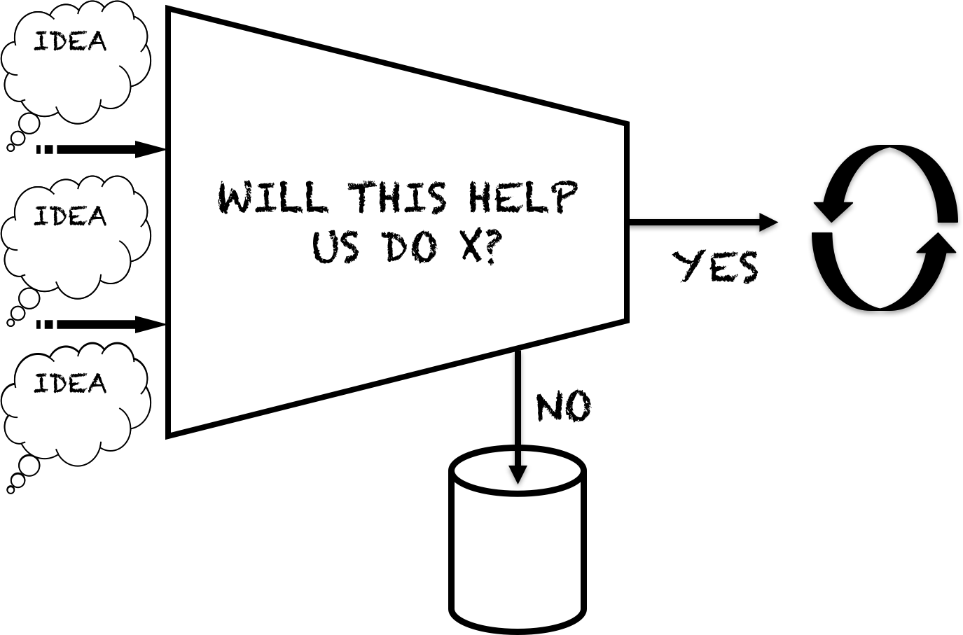
Decision Filters

Slide 17
Purpose Filter
Idea
Idea
Partner | Invest
Who Cares | Parity
Critical
Items
Evaluate
Economics
Prioritize
By
Value/Cost
Idea
Prioritize
Idea
Strategic
Fit
Other
Release
Backlog
Idea
Idea
Non-
Economic
Non-
Strategic

Slide 18
Is your Strategy a Bucket or a Filter?

Slide 19
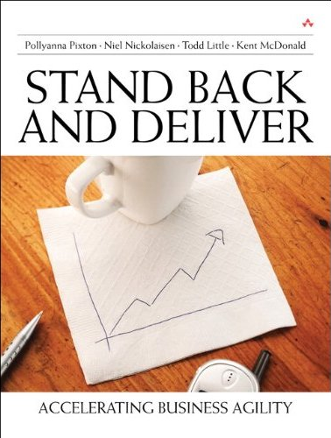

Contact
Todd Little
  toddelittle@gmail.com
  www.linkedin.com/in/toddelittle/en

